Slide 1
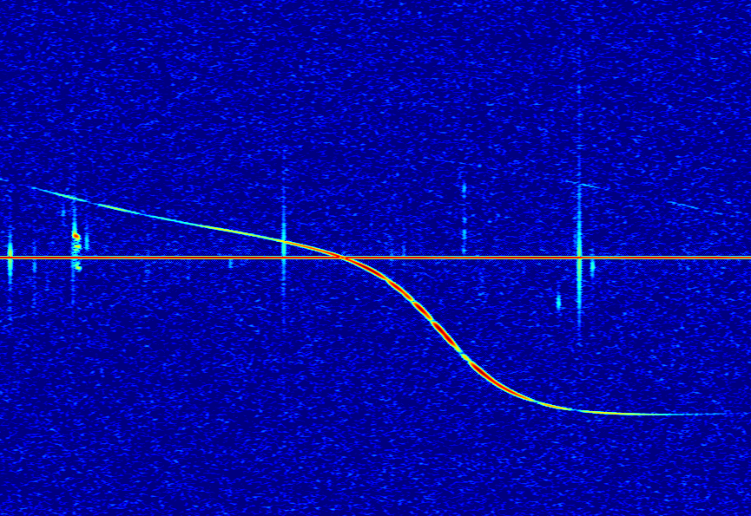

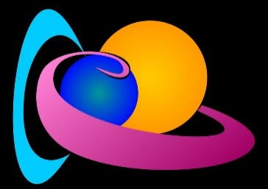
Observability Function of the BRAMS forward scatter network
Lamy H.¹, Verbeeck C.², Balis J.¹; Anciaux M.¹,
Calders S.¹ ; Calegaro A.¹ ; Martínez Picar A.²
¹ Royal Belgian Institute for Space Aeronomy
² Royal Observatory of Belgium

Slide 2
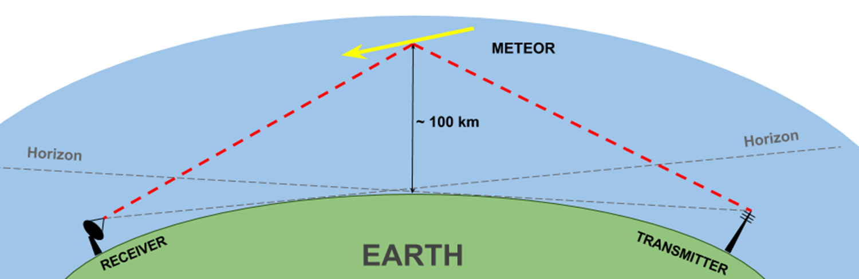
What is Observability Function (OF)?
Forward scatter of radio waves
Raw meteor rates observed during a meteor shower
“Real” activity of the meteor shower
OF

Slide 3
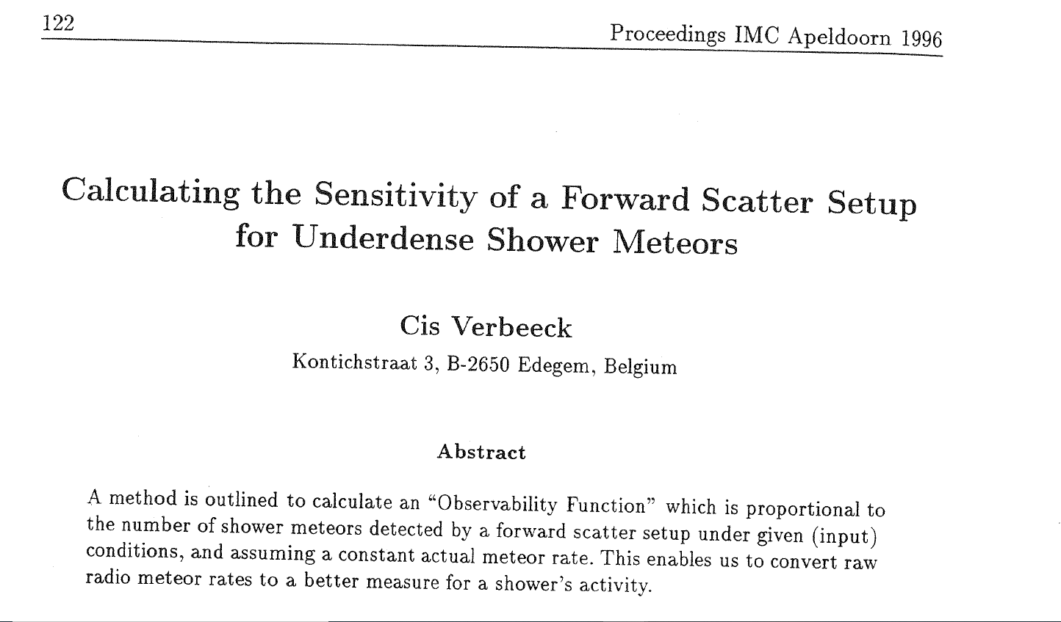
Work mostly based on Verbeeck (1997)

Slide 4
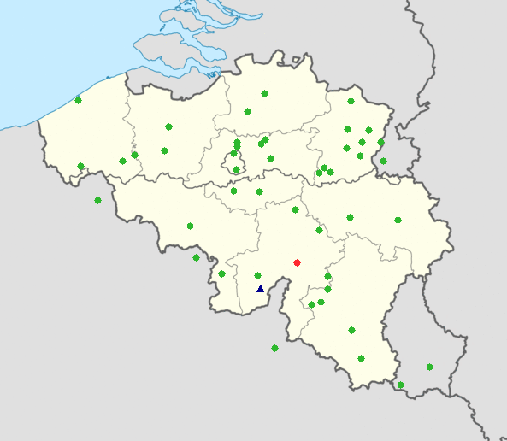
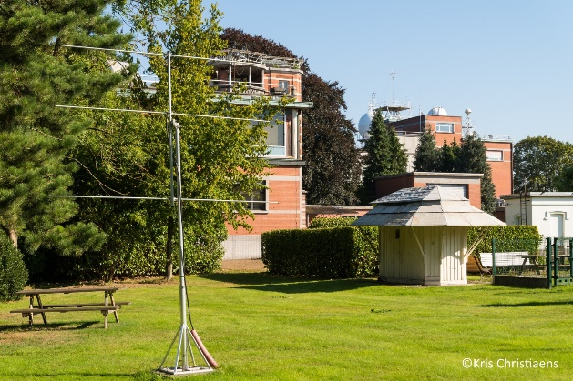
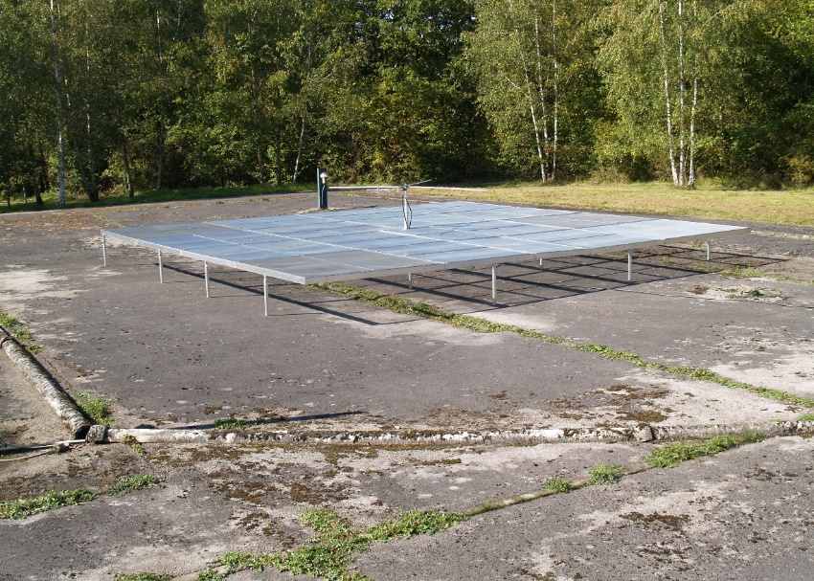
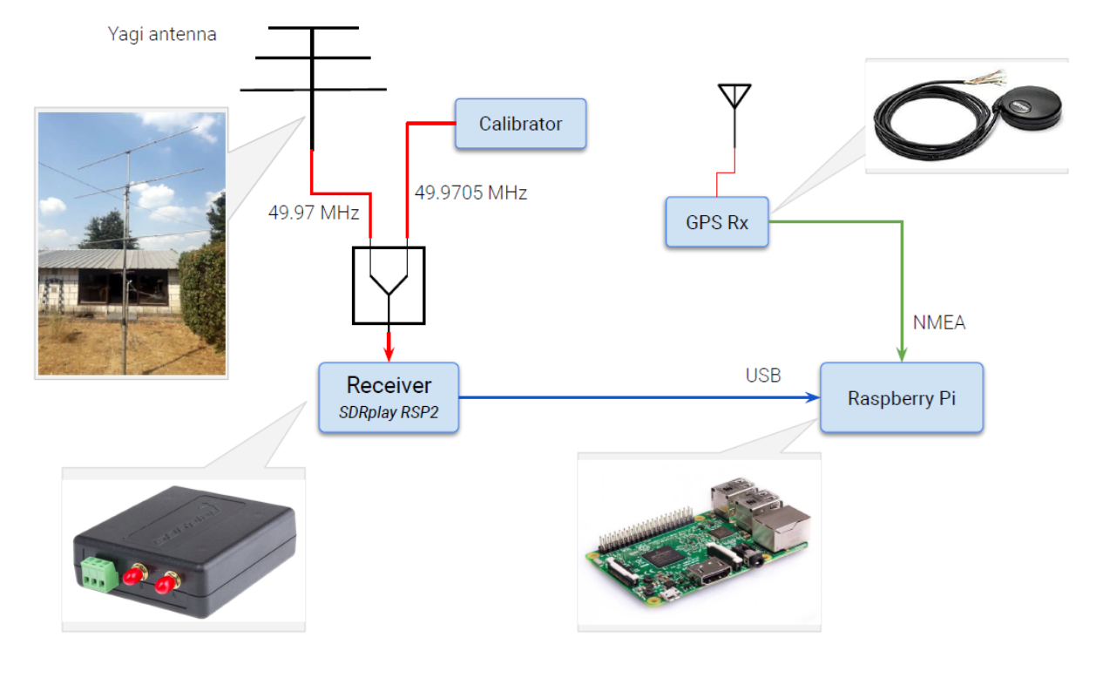
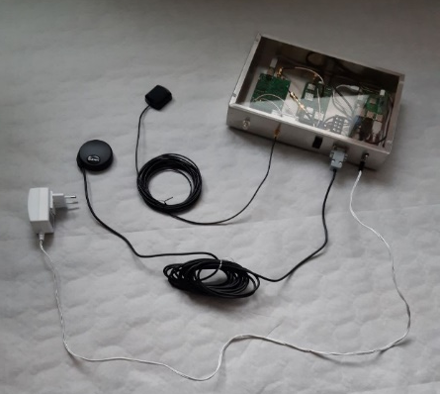
The BRAMS network
A dedicated Transmitter
Located in Dourbes (blue triangle) :
f=49.97 MHz
CW with no modulation
Radiated power: 130 Watts
circular polarization towards zenith
44 Receiving stations
Green dots
3-elements Yagi antennas
Synchronized using GPS clocks

Slide 5
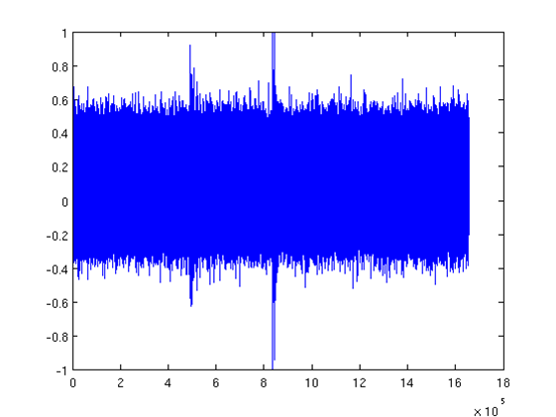
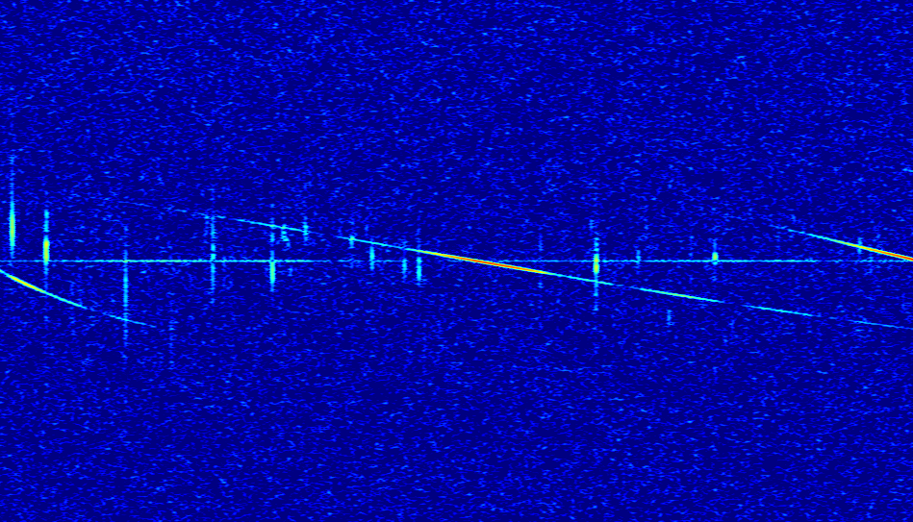
The BRAMS data
200 Hz
Sampling frequency : 6048 Hz
16 bit coding
WAV format
5 minutes

Slide 6
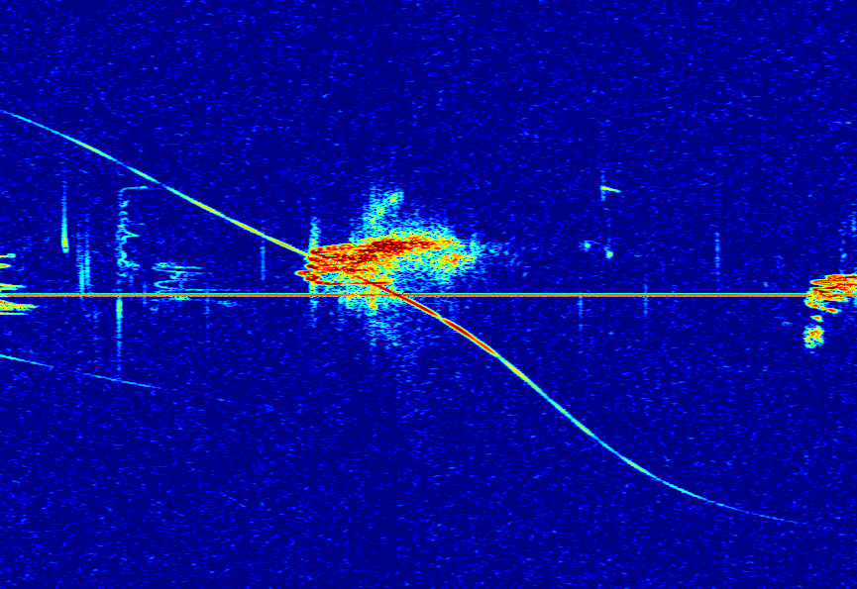
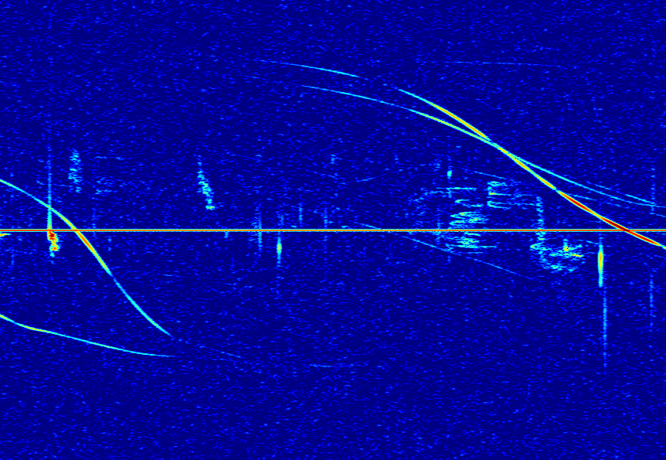
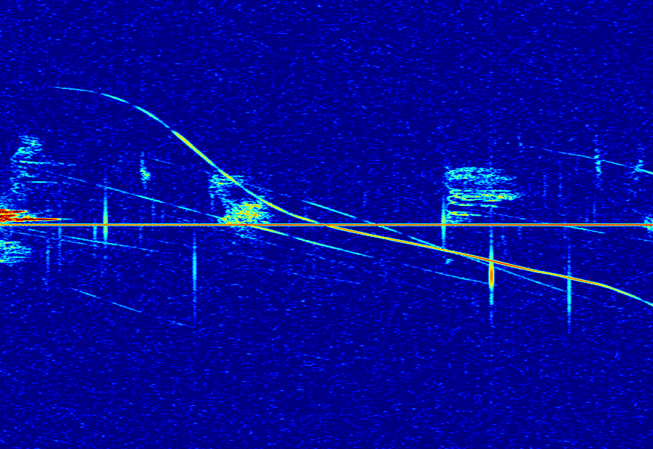
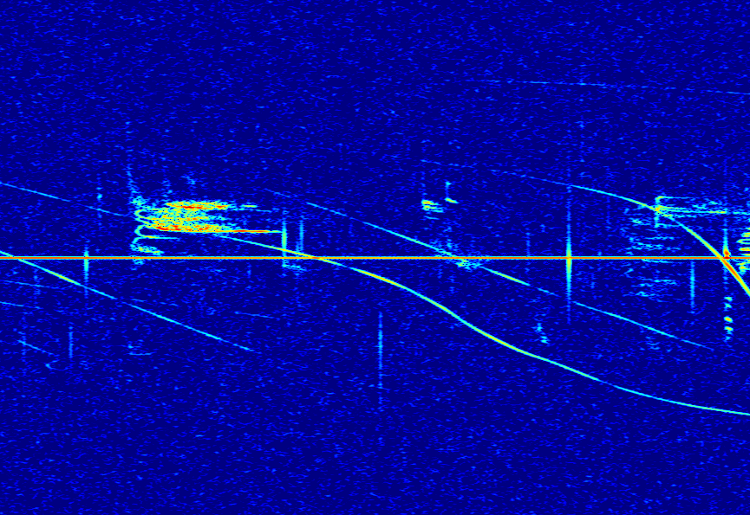
BRAMS data during meteor showers

Slide 7
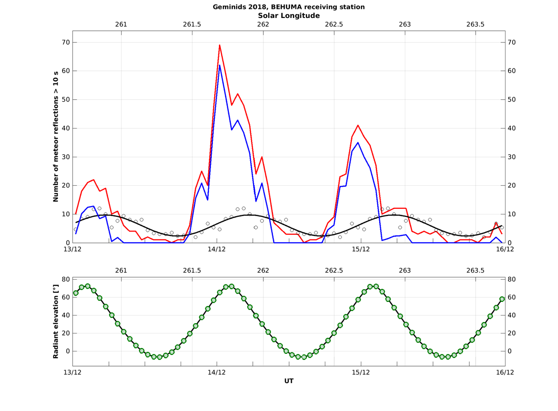
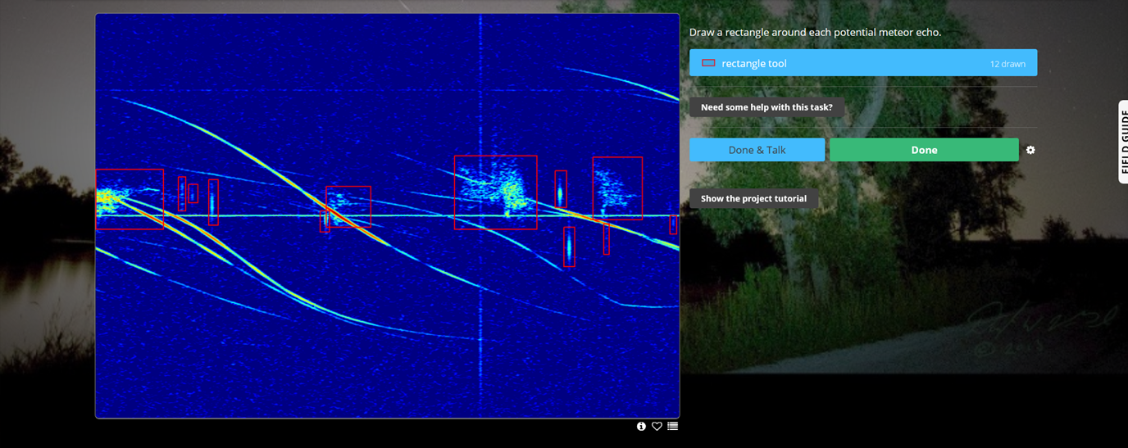

Geminids activity measured with BRAMS data
Radio Meteor Zoo
Data from station in Humain

Slide 8
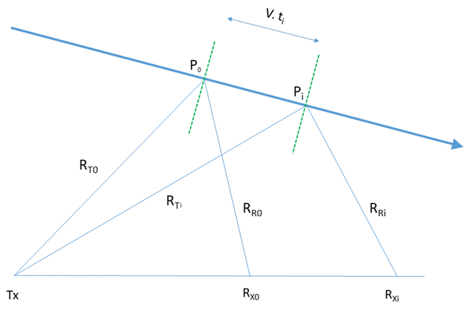
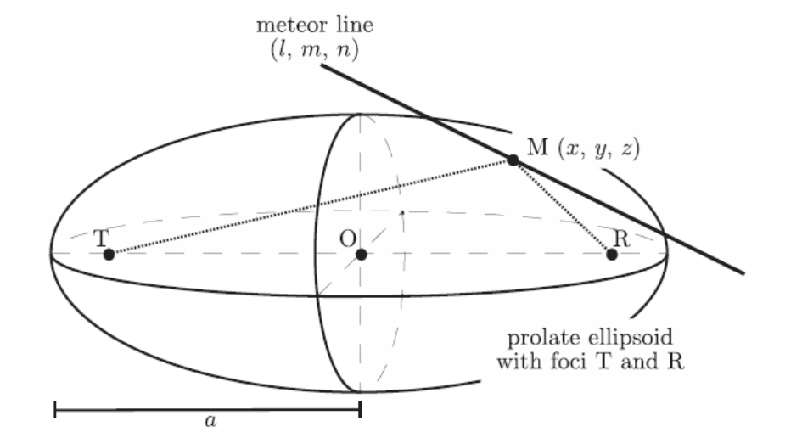
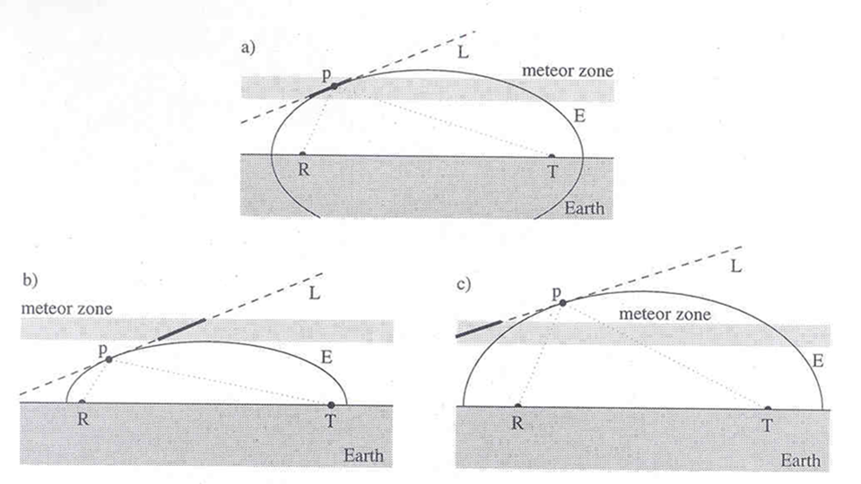
The specularity condition and its consequences
Suleymanova et al. (2008)
Wislez et al. (2005)

Slide 9
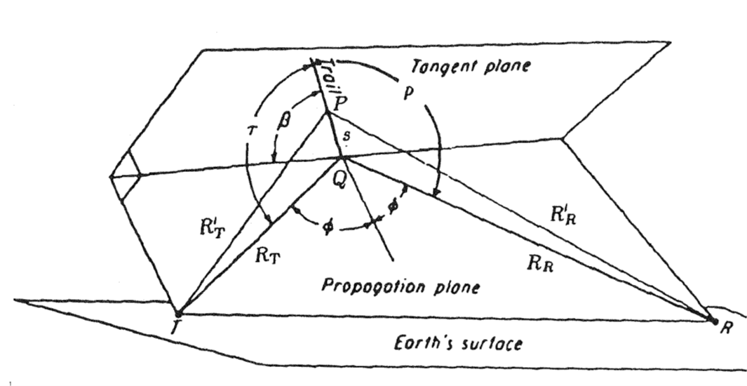
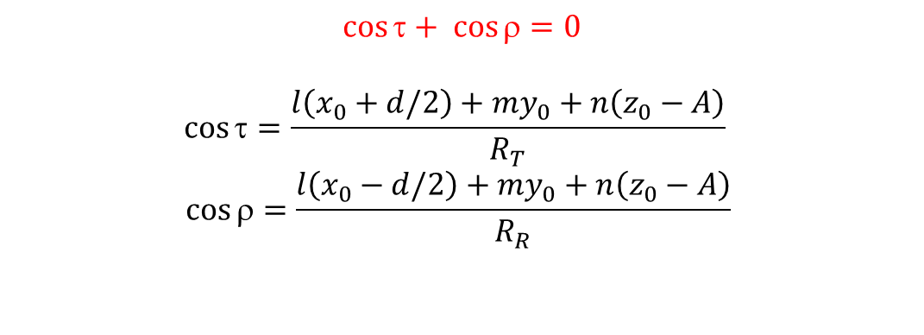
Observability Function (OF) : geometrical part
x₀, y₀, z₀ = coordinates of reflection point
l, m, n = director cosines of the radiant
$$\cos{τ+ \cos{ρ=0}}$$
$$\cos{τ=\frac{l\left(x_{0}+d/2\right)+my_{0}+n\left(z_{0}−A\right)}{R_{T}} }$$
$$\cos{ρ=\frac{l\left(x_{0}−d/2\right)+my_{0}+n\left(z_{0}−A\right)}{R_{R}} }$$
For a given altitude / z₀, we obtain a 6th order polynomial equation between x₀ and y₀

Slide 10
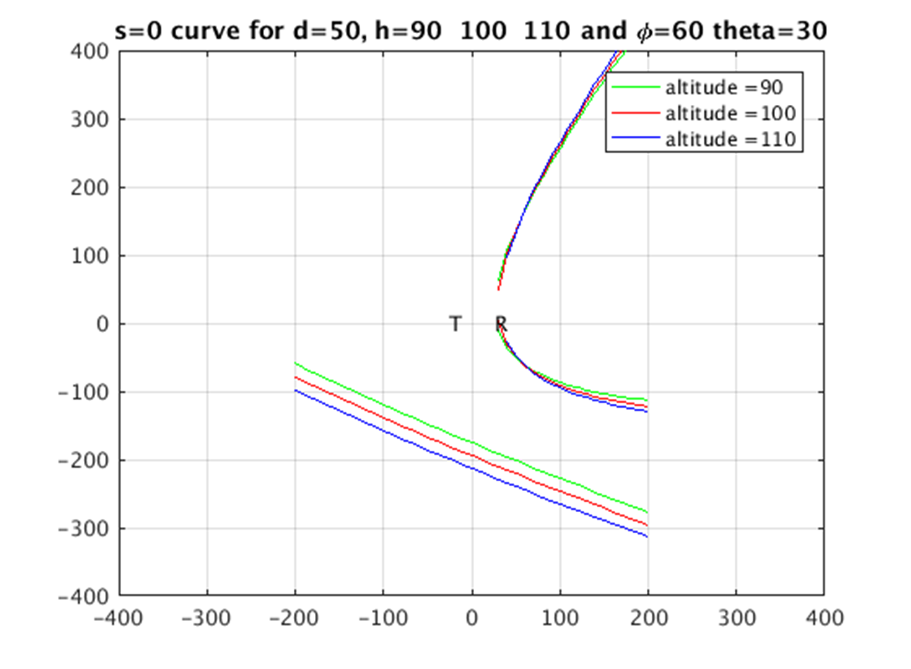
Example of geometrical OF calculated for the BRAMS network
l = sin θ cos φ, m = sin θ sin φ, and n = cos θ.
Integration over altitude with steps of 5 km

Slide 11
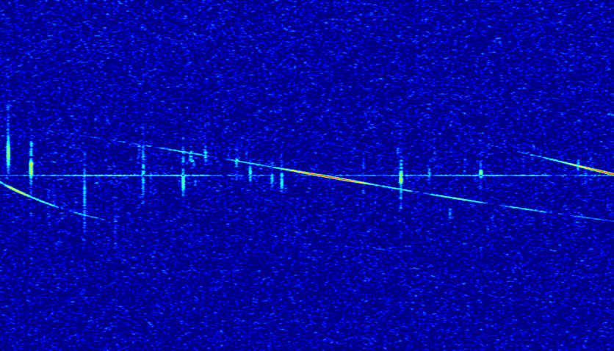
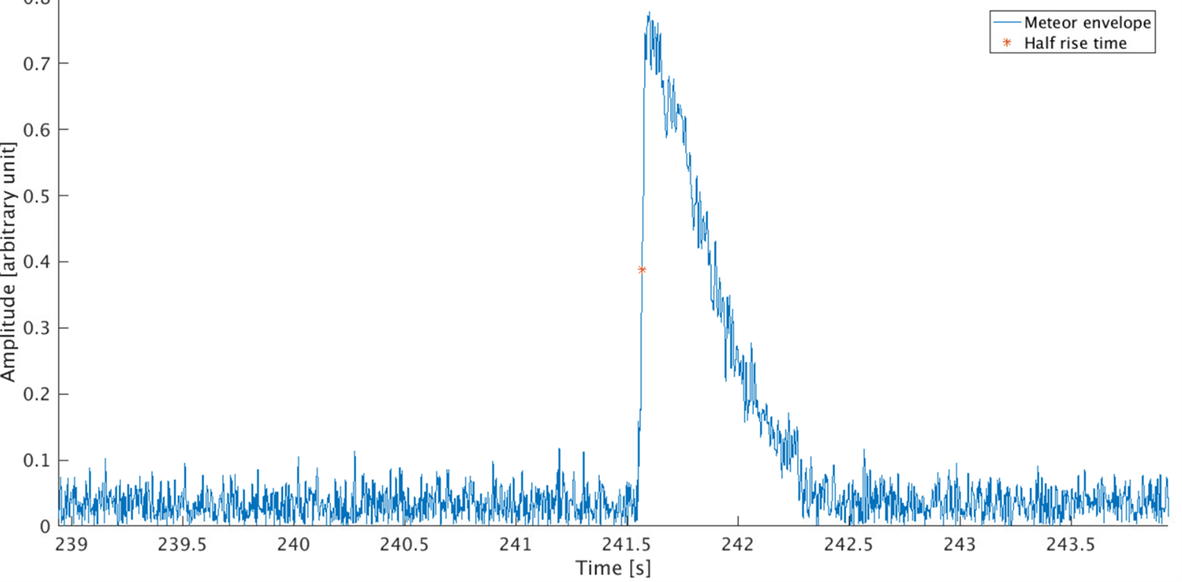
Observability Function : sensitivity part
A_{max}
A₀
Underdense meteor echoes

Slide 12

Observability Function : sensitivity part

Slide 13
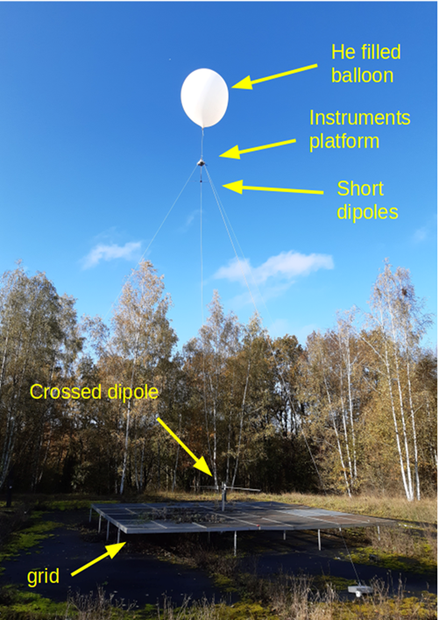
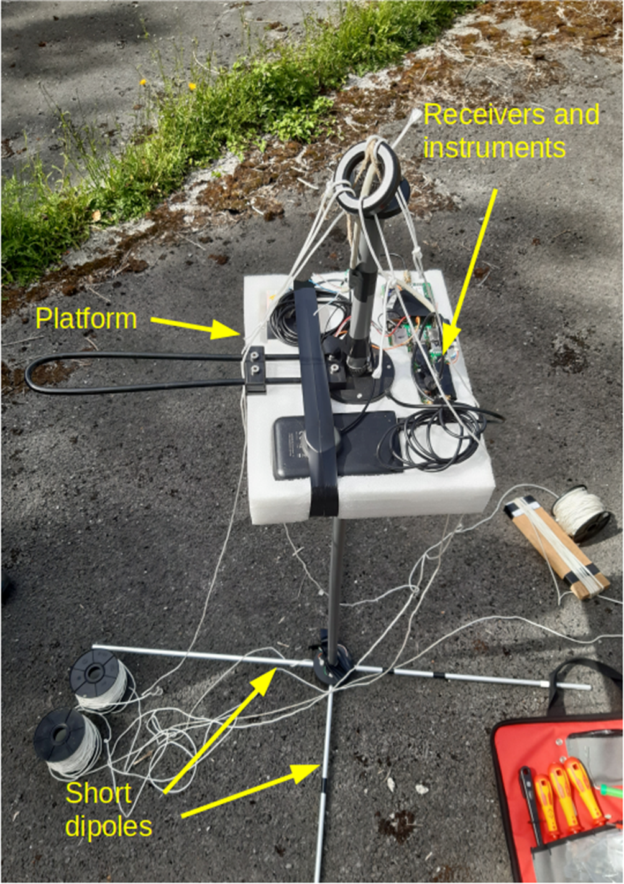
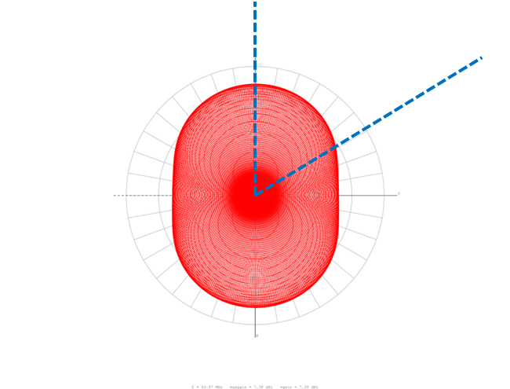
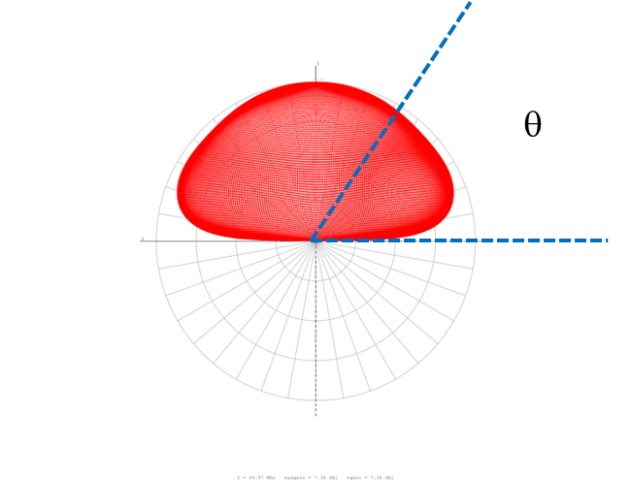
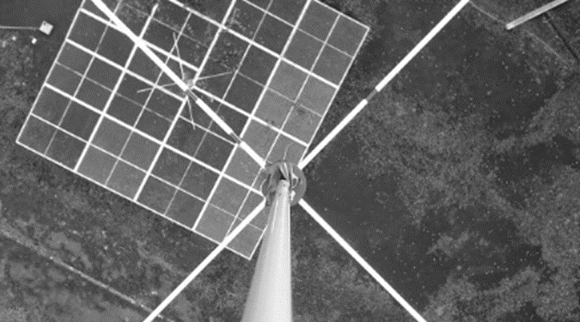
Observability Function : sensitivity part
φ
Receiving antennas
Transmitting antenna

Slide 14
Observability Function : sensitivity part
A_{max} ∼ K . α
K = K(G_{T}, G_{R}, γ, λ, geometrical parameters, r₀, D)
Min value for the ionization α
Min value for the mass m
Distribution of mass particles inside a meteor shower
N(m > m₀) ∼ m^{1-s}
S can come from previous measurements or be calculated from the CDF of meteor echoes amplitude

Slide 15
Summary and perspectives
We can calculate the OF for a given Tx-Rx pair of the BRAMS network and for a given position of the radiant of a meteor shower.
We would like to produce a polar plot of the OF as was done e.g. by Pavel Zigo for the Lecce-Modra system
Zigo (2008)

Slide 16

Perspectives and limitations
2 stations : BEDOUS and BEHUMA
Several meteor showers analyzed by RMZ users
Different distances, different sensitivities, slightly different geometries
Calculating their OF at a given time and correct their raw data should provide two values which are consistent with each other
The sensitivity part assumes underdense meteor echoes while a non-negligible part of meteor echoes during meteor showers are intermediate or overdense …
Other formulas?

Slide 17
Thank you for your attention

