Slide 1
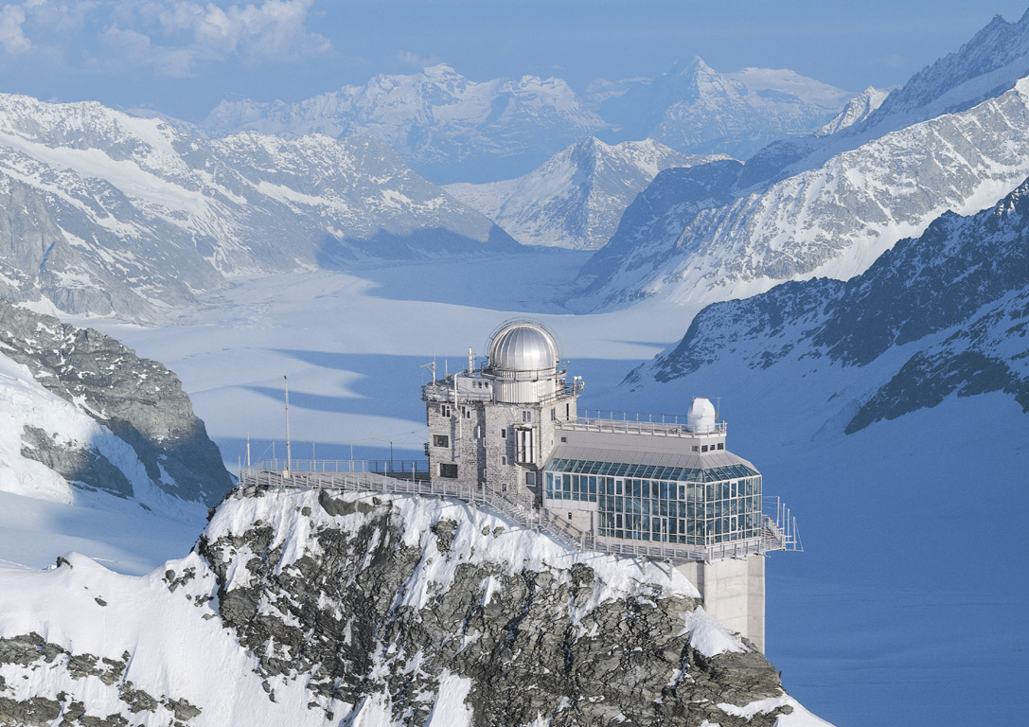
Meteor radar concepts for monostatic, multistatic and forward scatter
- velocity measurements, orbit determination and radiant mapping
Gunter Stober
Institute of Applied Physics & Oeschger Center for Climate Change Research, Microwave Physics,
University of Bern, Bern, Switzerland
Photo: HSFJG and OCCR

Slide 2
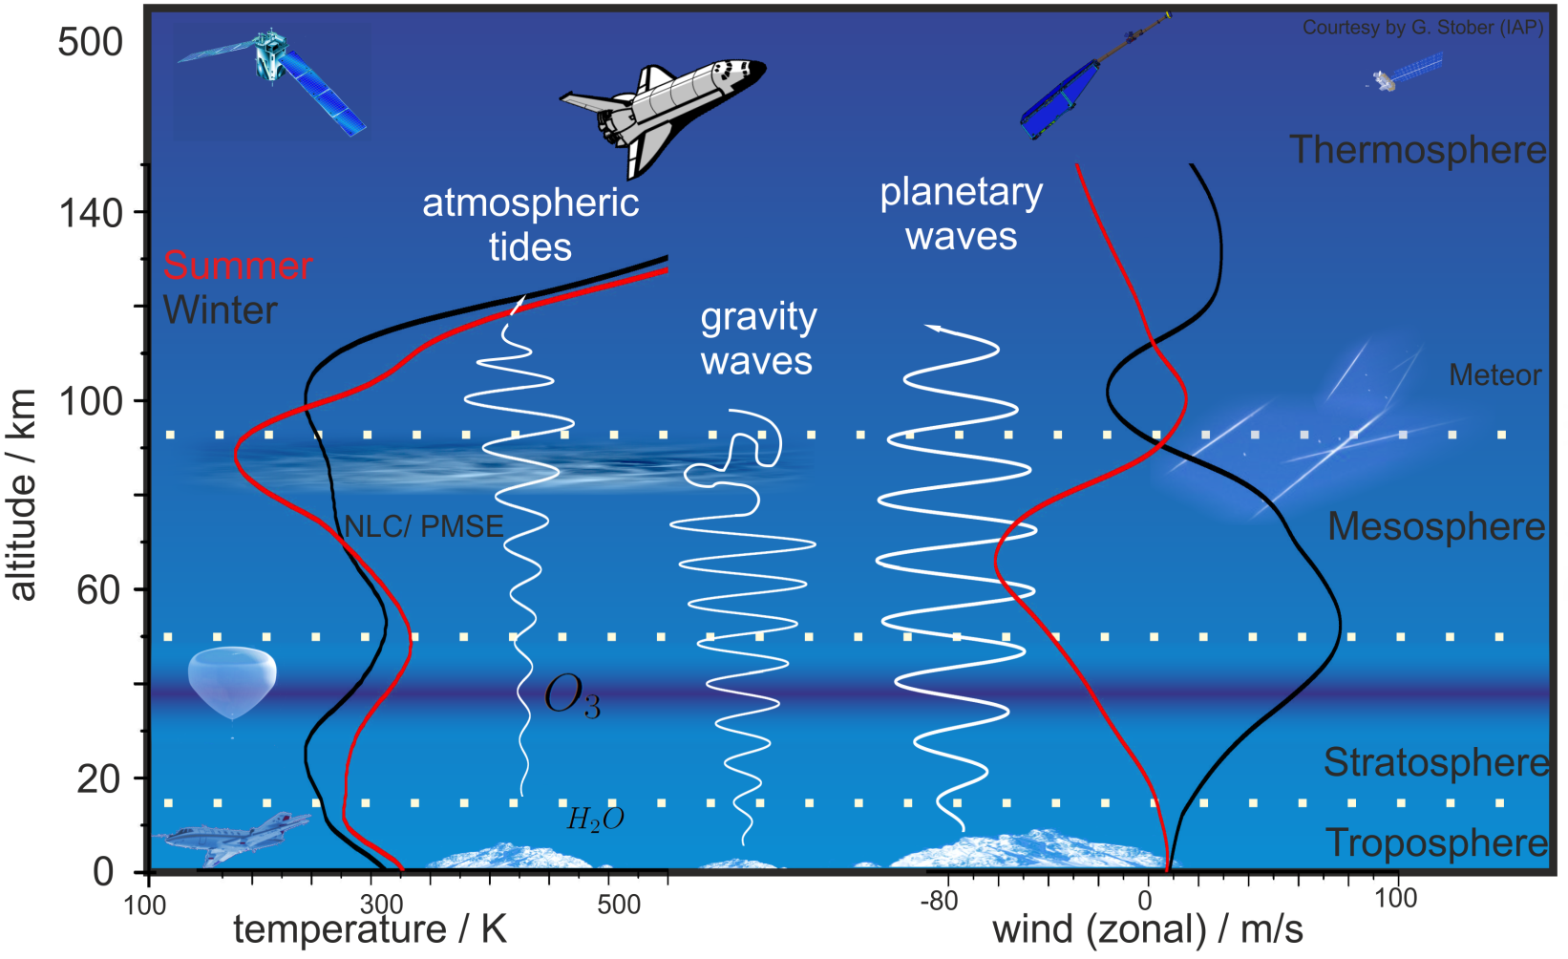
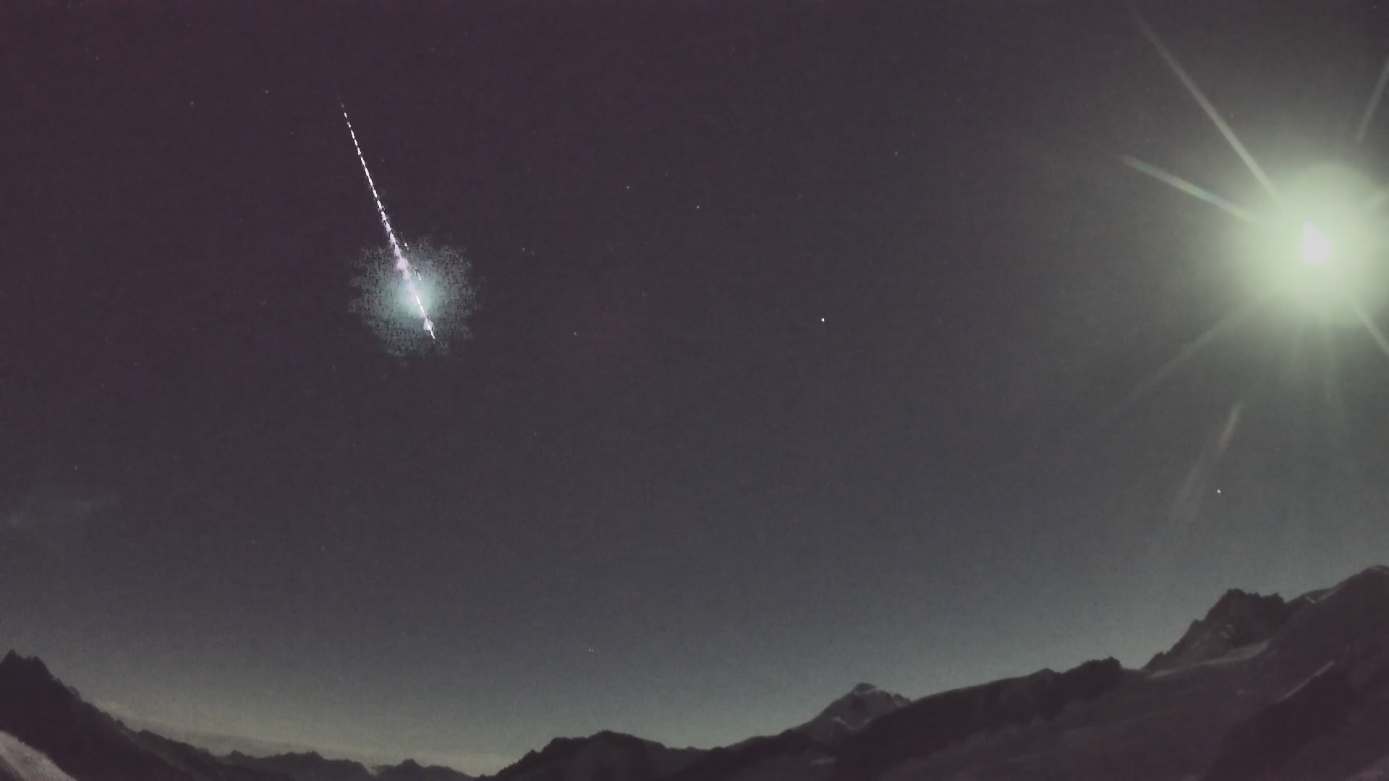
Meteors and their radar signatures

Slide 3
Fragmenting meteoroid
Photo Credit: Prof. Peter Brown and the Western Ontario meteor group
90% of all meteoroids fragment apparently independent of their size/mass

Slide 4
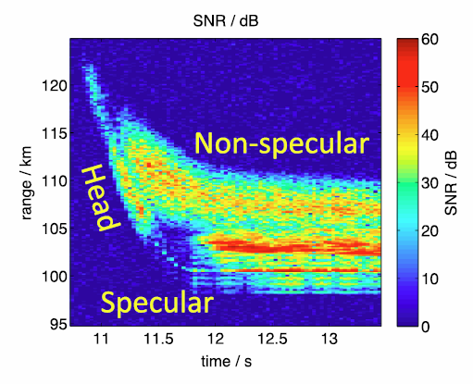
Meteors - Scattering and Radar cross section
Fukao, (2014 book)
specular RCS (radar cross section) is much higher compared to head echo
head echo scattering – plasma bubble with diameter of centimeter to meter
extremely high energy density
specular scattering – plasma cylinder with diameter from centimeter to several meters with several km length

Slide 5
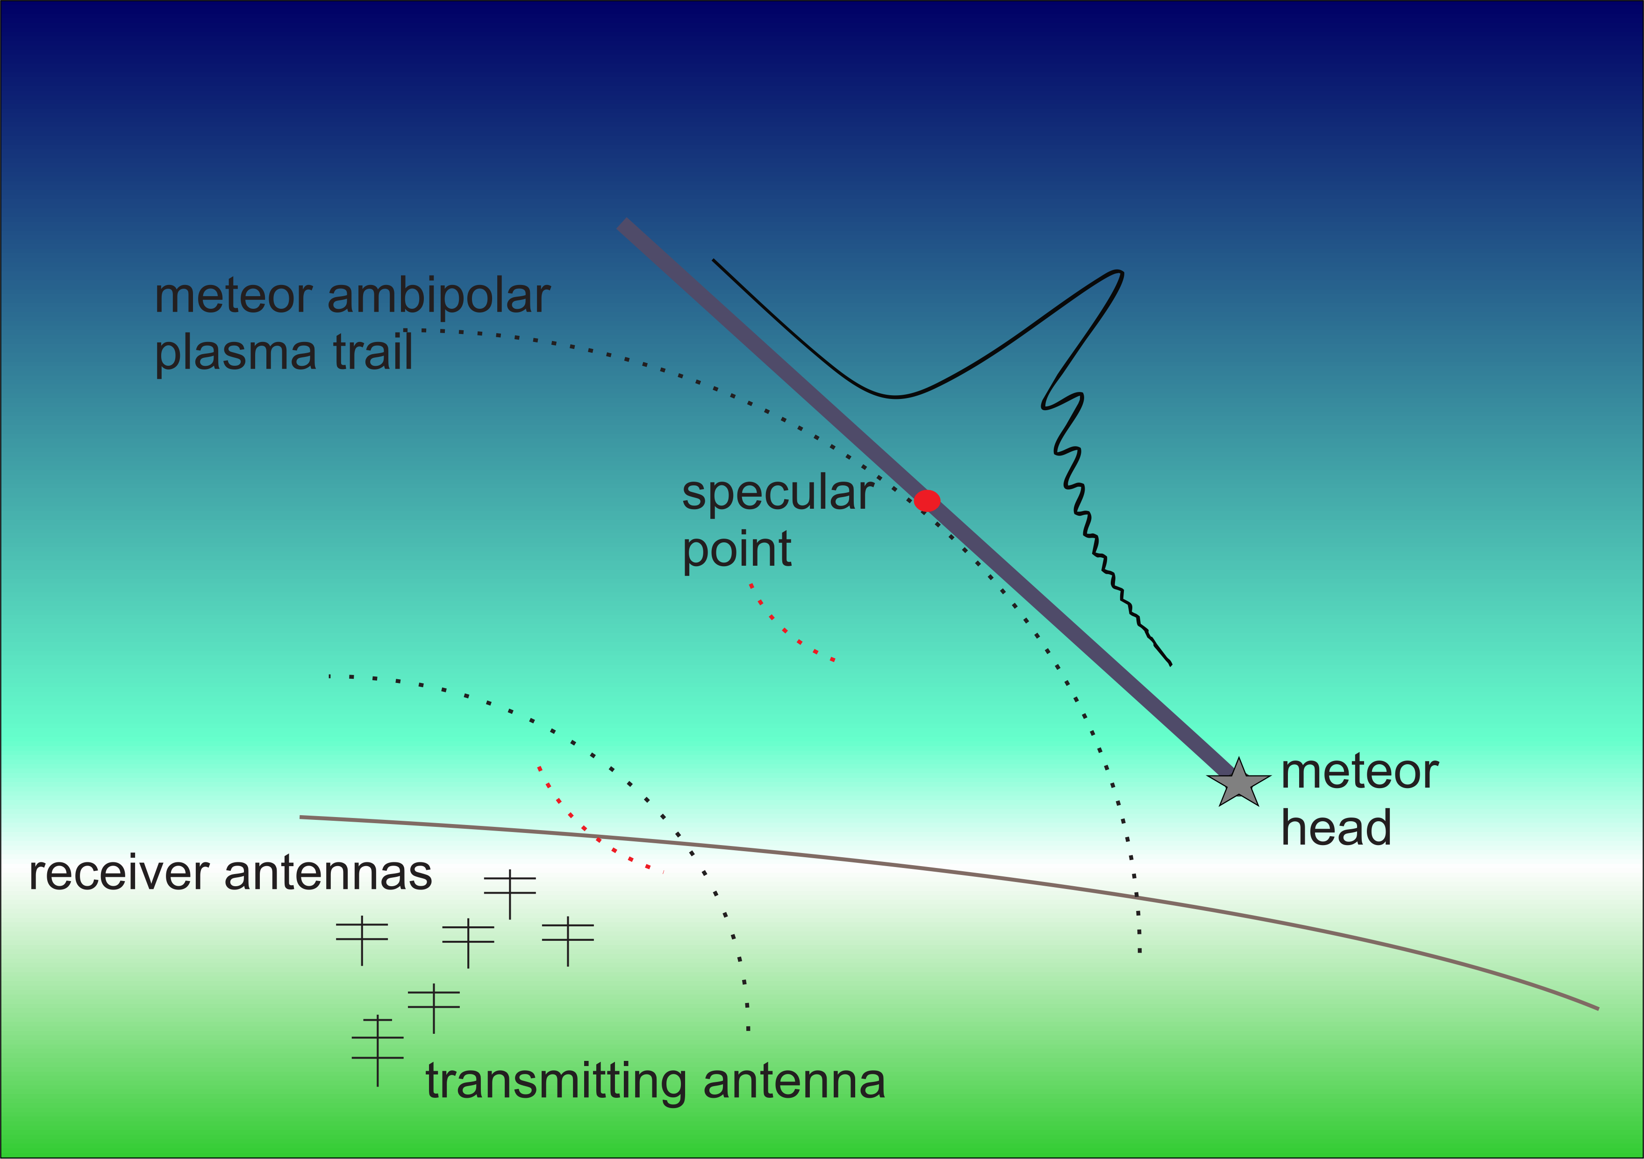
Specular meteor observations
VHF-radio waves are scattered by the cylindrical plasma columns formed by meteoroids entering the Earth’s atmosphere
widely spread observation technique to observe meteors between 70-120 km altitude

Slide 6
Meteor velocity measurements

Slide 7
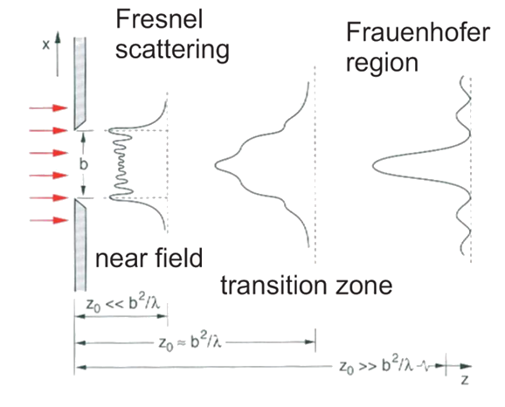
Theoretical description of specular meteor
Signal morphology is described by the radar parameters and the Cornu-Spiral given by the Fresnel Integral

Slide 8
Meteor speed measurement methods
Amplitude rise time
Fourier techniques (Hocking (2004), Stober (2009))
pre-t0 methods (Baggaley and Grant, 2005)
  pre-t0: phase measurement (Baggaley and Grant, 2005, Schult et al., 2020)
  pre-t0 speeds by sliding-slopes technique (PSSST) (Mazur et al., 2020)
post-t0 methods (Baggaley and Grand, 2005)
Fresnel holography (Elford, 2001, Holdsworth et al., 2007)
Time of flight speed (CMOR, SAAMER-OS, BRAMS)

Slide 9
Amplitude Rise-time meteoroid speeds
Schult et al., 2020
Baggaley, 1997

Slide 10
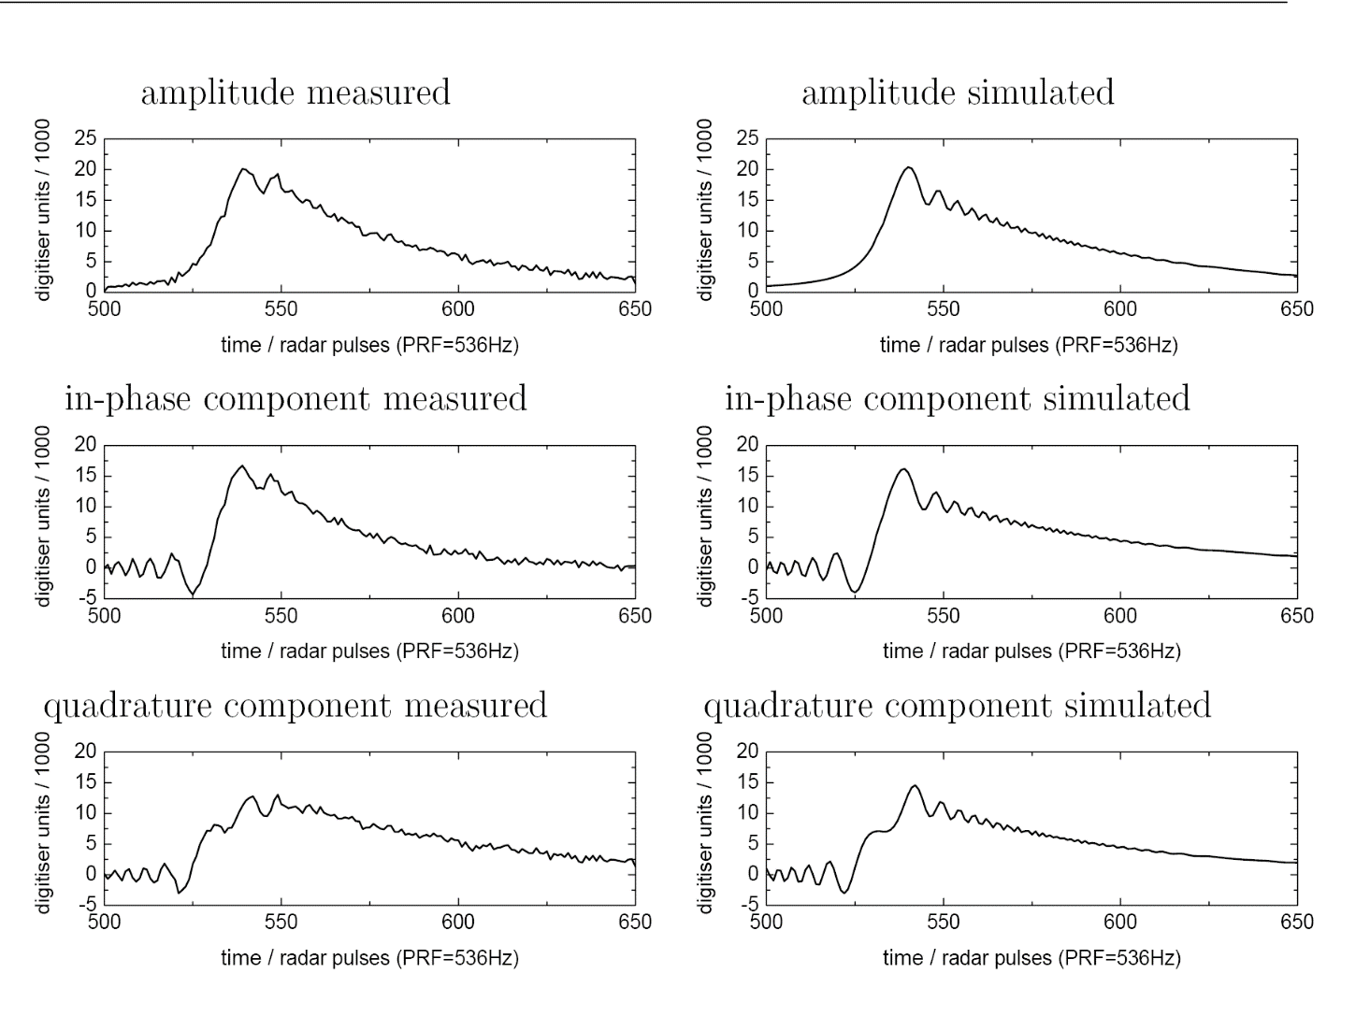
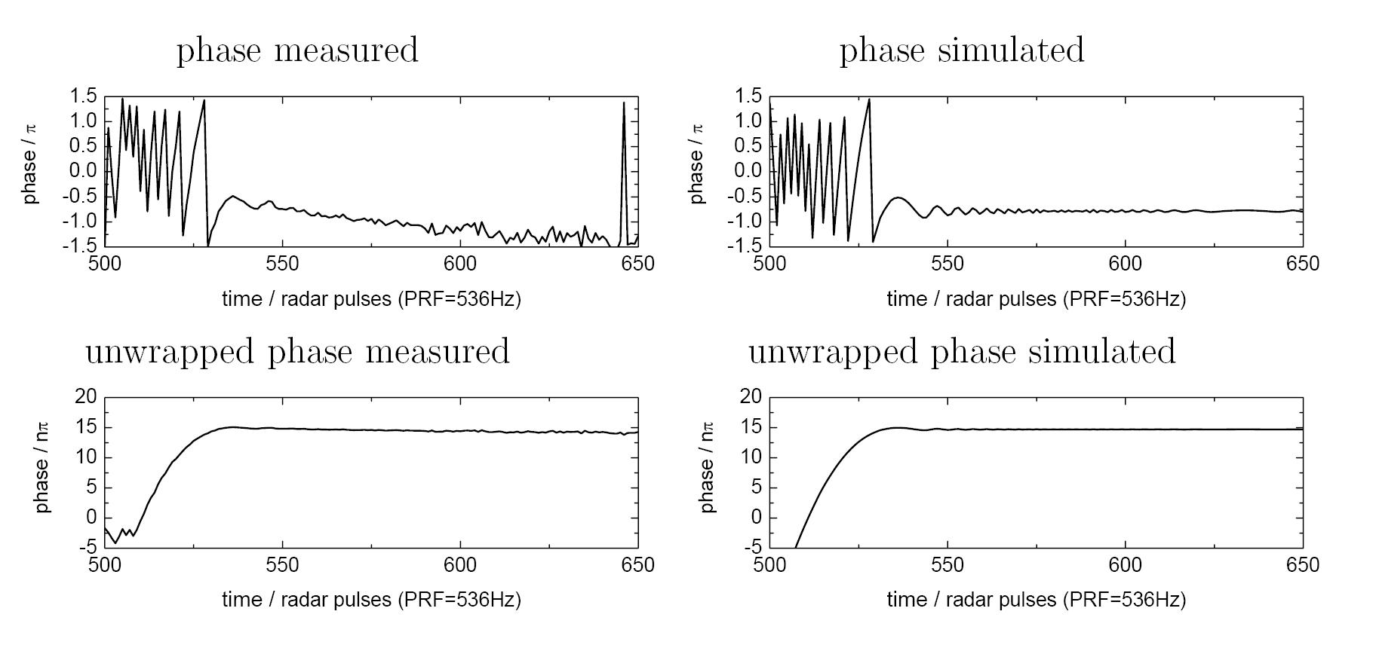
Matched filter approach to measure velocity
date 12.12.2007 18:58
24.2 km/s
decay time 0.06 s
range 100 km
altitude 90 km
snrdb 25.6 dB
radial drift 0.02 m/s

Slide 11
Pre-t0-phase meteoroid speeds
Schult et al., 2020

Slide 12
Pre-t0 speed comparison to synthetic data
Mazur et al., 2020 shows the robustness of the pre-t0 speed applied to model data
this method seems to be a good and rather easy method to implement
Speed measurements are reliable within the standard theory

Slide 13
PSSST speed measurement
PSSST builds on Cevera, 1997
Algorithm coverts phase measurement in distance
the algorithm estimates a theoretical phase backward from the t0-pick for different velocities
the best fit is selected from a KDE (kernel density estimate)

Slide 14
Fresnel-Fourier based velocity measurement
Fourier-transform of the pre-t0 in-phase and quadrature component
very precise method
only 5% successrate
Geminids
Stober et al., 2011

Slide 15
Fresnel holography
Basic theory in Elford, 2004
Holdsworth et al., 2007 implementation for meteor radars

Slide 16
Pre-t0 speeds vs. Fresnel transform (MAARSY observations)
Comparison between pre-t0 and Fresnel transform shows good agreement for the bulk of observations
Individual speed estimates can differ substantially
Mazur et al., 2020

Slide 17
Multistatic meteor observations

Slide 18
Trajectory determination – CMOR (Canadian Meteor Orbit Radar)
Webster et al., 2004

Slide 19
Time of flight vs. Pre-t0 speed measurements
Pre-t0 vs time of flight shows remarkable agreement for CMOR
indicates the reliability and robustness of both methods when applied to large number of observations
Mazur et al., 2020

Slide 20
Meteor source radiants

Slide 21
Single Station radiant mapping - Webmonostatic analysis
Jones (2005) published the single station radiant mapping algorithm for monostatic meteor radars
Statistical solution by estimating propability densities for all preselected source radiants to satisfy the specular condition

Slide 22
Trajectory determination – CMOR (Canadian Meteor Orbit Radar)
Mazur et al., 2020
Webster et al., 2004
Mazur et al., 2020

Slide 23
Trajectory determination – SAAMER (Southern Argentina Agile Meteor Radar- Orbital System)
Janches et al., 2015
Panka et al., 2021

Slide 24
Single Station radiant mapping vs. orbit determination
Webster et al., 2005
Webster et al., 2005 Geminid/Sextantid meteor shower source radiant comparison
Meteor showers are well-resolved in single station radiant mapping for sufficient high meteor fluxes – quality depends on probe size and interferometry
Sporadic meteor background becomes diffuse sources and requires separate analysis

Slide 25
Multi-static approaches (long baselines)

Slide 26
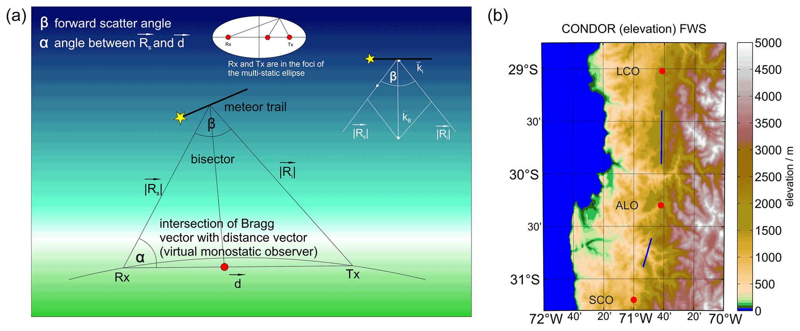
Forward Scatter - interferometry

Slide 27
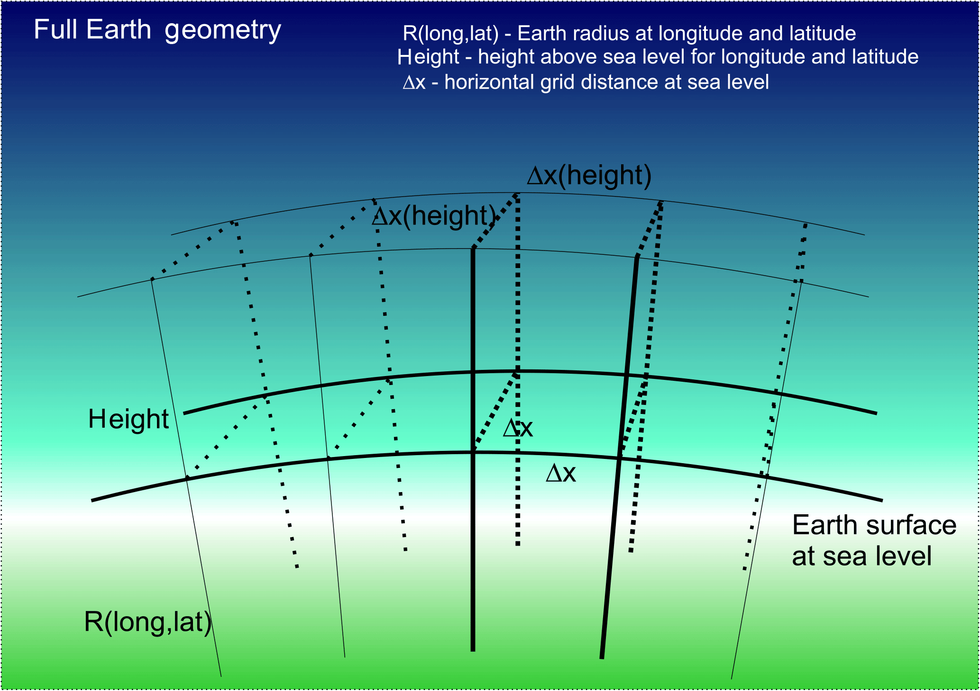
World Geodetic System 84 geodetic coordinates

Slide 28
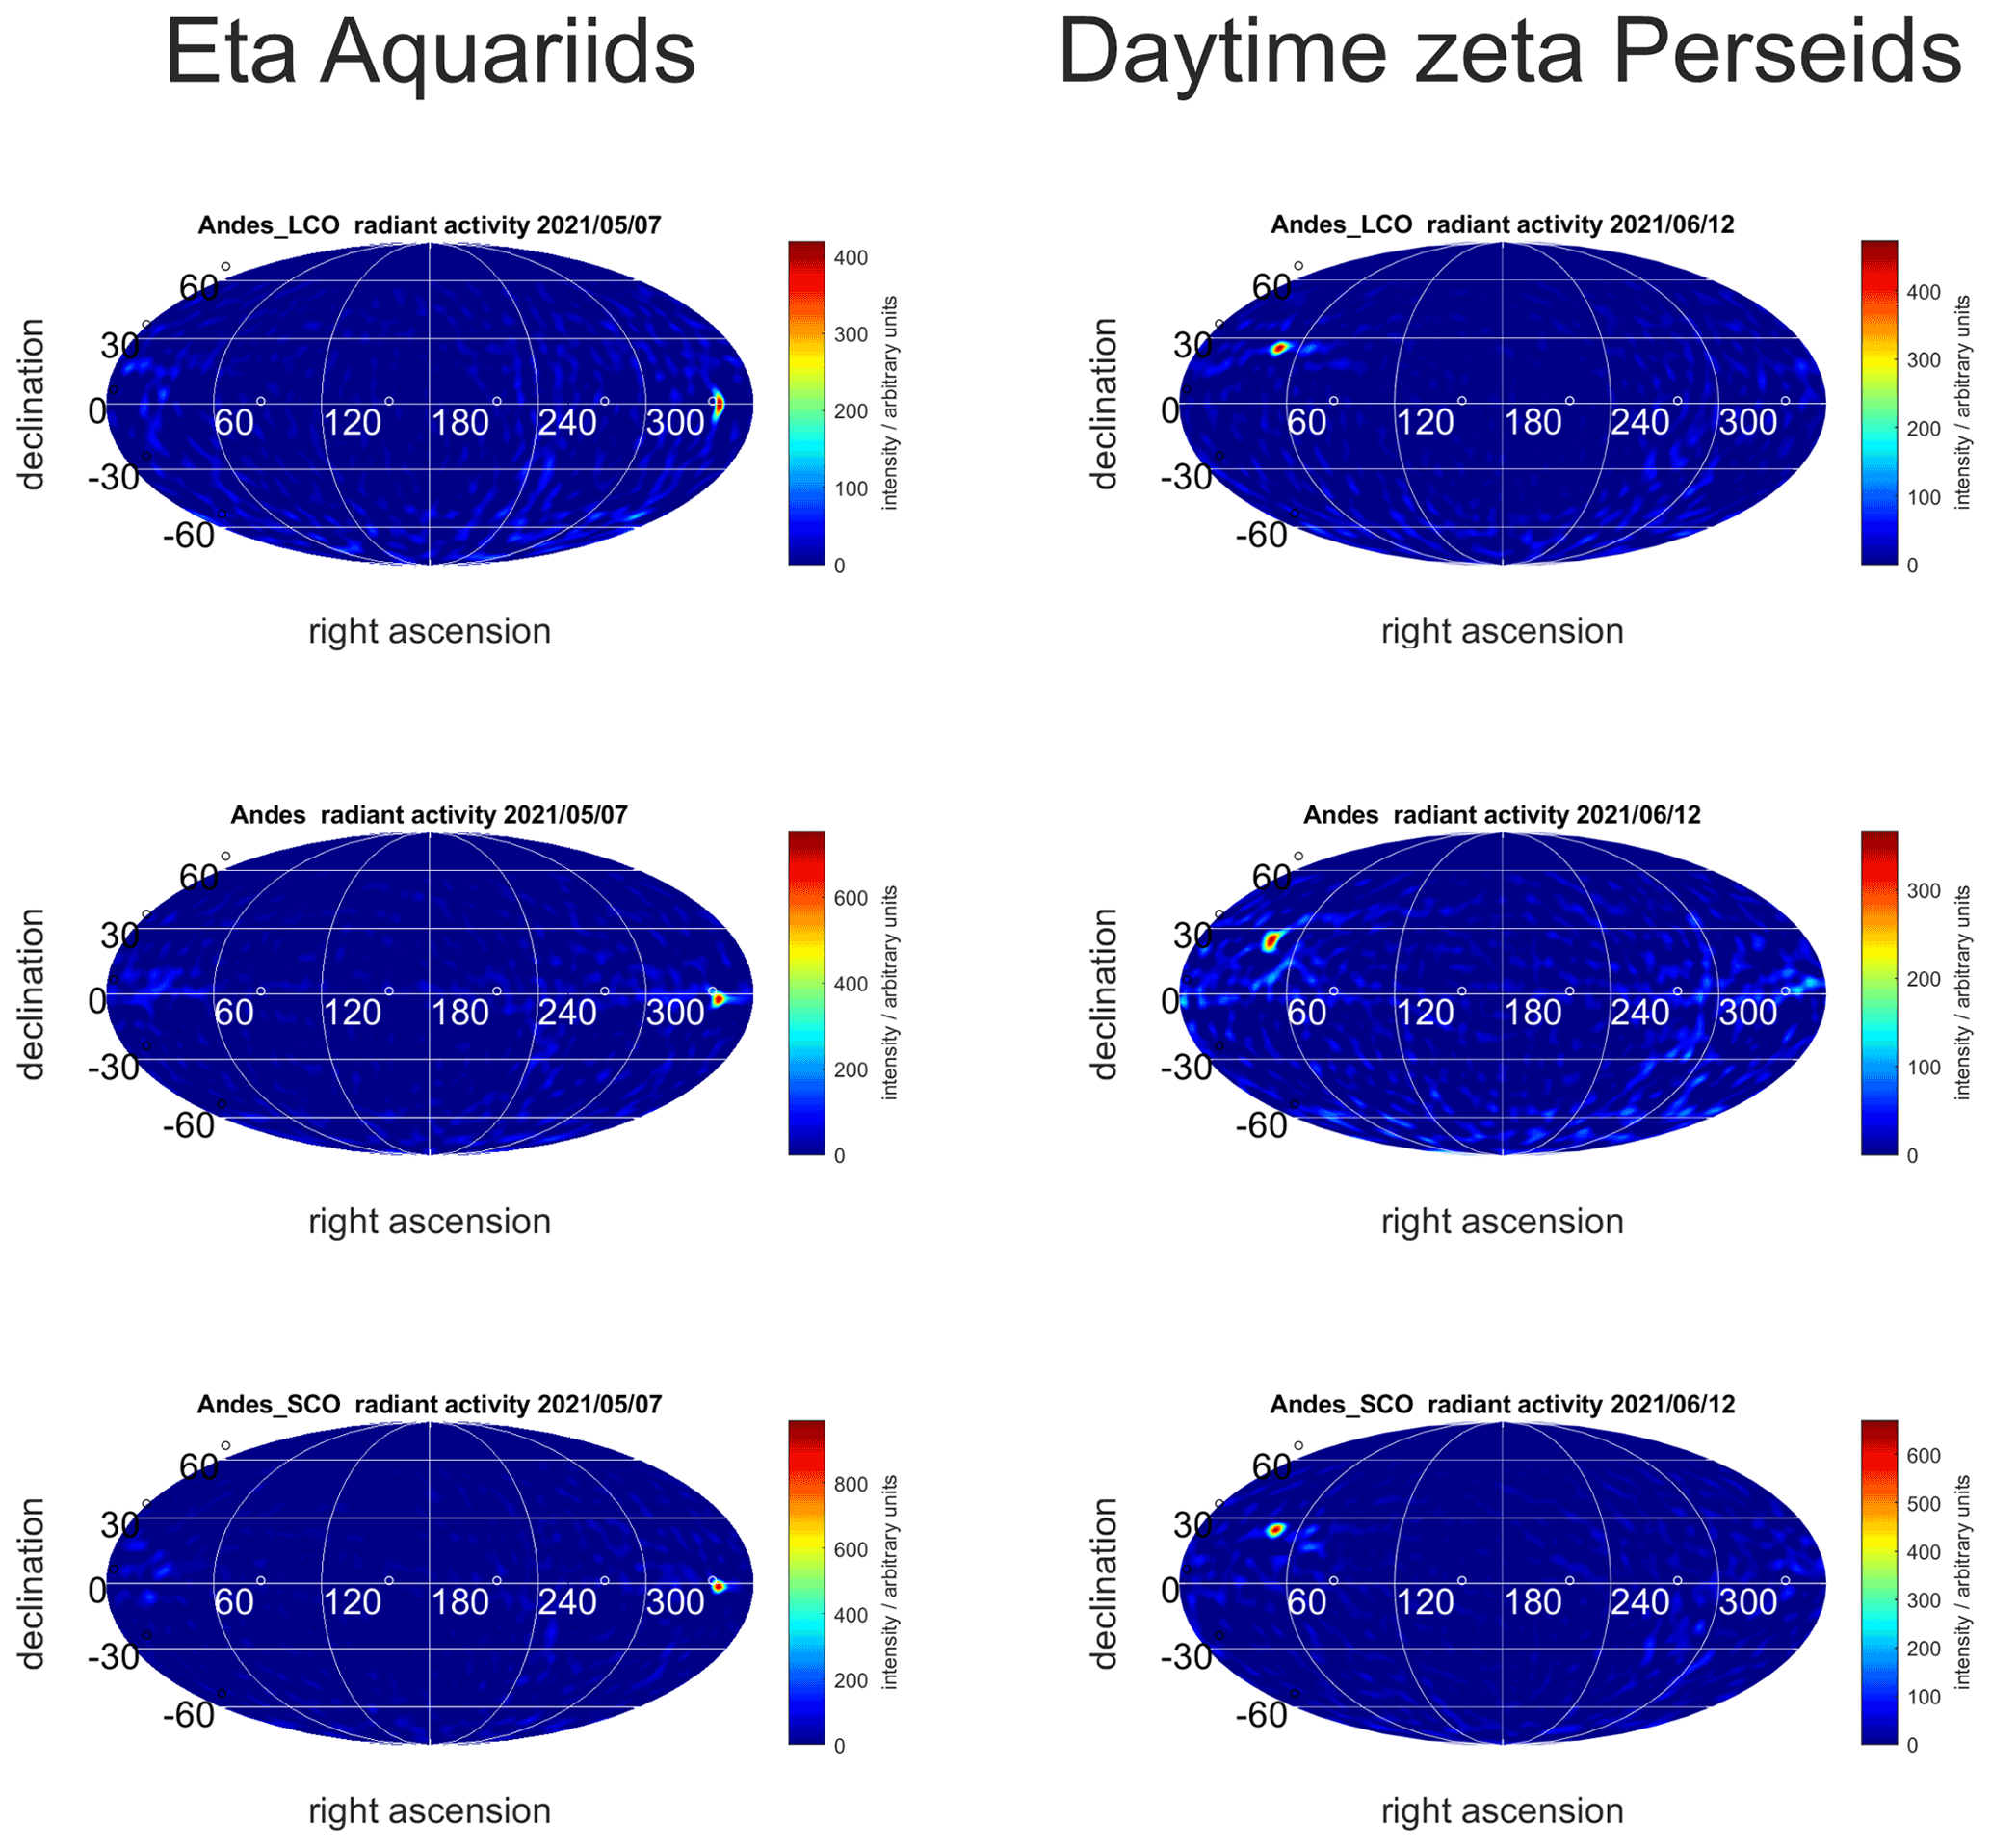
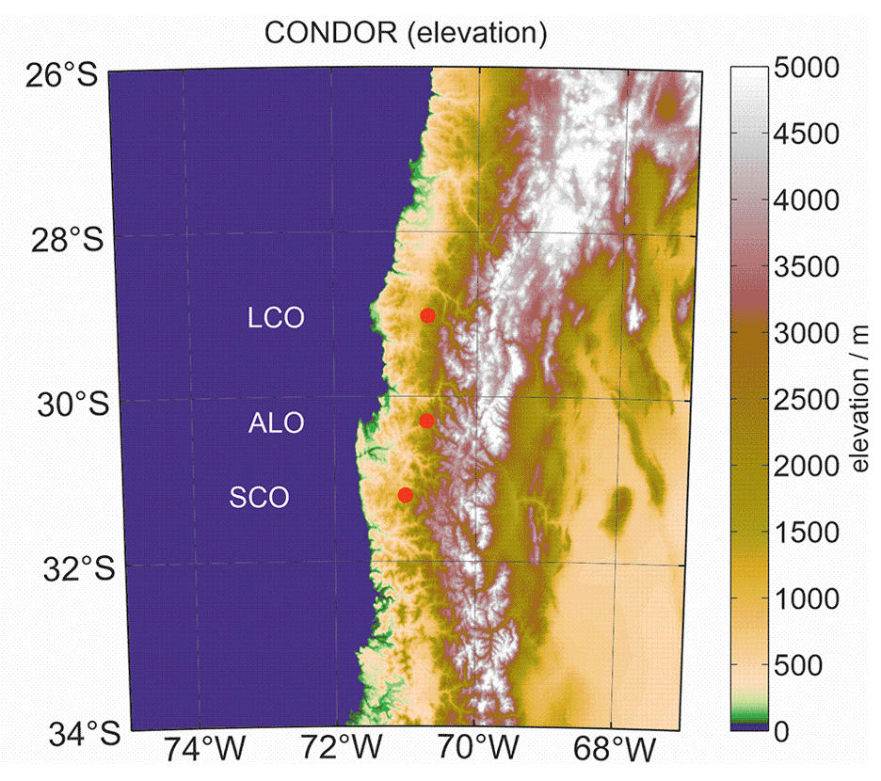
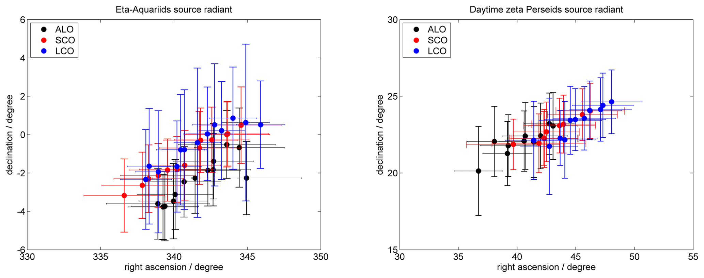
Single station radiant mapping –multistatic (long baseline)

Slide 29
Conclusions
Specular meteor radar signatures agree well with Fresnel optics
various methods for meteor speeds measurements
pre-t0 and PSSST provide robust and reliable meteor speeds for monostatic and multi-static meteor speeds
Fresnel holography speed measurement shows deviations to pre-t0 speeds
pre-t0 and time-of-flight measurements agree very well
Fourier based techniques are precise, but have a low success rate
orbits require multistatic observations (CMOR, SAAMER-OS)
radiant mapping for single station and multistatic radars

