Slide 1
Introduction Chris Steyaert
started meteor related activities in the VVS 1973
1978, 1980: photographic campaigns in Switzerland
radio work from mid 80’s (‘East block’ FM)
Founding IMO member
RMOB text 1993
RMOB web site 2000 (Pierre Terrier)
VVS meteor beacon 2005 (inspired on the Japanese beacon)
Re-attending the IMC’s since 2010
IMO radio commission director 2021, following up J-L. Rault

Slide 2
Combined determination of stream activity and Observability Function
Chris Steyaert
steyaert@vvs.be

Slide 3
Reference
A numerical method to aid in the combined determination of stream activity and Observability Function
Steyaert, Christian; Brower, Jeffrey; Verbelen, Felix
WGN, Journal of the International Meteor Organization, vol. 34, no. 3, p. 87-93
Метод Стиерта
Предложенный метод анализа данных любительских радионаблюдений
метеорных потоков был предложен Кристианом Стиертом (Christian Steyaert)
в 2005 году на Международной метеорной конференции в Оостмале
(Oostmall), Бельгия, и детально описан в статье [*Christian Steyaert, Jeffrey Brower, and Felix Verbelen, WGN, the Journal of the IMO 34:3 (2006)*]. Рассмотрим суть этого метода.

Slide 4
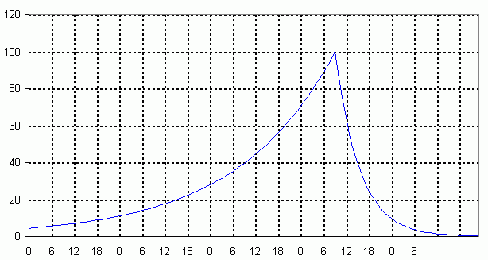
Some maths
O observed ‘activity’
S sporadic background
Z stream profile
OF Observability Function
t_{M} instance of maximum
a rise time constant
b decay

Slide 5
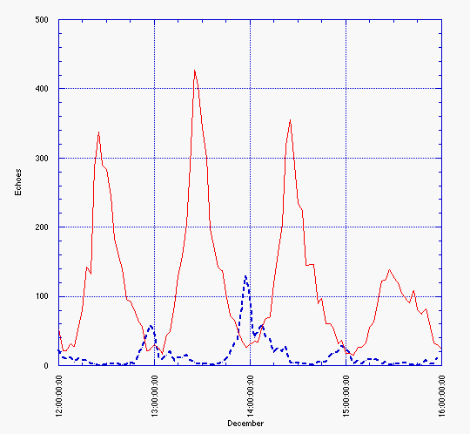
Geminids 2005
Brower
Verbelen

Slide 6
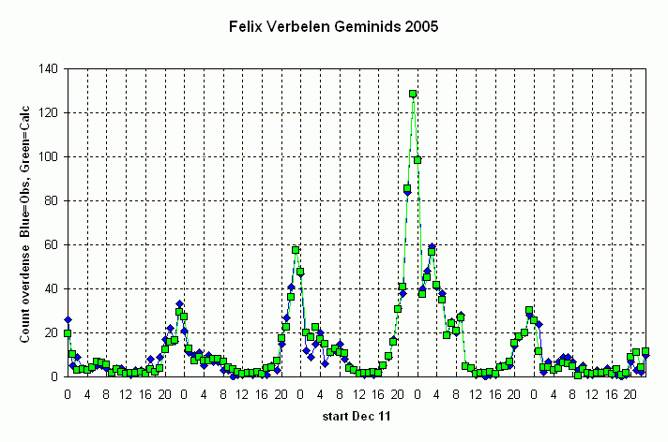
Geminids 2005
Observed =
Sporadic + Stream * ObsF

Slide 7
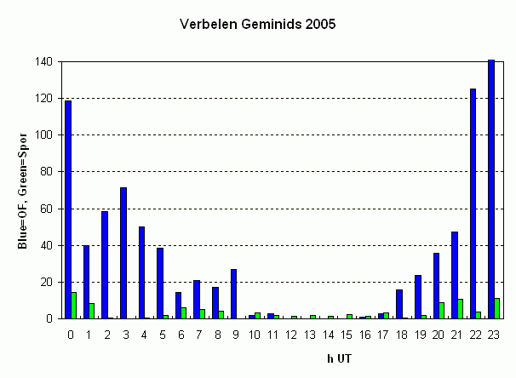
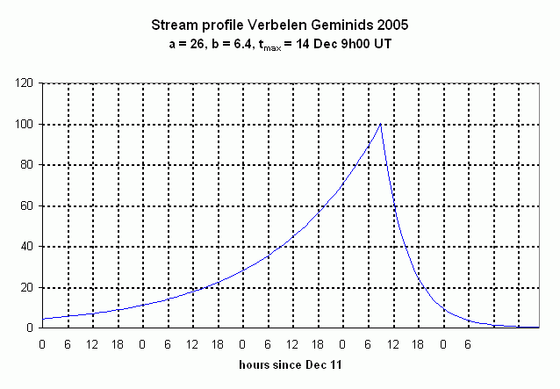
Geminids 2005
Obs F
Sporadic

Slide 8
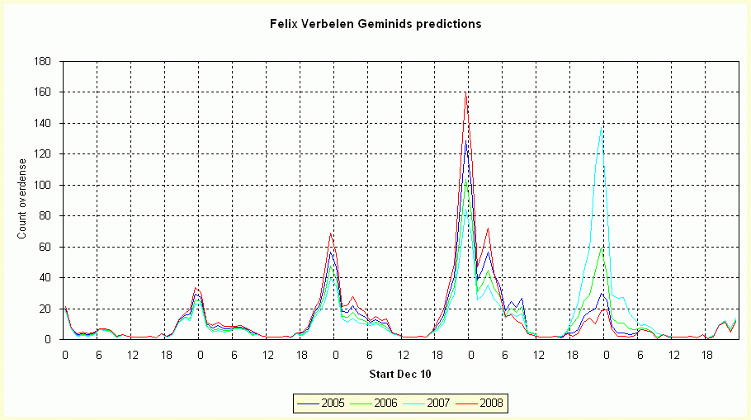
Geminids predictions

Slide 9
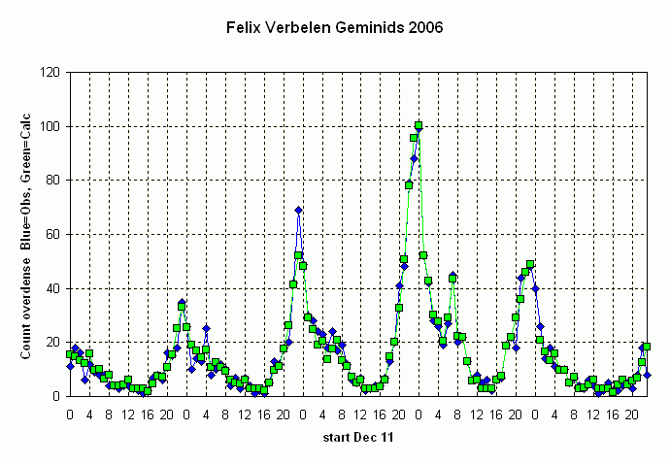
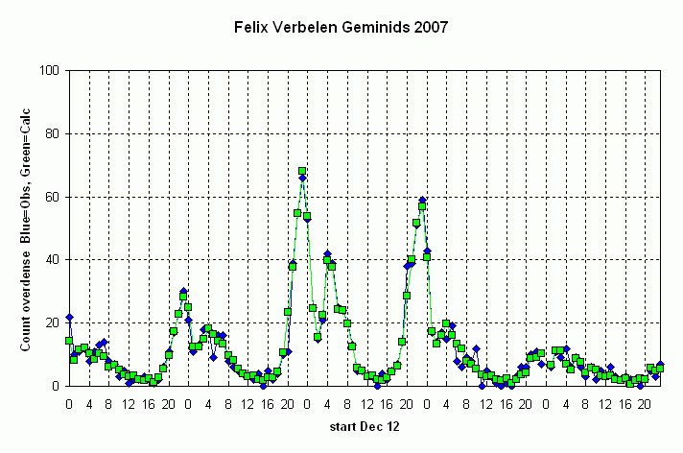
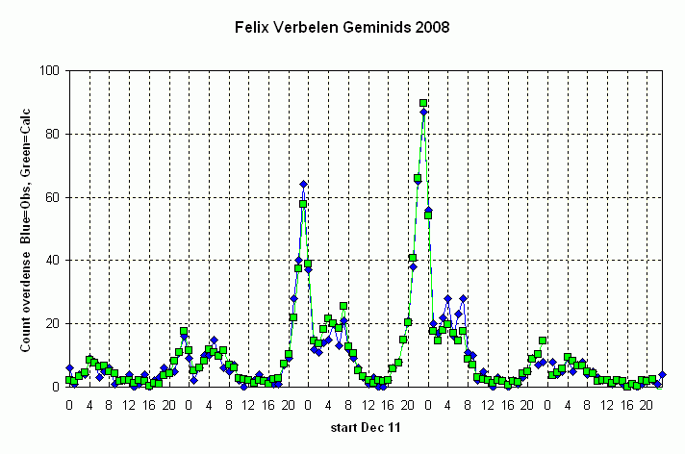
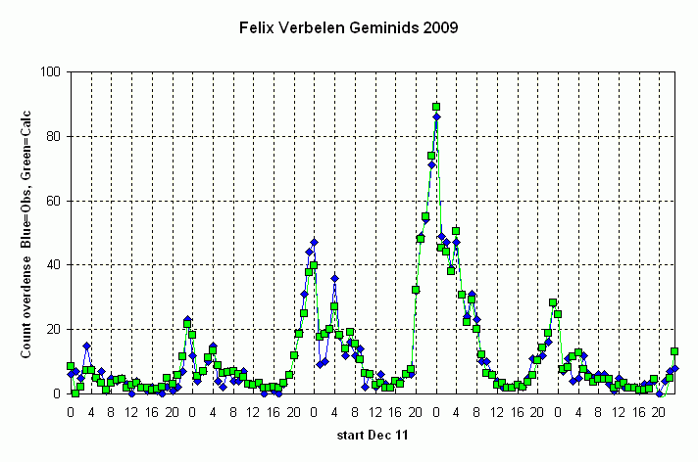
Geminids 2005-2009
Observed =
Sporadic + Stream * ObsF

Slide 10
Geminids 2005-2009

Slide 11
Enhancements and variants of the method
Sensitivity analysis
Poisson Monte Carlo simplex
(Verbelen_Gem2012, FLXHRG12, POISSRND, OFS1S 2012
note about other measures besides counts
Enhancements
Integral i/o point value (OFS1S exp intgr)
Model sporadics i/o hourly values
Other model Lorentz see Jenniskens p. 236

