Slide 1
Estimating the sporadic background and raw shower meteor rates
Stijn Calders
& the BRAMS team

Slide 2
Agenda
Introduction
Estimating the sporadic background
Estimating the raw shower activity
Comparisons between observing stations
Comparison over several years
Conclusions
Notes:
15 minutes

Slide 3
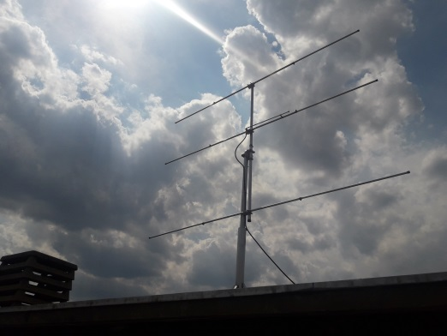
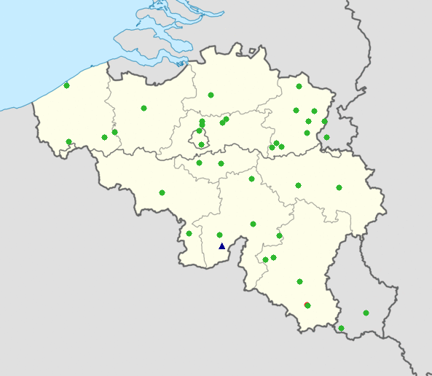
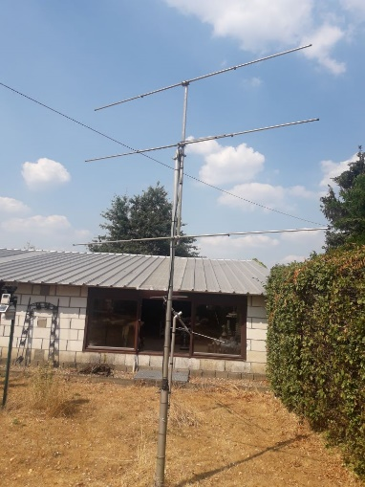
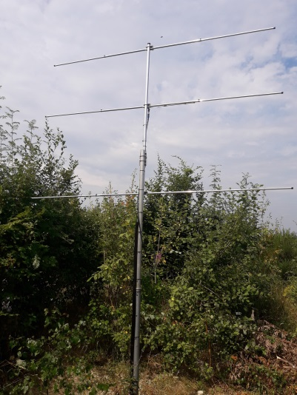
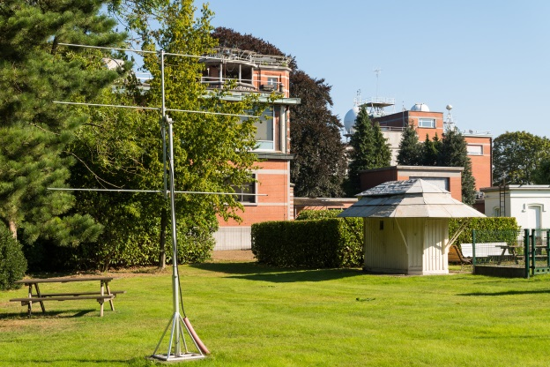
BRAMS network
Mons
Overpelt
Uccle
Neufchâteau
Notes:
Since June 2020: emitting 150W

Slide 4
Radio Meteor Zoo
During meteor showers, overdense meteors (with complex shapes) occur often.
There the human eye remains the best detector.
In 2016 we launched the Radio Meteor Zoo, in collaboration with Zooniverse.
To avoid mistakes, each spectrogram is processed by 10 different volunteers. → ~ majority vote

Slide 5
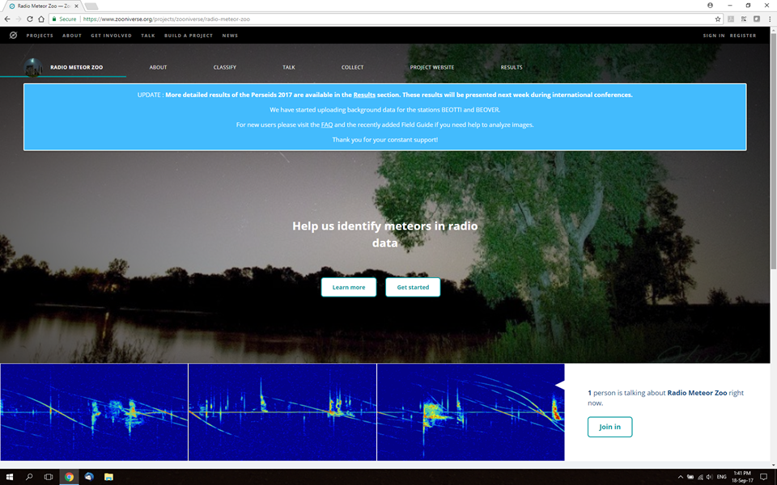
Radio Meteor Zoo

Slide 6
Estimating the sporadic background
We take several days outside the peak period.
Sine fit: y = a + b*sin(2π*x/24 + d) with LSF on averages
Both for number of reflections as for duration

Slide 7
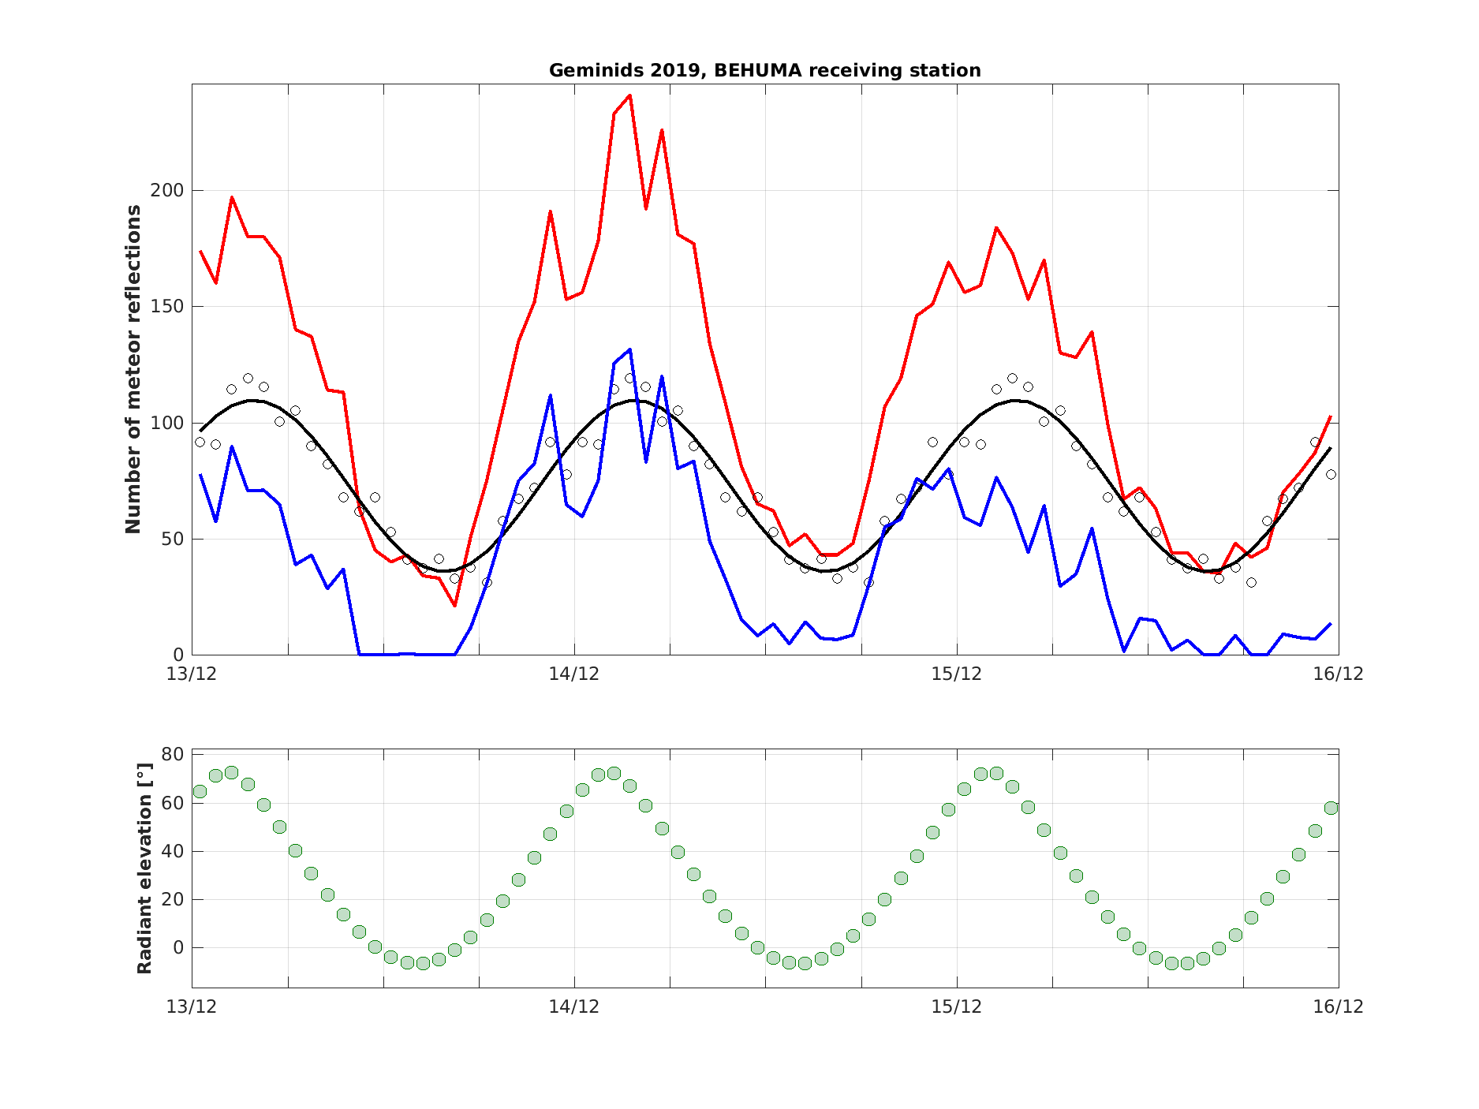
Estimate of the raw shower activity

Slide 8
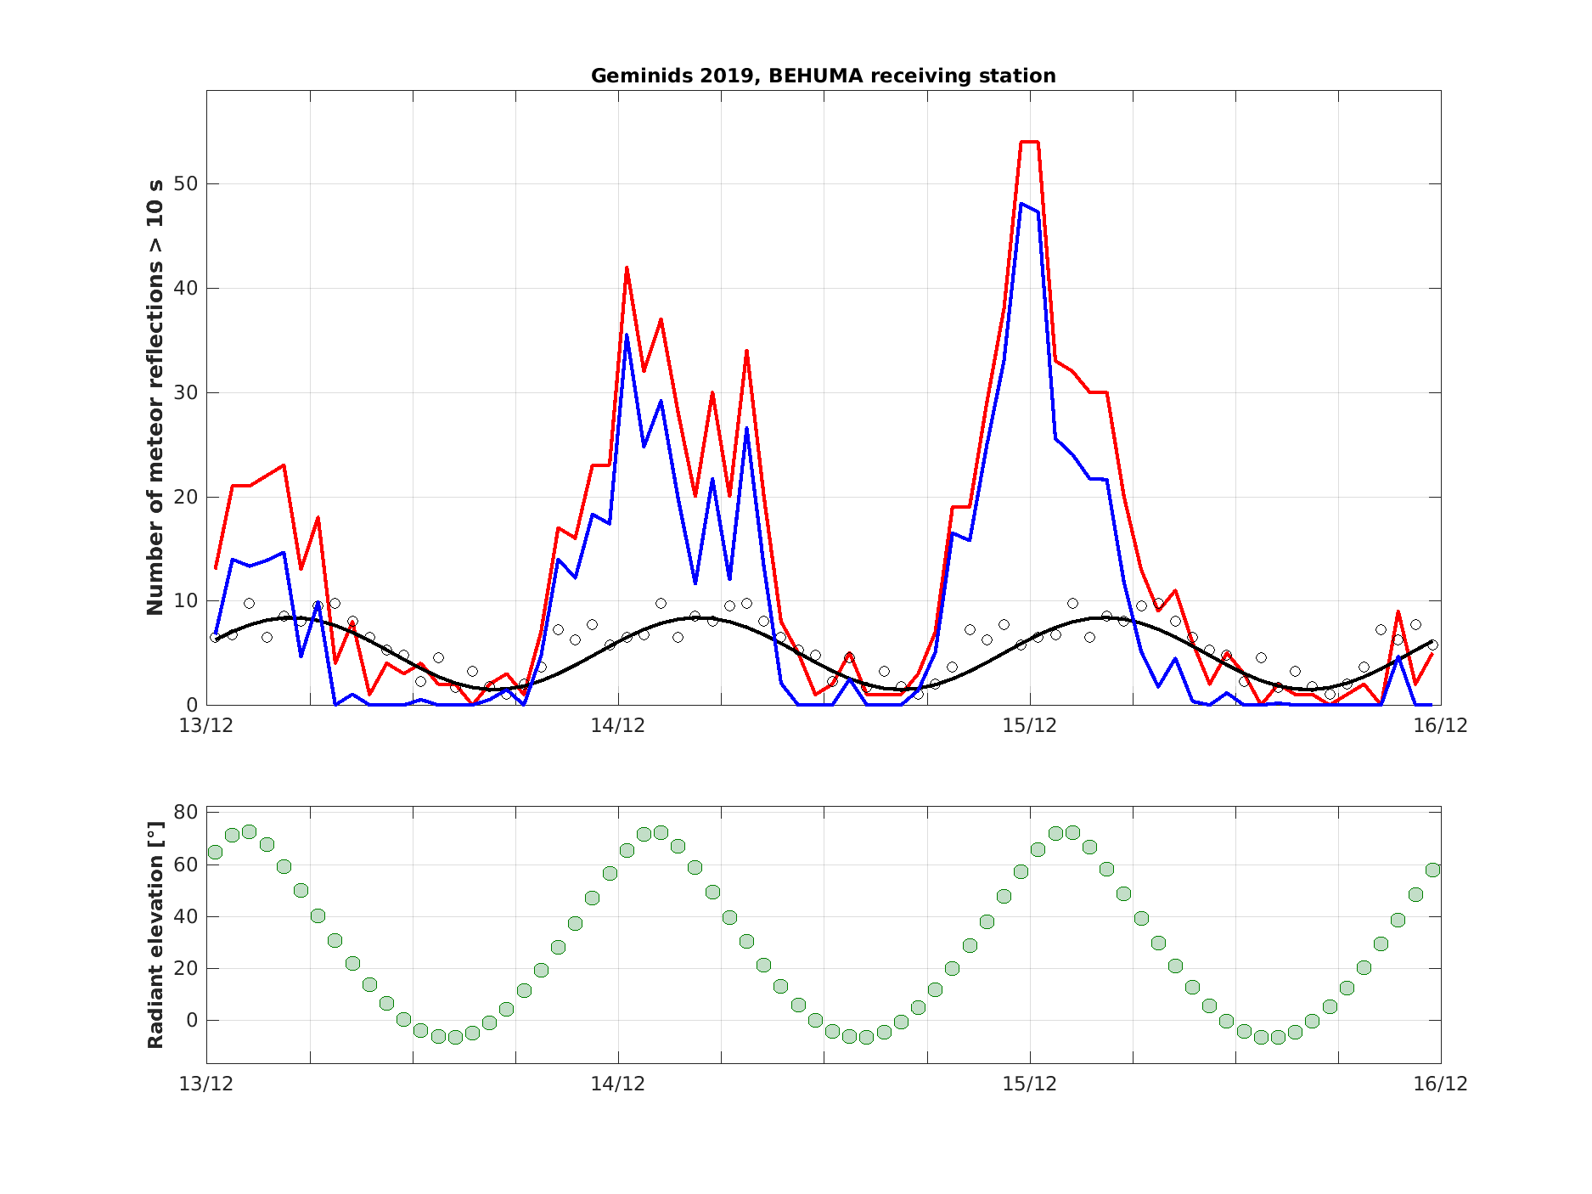
Estimate of the raw shower activity

Slide 9
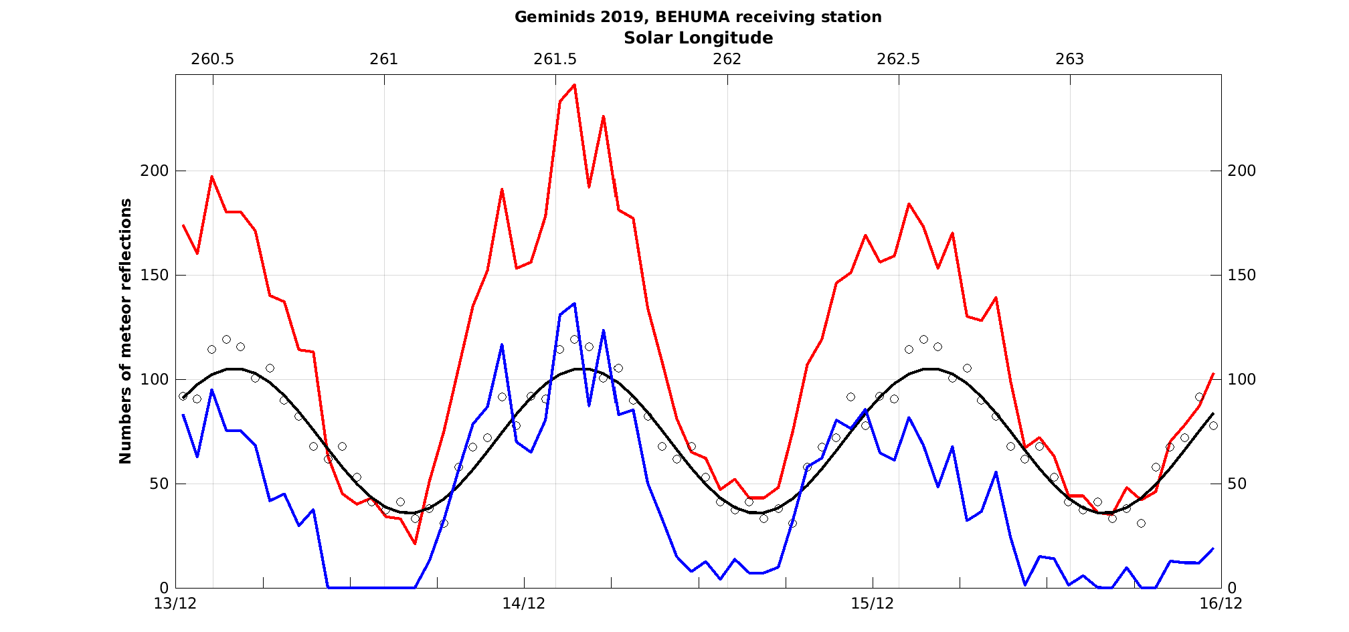
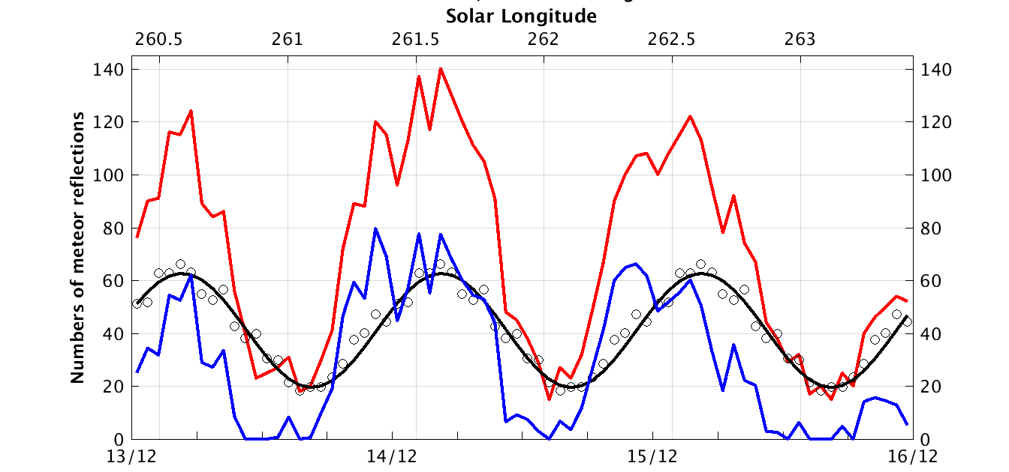
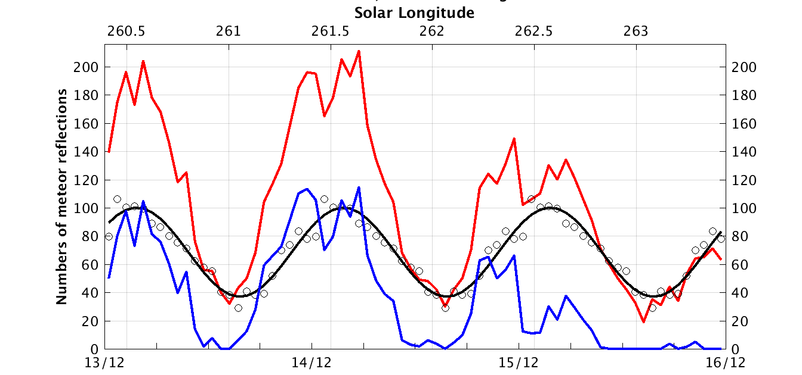
Comparison between different stations
Humain Sivry
Overpelt
Notes:
Humain is east of Dourbes, Sivry west. Humain (interferometer) and Sivry use different receivers.
Overpelt is much more north (close to Eindhoven).

Slide 10
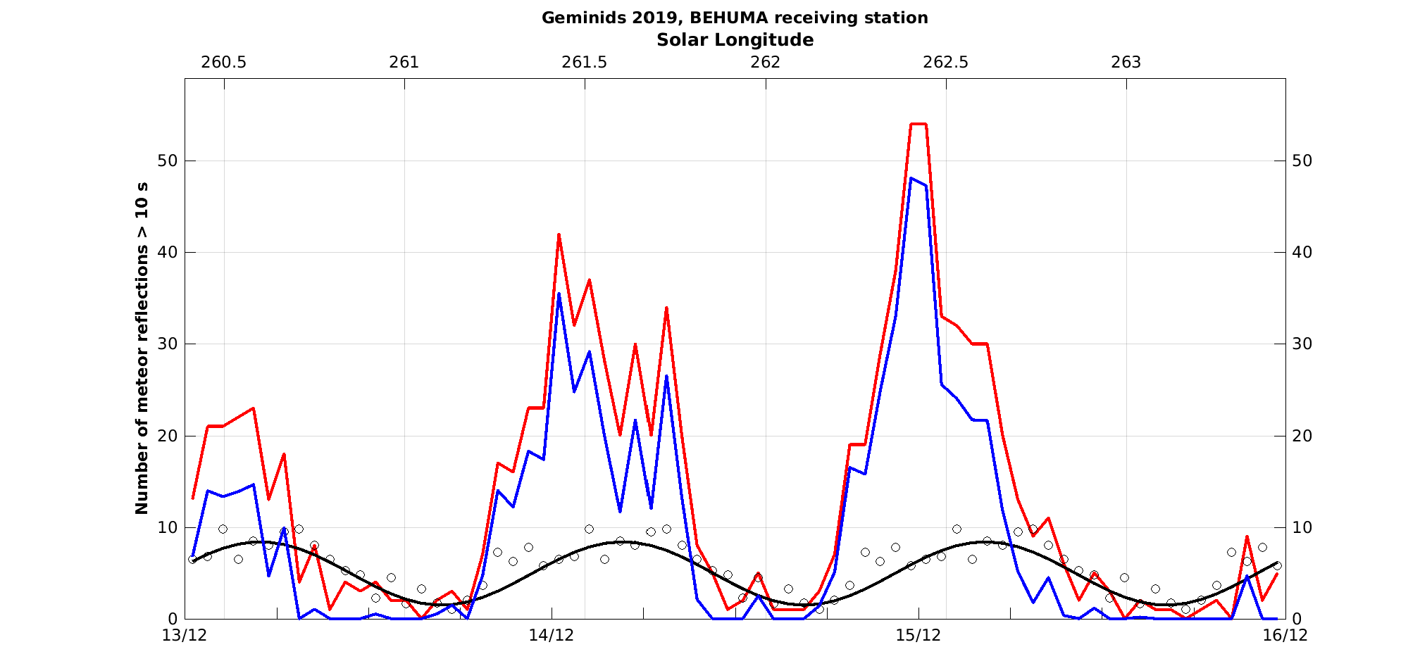
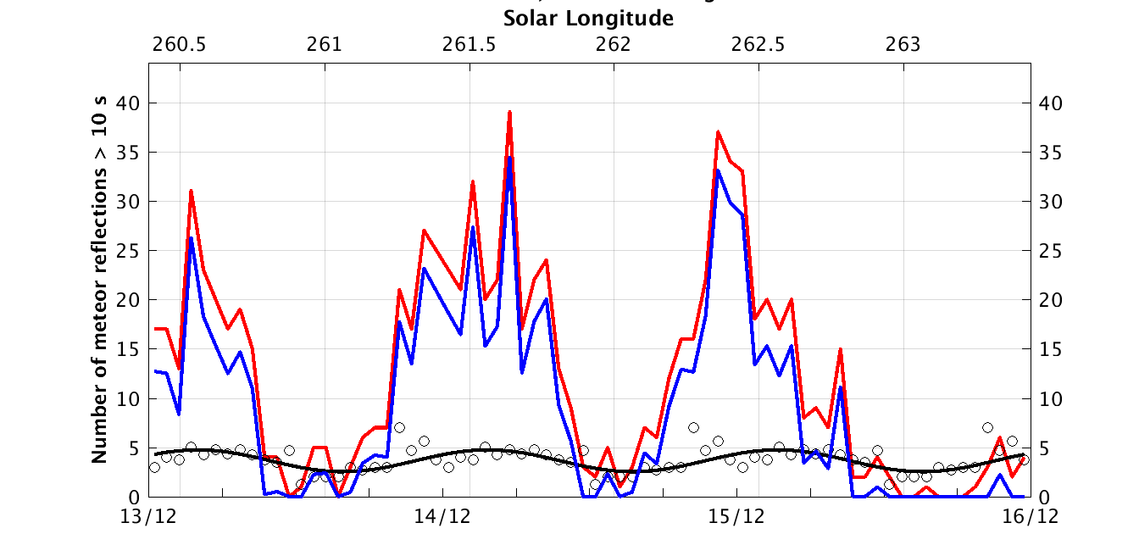
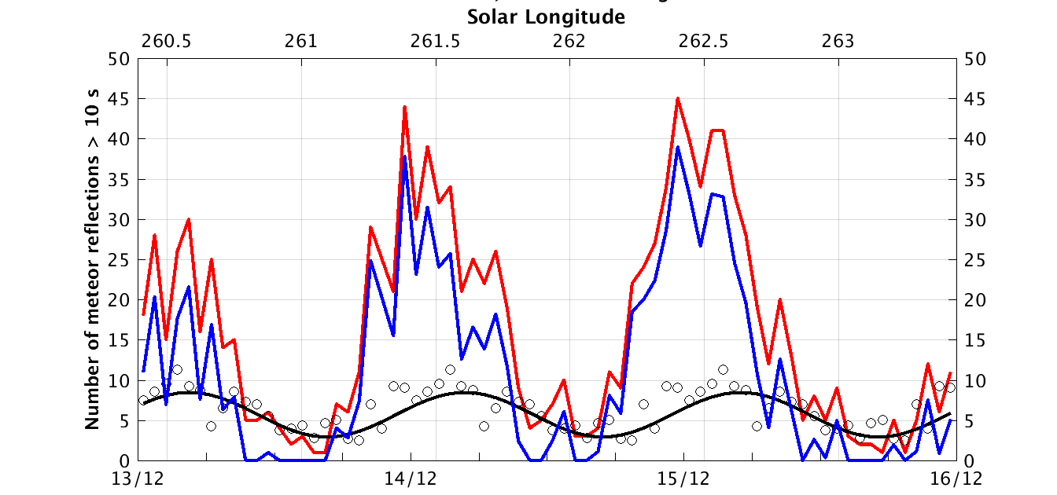
Comparison between different stations
Humain Sivry
Overpelt
Notes:
Humain is east of Dourbes, Sivry west. Humain (interferometer) and Sivry use different receivers.
Overpelt is much more north (close to Eindhoven).

Slide 11
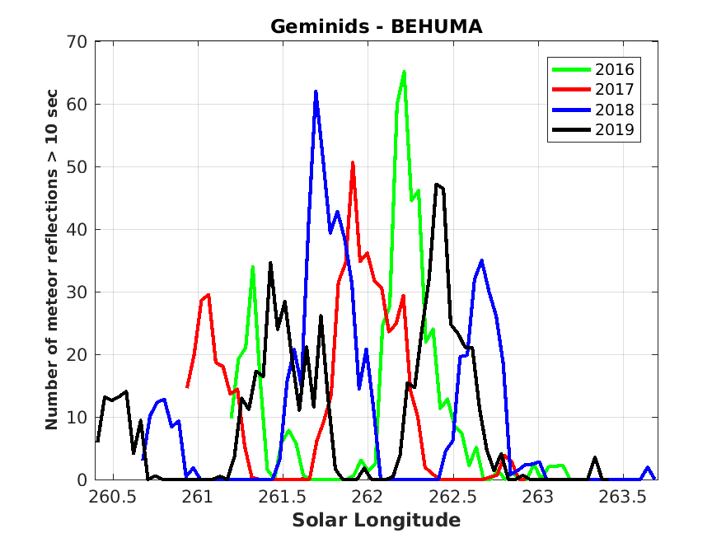
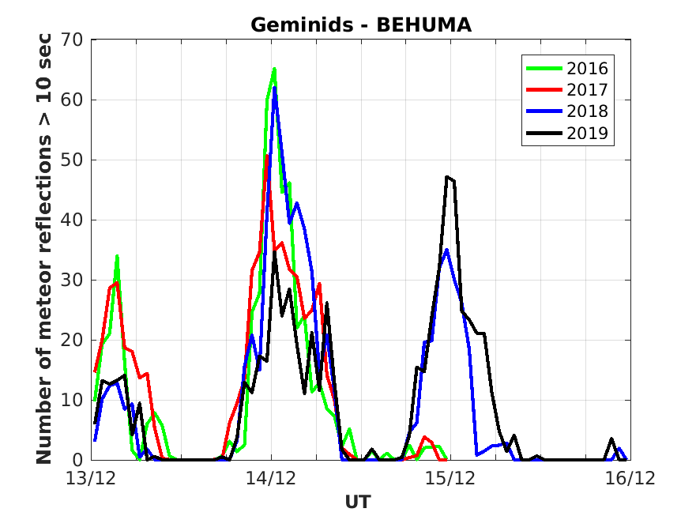
Comparison over several years (Humain)

Slide 12
Conclusion
We have estimated the sporadic background and subtracted it from the total BRAMS radio meteor activity to obtain shower activity for the Geminids 2016-2019.
Annual peaks in observed shower activity in different years do not correspond to the same interval in solar longitude (as we would expect from the real shower activity), but they do align well in diurnal patterns in UT.
This means system sensitivity is the dominant factor in the observed meteor activity. This system sensitivity has a diurnal pattern due to its dependence on the radiant position in the sky: the Observability Function (OF, see Verbeeck paper in IMC Proceedings 1996).
To estimate the real shower activity, we have to calculate or estimate the OF. This is under development.

