Slide 1



Calibration of the BRAMS radio interferometer
H. Lamy¹, M. Anciaux¹, S. Ranvier¹, A. Martínez Picar²,
S. Calders¹, A. Calegaro¹, C. Verbeeck²
¹ Royal Belgian Institute for Space Aeronomy
² Royal Observatory of Belgium
International Meteor Conference 2019 – Bollmannsruh, Germany – 3-6 October 2019

Slide 2
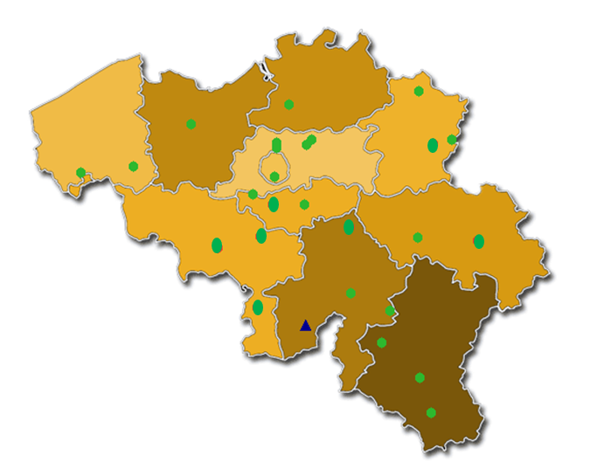
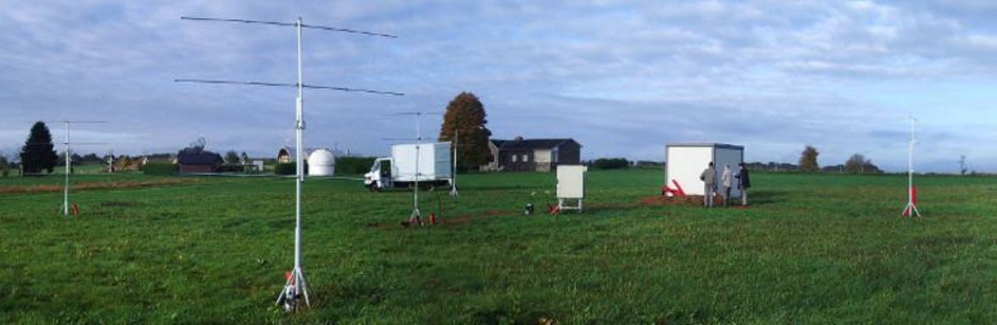
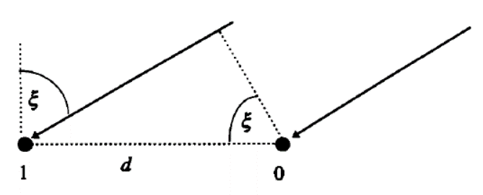
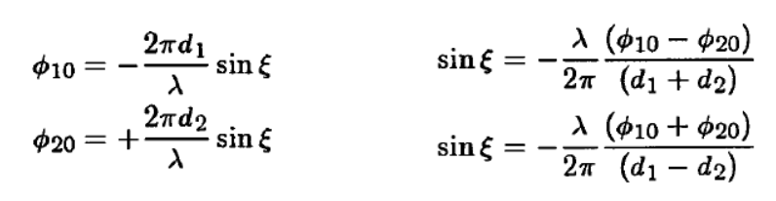

The BRAMS radio interferometer in Humain
Jones et al (1998)
d₁ = 2.5 λ
d₂ = 2 λ

Slide 3
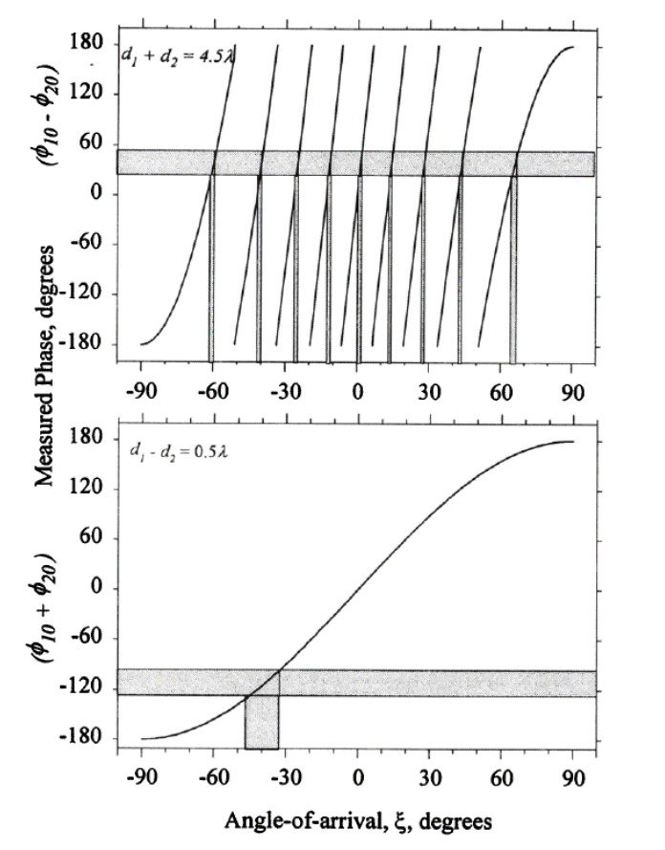
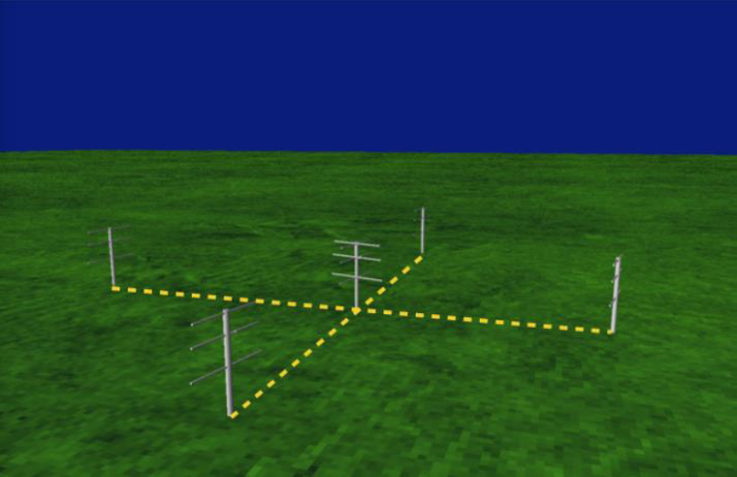
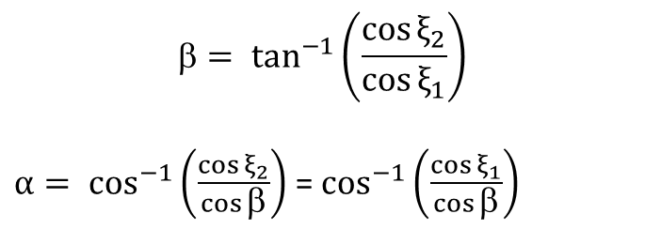
The BRAMS radio interferometer in Humain
α : elevation
β : azimuth

Slide 4
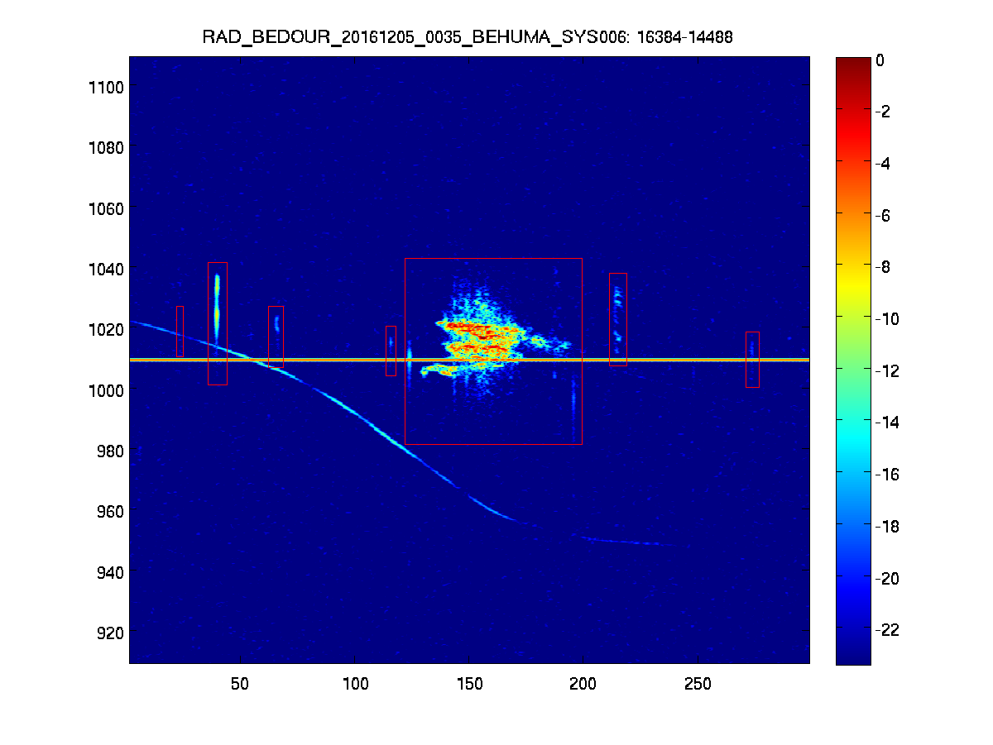
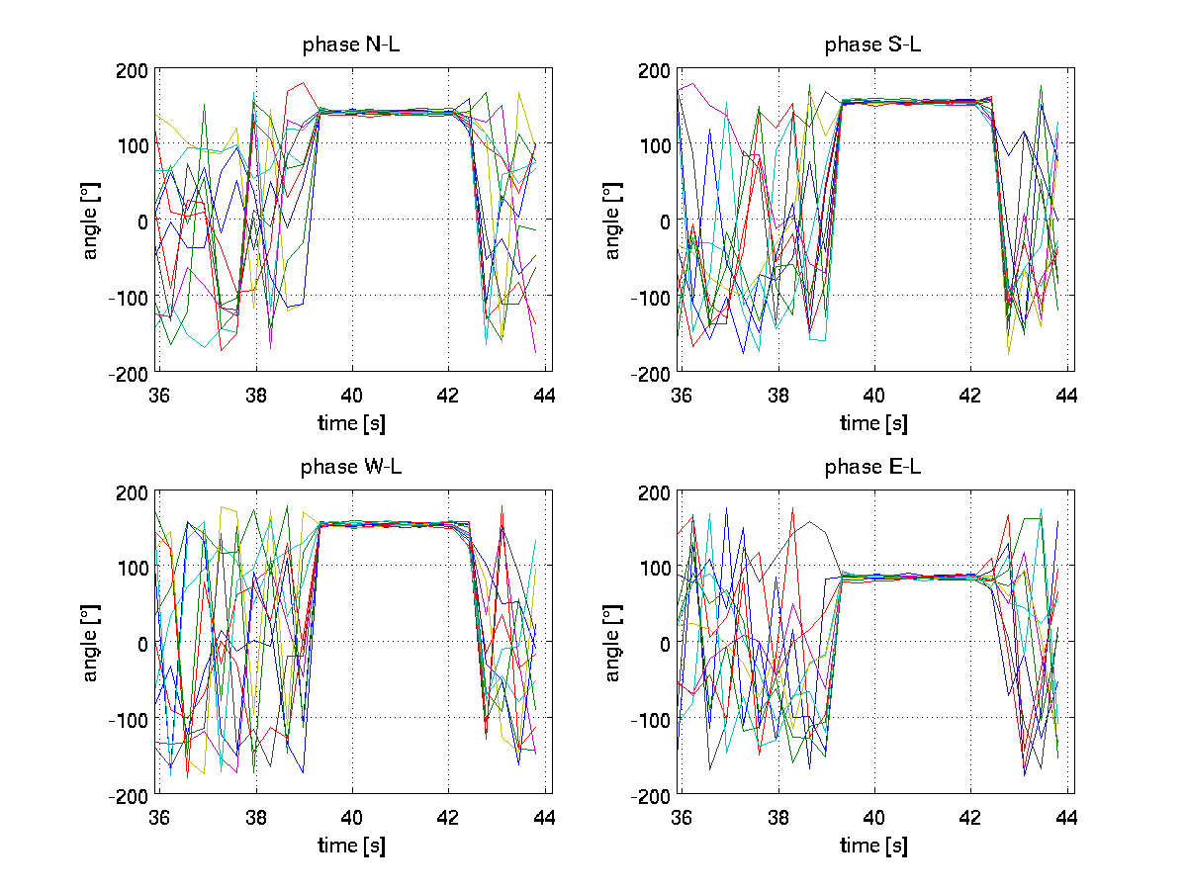
An example of result
Frequency
Time (sec)
Phase differences between antenna pairs

Slide 5
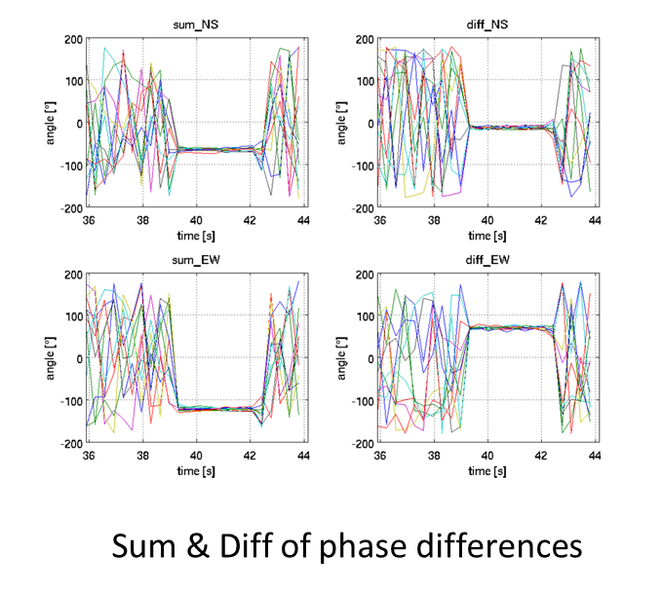
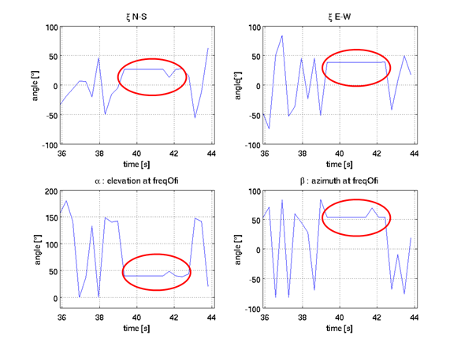
An example of result

Slide 6
Calibration of the BRAMS interferometer
data from a drone equipped with a transmitter and flying in the far-field of the interferometer
data from airplanes whose positions were recorded using ADS-B signals.
data from trajectories obtained from CAMS-Benelux optical observations for which the direction of the first Fresnel zone can be calculated

Slide 7
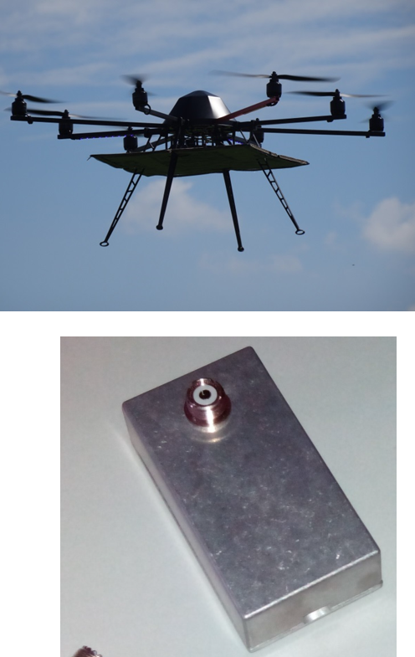
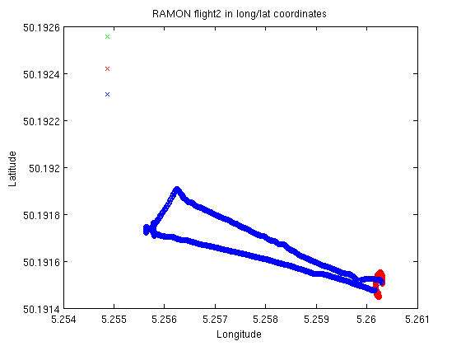
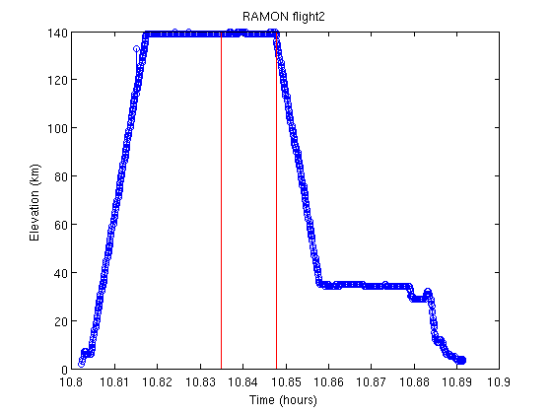
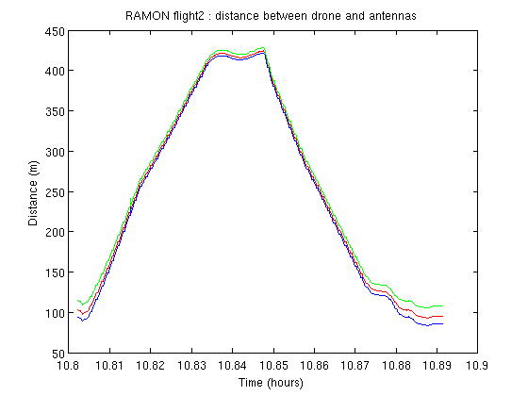
Flight with a drone and a transmitter
Distance to the antennas ∼ 400 m
Tx = BRAMS calibrator

Slide 8
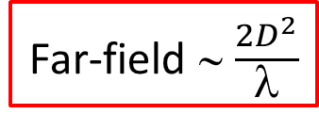
Flight with a drone and a transmitter
Far-field ∼ $\frac{2D^{2}}{λ}$
D is the largest dimension of the interferometer = 4.5λ ∼ 27 m
Far-field ∼ 243 m
OK but wave front still cannot be considered as plane, so a correction has to be made for the curvature

Slide 9
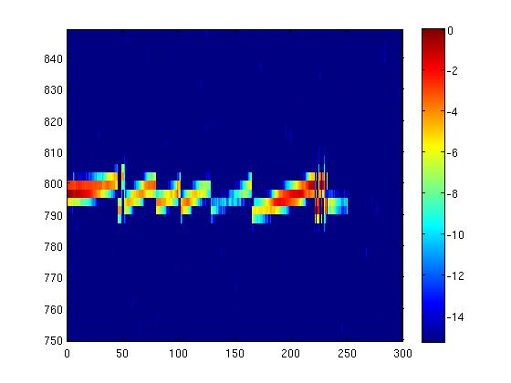
Flight with a drone and a transmitter

Slide 10
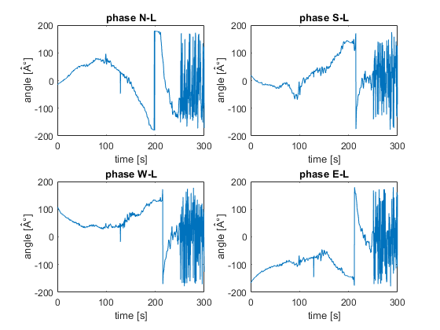
Flight with a drone and a transmitter

Slide 11
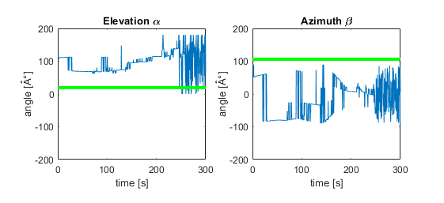
Flight with a drone and a transmitter

Slide 12
Flight with a drone and a transmitter
Potential source of errors :
Drone is more or less stable in position but orientation of the antenna might change randomly due to winds …?
Drone flies at relatively low elevation (∼ 20°) → prone to more errors?
Central antenna was tilted by 45° compared to N/S/E/W antennas at the time of the flight → impact on the measurements?

Slide 13
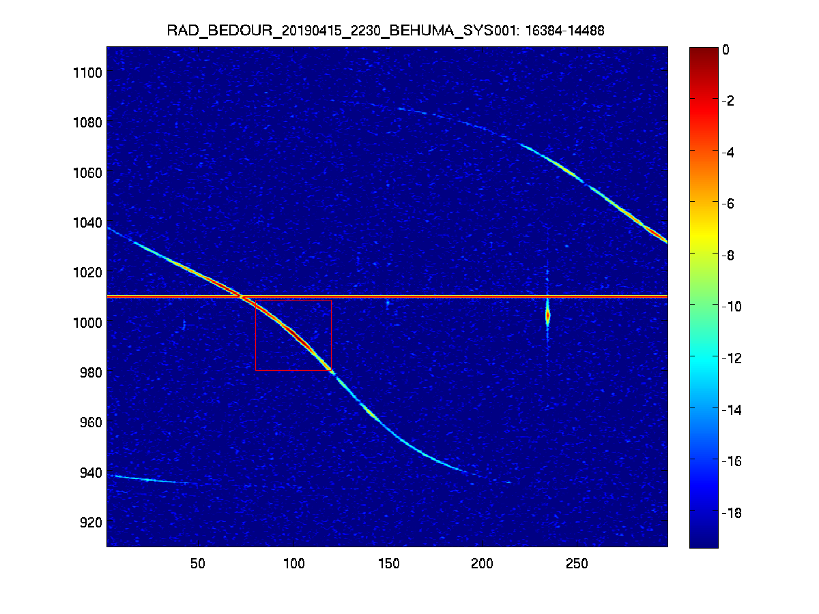
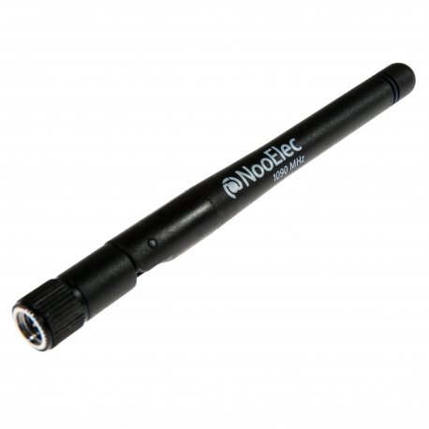
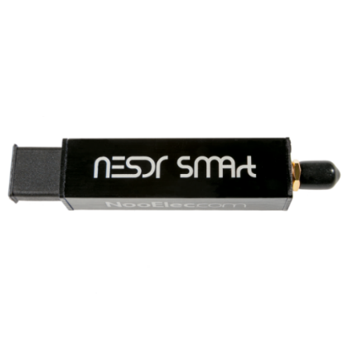
Airplane signals
1090MHz ADS-B Antenna and receiver

Slide 14
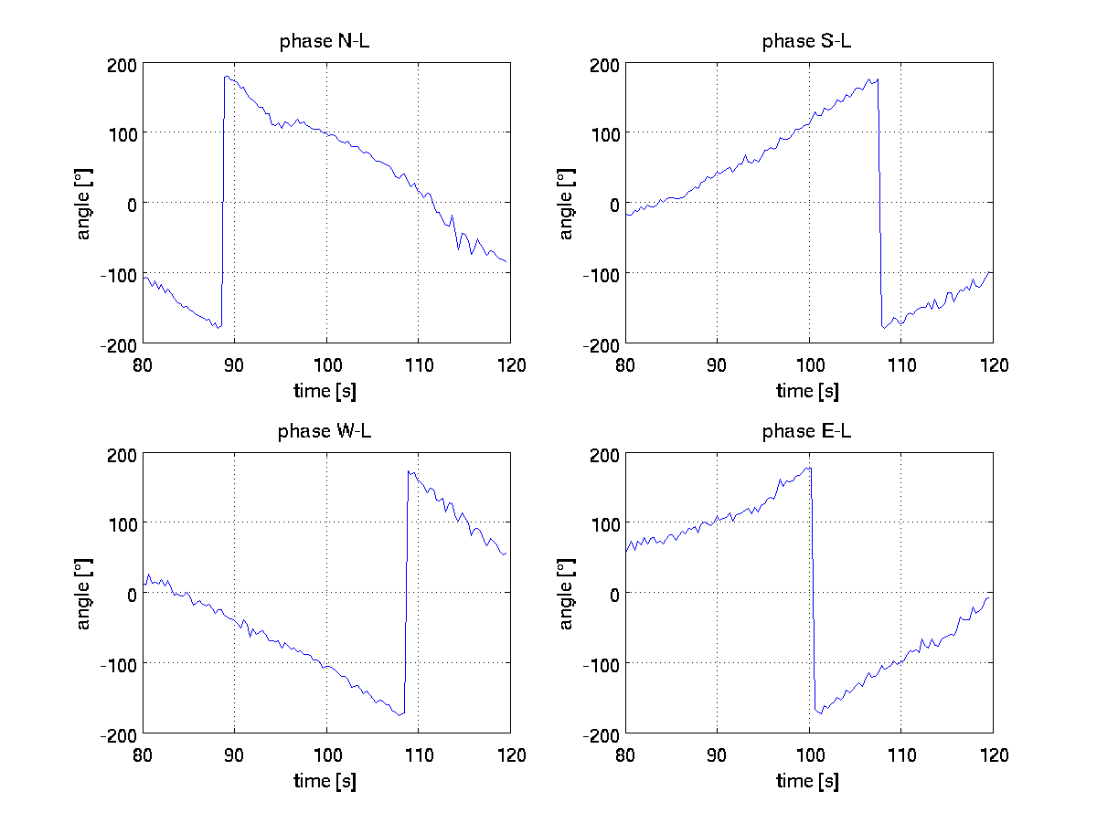
Airplane signals

Slide 15
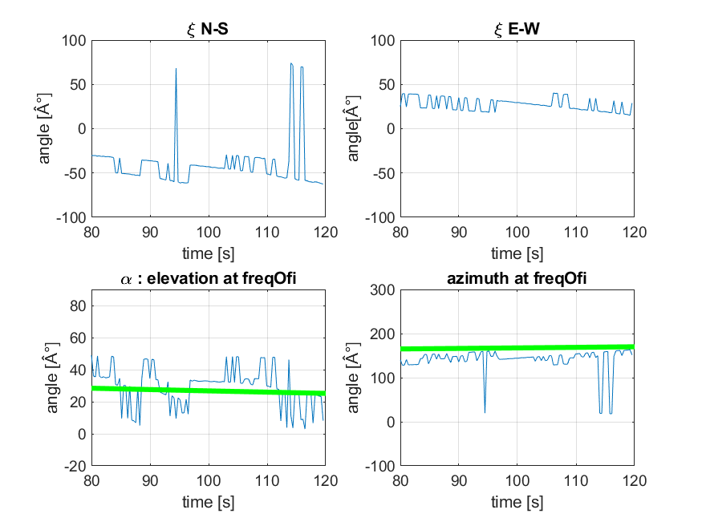
Airplane signals

Slide 16
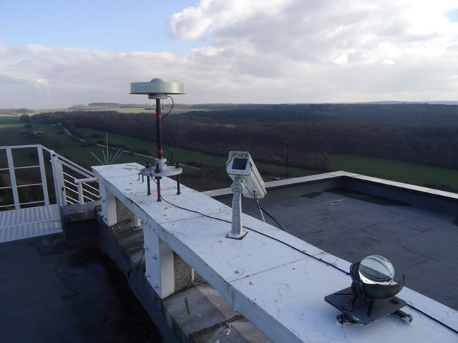
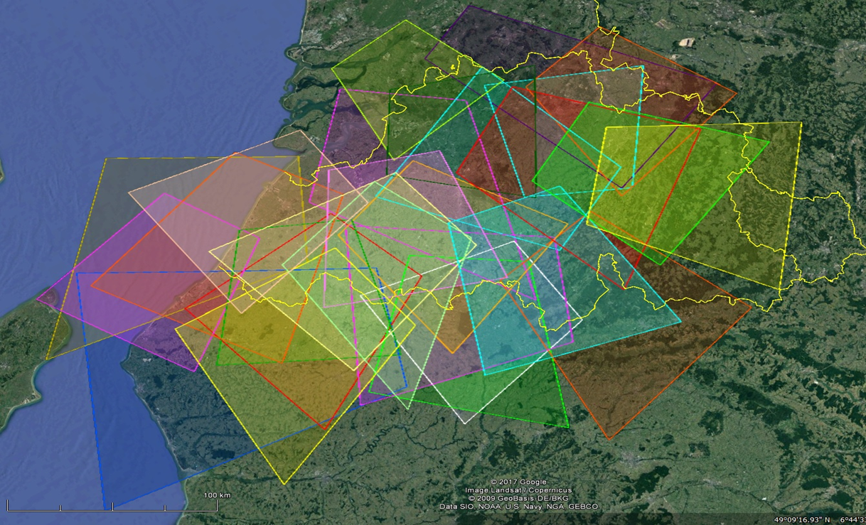
Data from optical CAMS observations

Slide 17
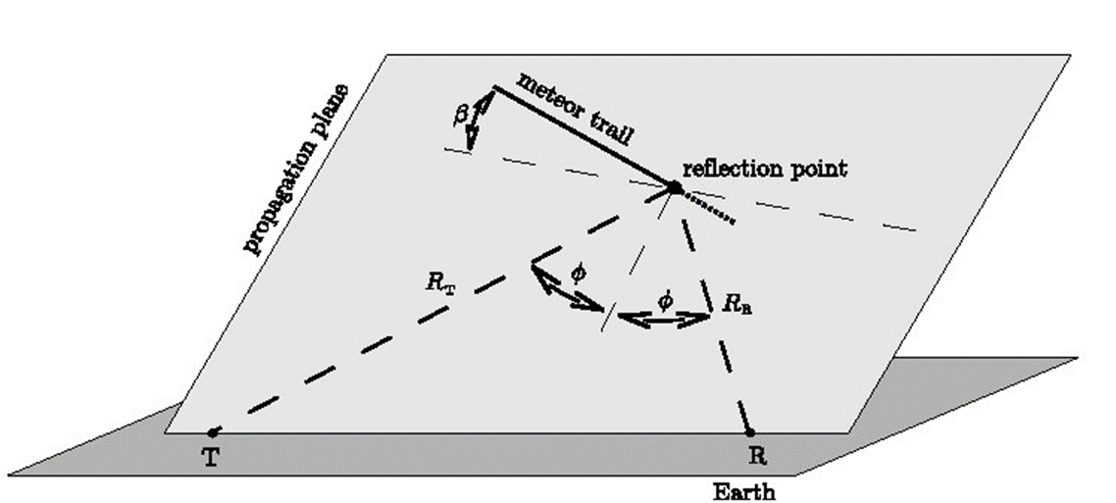
Data from optical CAMS observations

Slide 18
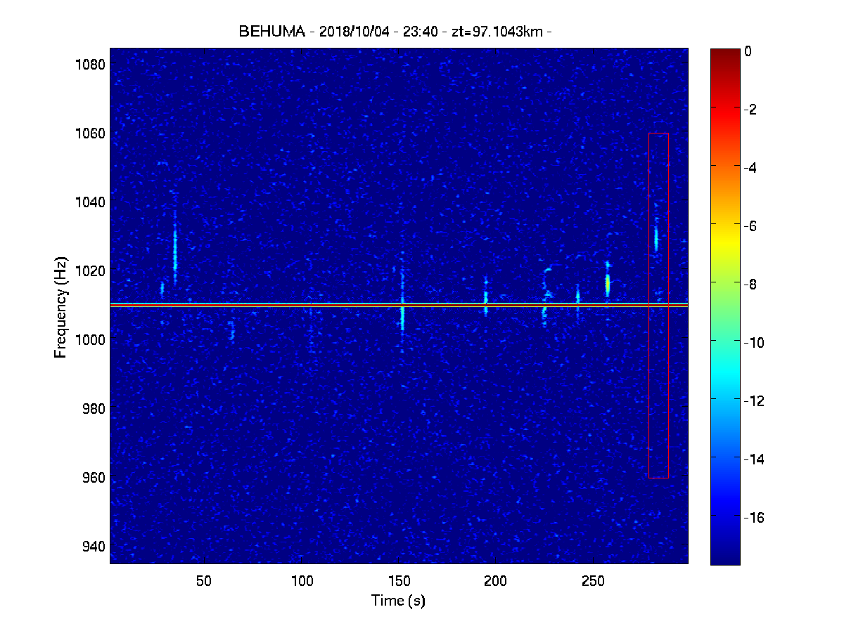
Data from optical CAMS observations

Slide 19
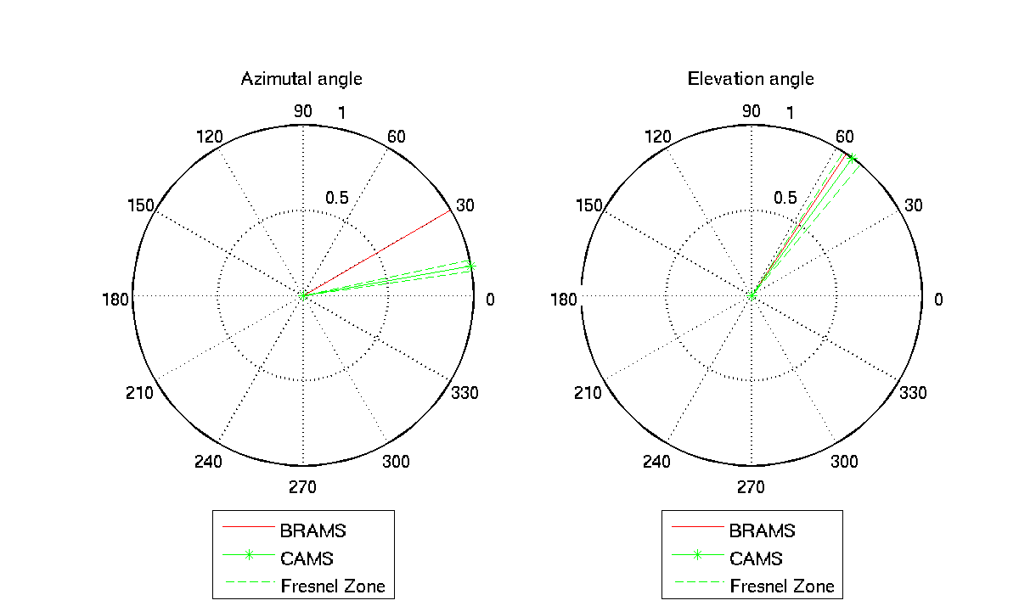
Data from optical CAMS observations

Slide 20
Conclusions
3 methods for calibrating the BRAMS interferometer have been developed. None of them is giving satisfactory results so far (precision on azimuth / elevation of ∼ 1°)
The use of the drone is the most complex one to analyze and reproduce, therefore the two other methods will be favored in the future
Additional tests and analyses need to be done to reach the desired accuracy. One important aspect is that the phase centers of the antennas have been accurately measured using a telemeter and an inclinometer. There are vertical differences between these centers that can reach up to 20 cm. This will be corrected soon. The impact on these results still has to be determined.

Slide 21
Thank you for your attention
Thank you to Lea Planquart (University of Brussels)

