Slide 1
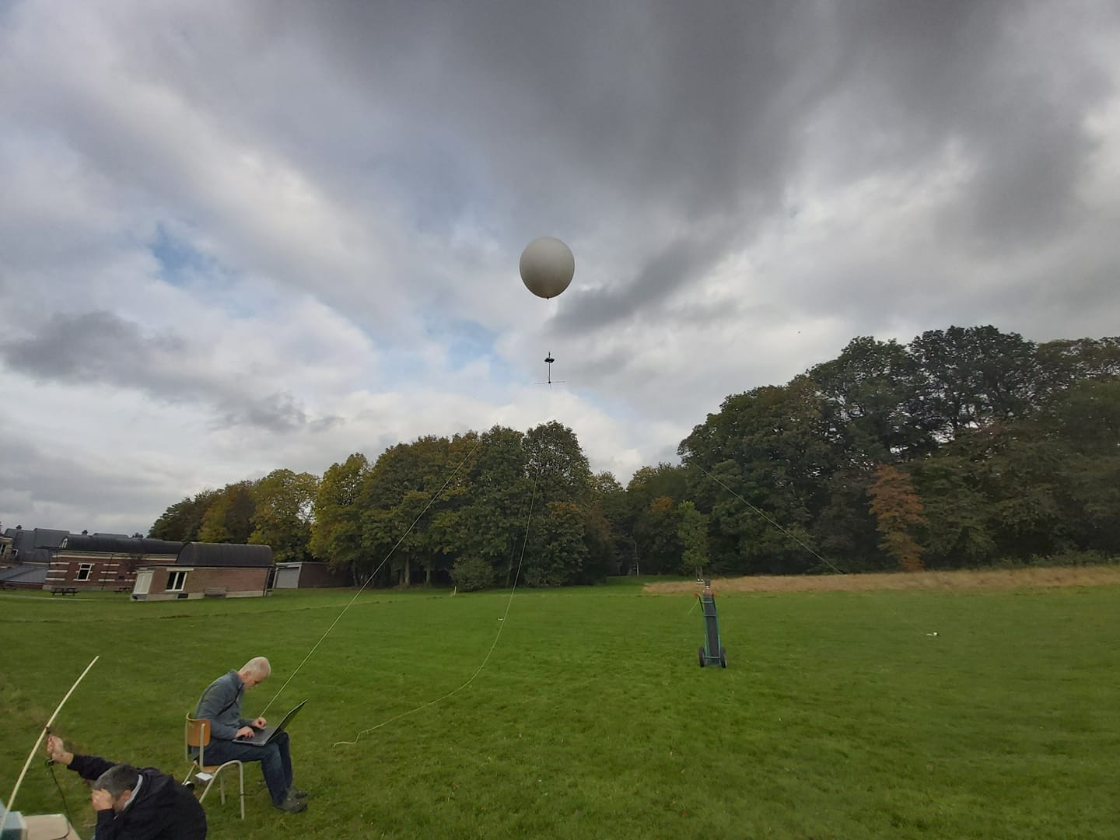
First tests with a captive balloon to characterize the radiation pattern of the BRAMS transmitter in Dourbes
H. Lamy & BRAMS team

Slide 2
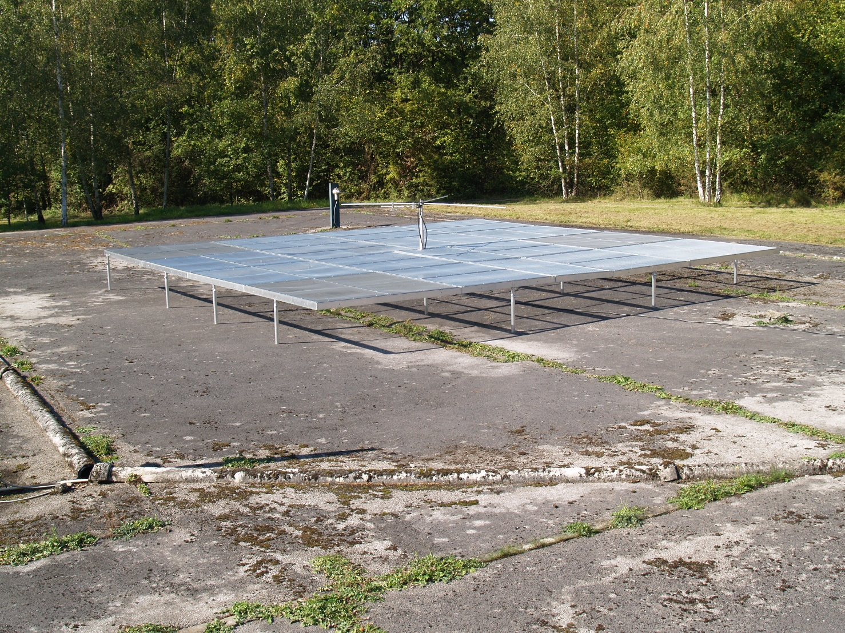
Goal : characterize the BRAMS transmitter

Slide 3
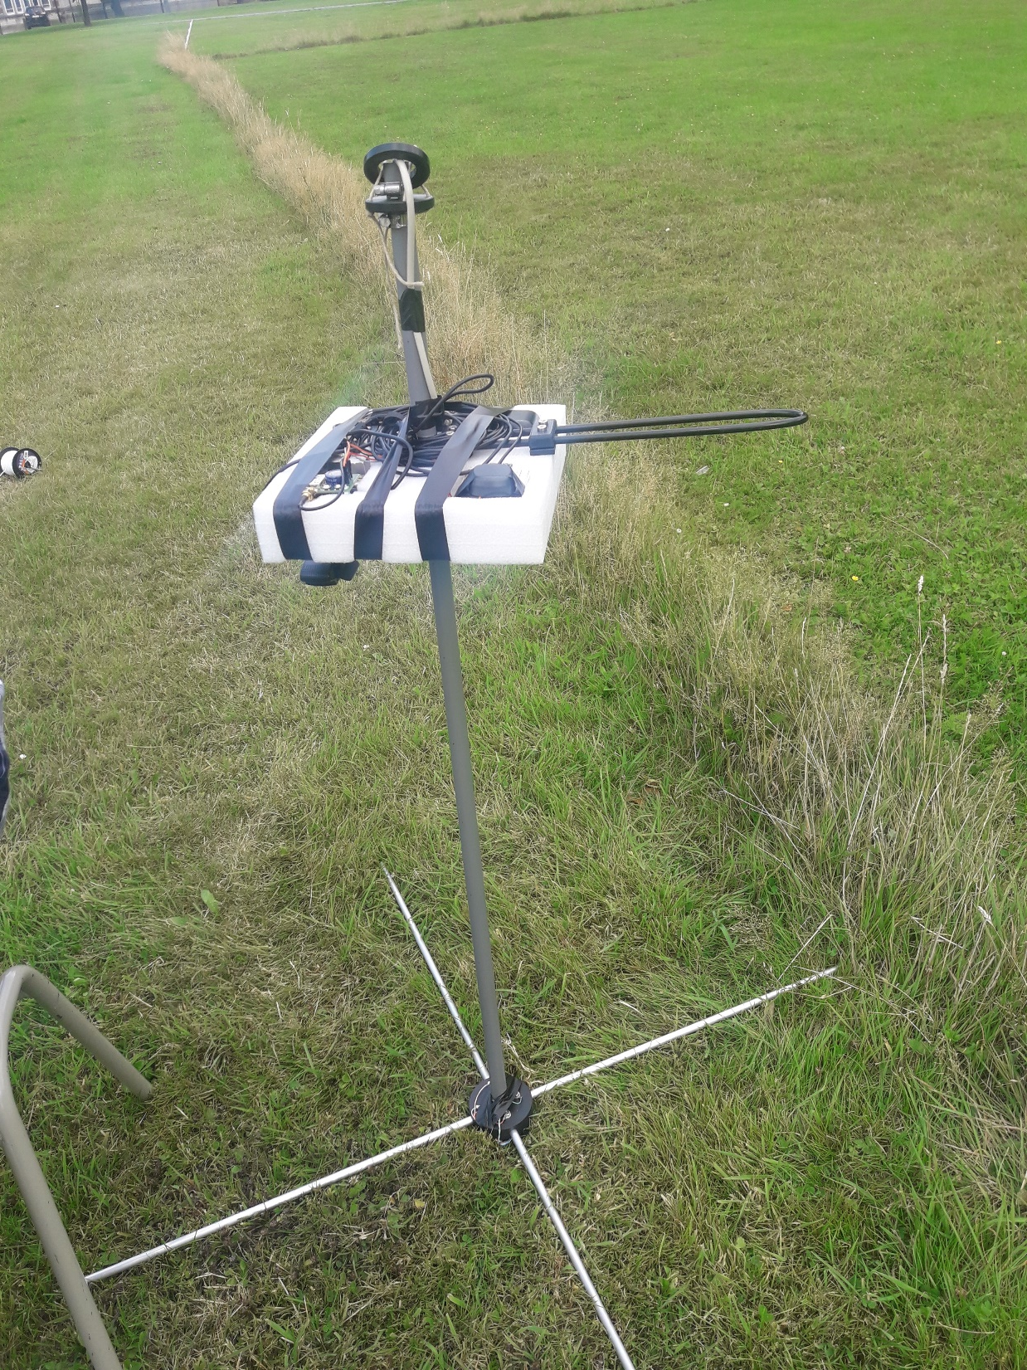
Payload
Crossed dipole antennas to measure both linear polarizations
2 FunCube Dongle Pro+ connected to the 2 antennas
1 Raspberry Pi controlling the 2 FunCube
1 inclinometer & 1 magnetometer to know exactly the orientation of the payload (3 angles along a fixed X, Y and Z Cartesian coordinates)
1 GPS working in differential mode with another GPS left on the ground (allows to achieve an accuracy of ∼ 1 cm for the position)
1 Webcam to take 1 picture per second as a back-up plan in case GPS or inclinometer does not work

Slide 4
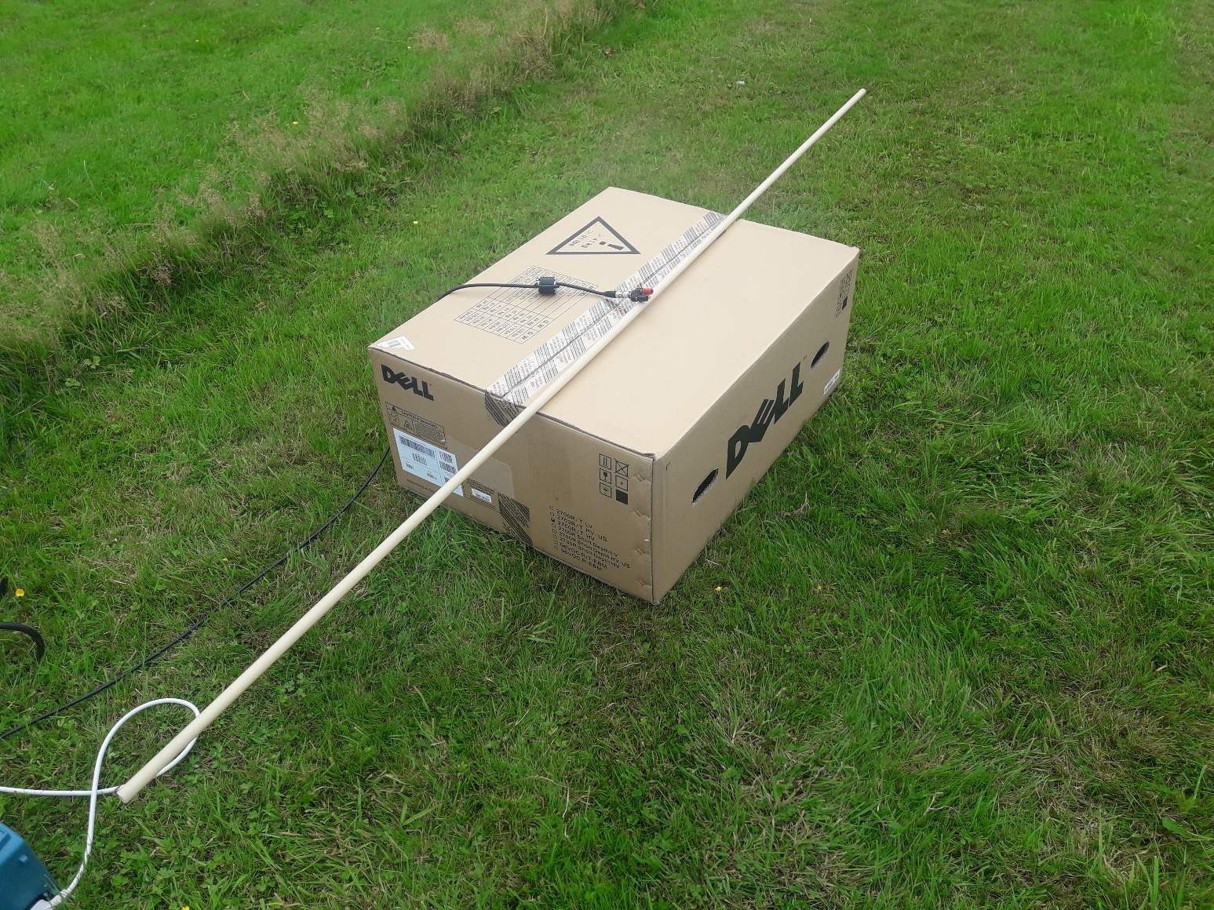
Transmitter for tests

