Slide 1
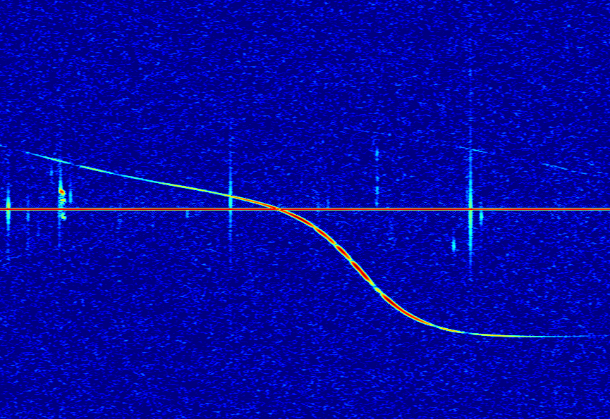

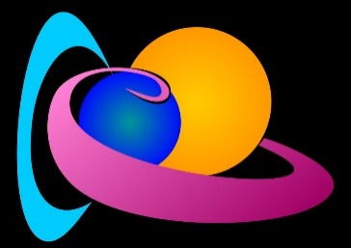
Observability Function of the BRAMS forward scatter network
Lamy H.¹, Verbeeck C.², Balis J.¹; Anciaux M.¹,
Calders S.¹ ; Calegaro A.¹ ; Martínez Picar A.²
¹ Royal Belgian Institute for Space Aeronomy
² Royal Observatory of Belgium

Slide 2
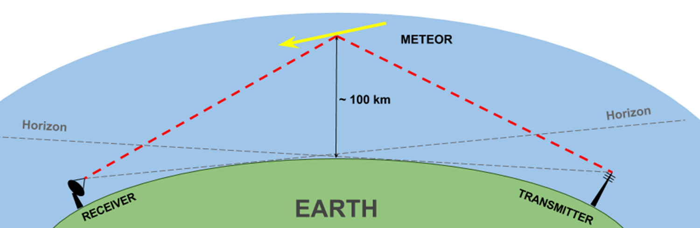
What is Observability Function (OF)?
Forward scatter of radio waves
Raw meteor rates observed during a meteor shower
“Real” activity of the meteor shower
OF

Slide 3
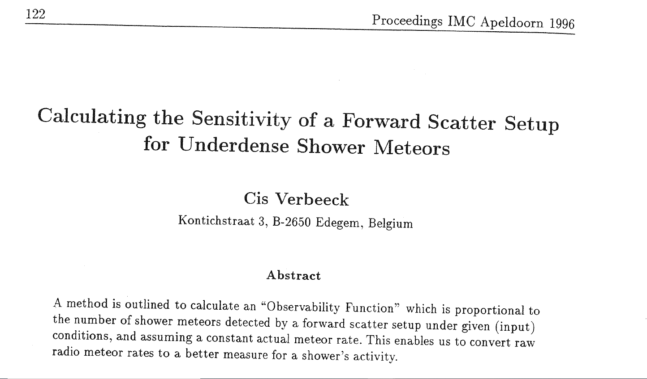
Work mostly based on Verbeeck (1997)

Slide 4
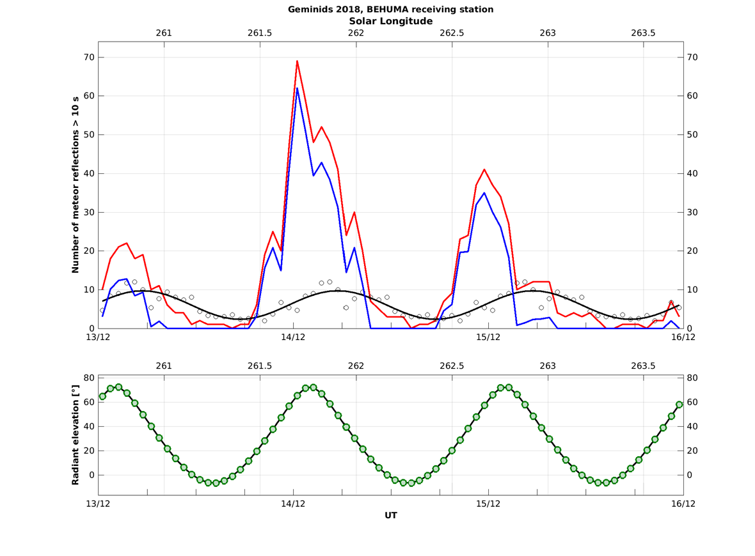
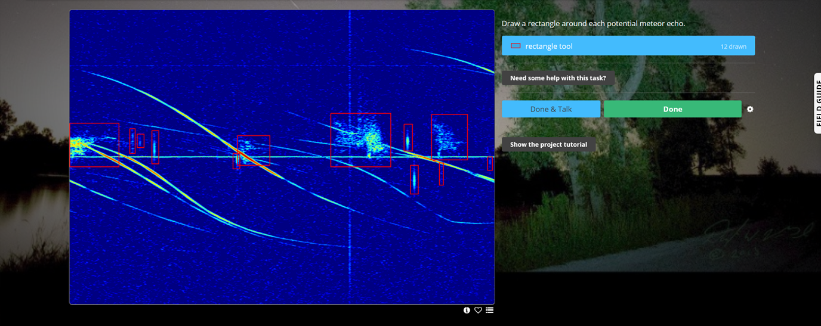

Geminids activity measured with BRAMS data
Radio Meteor Zoo
Data from station in Humain

Slide 5
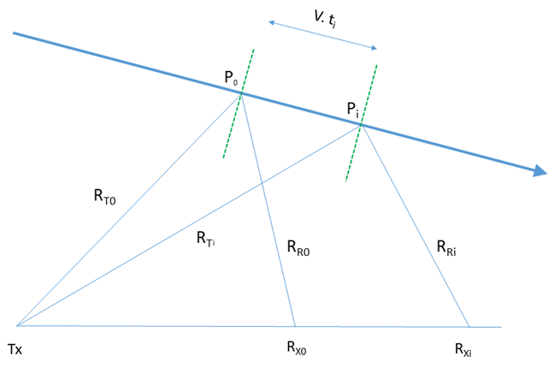
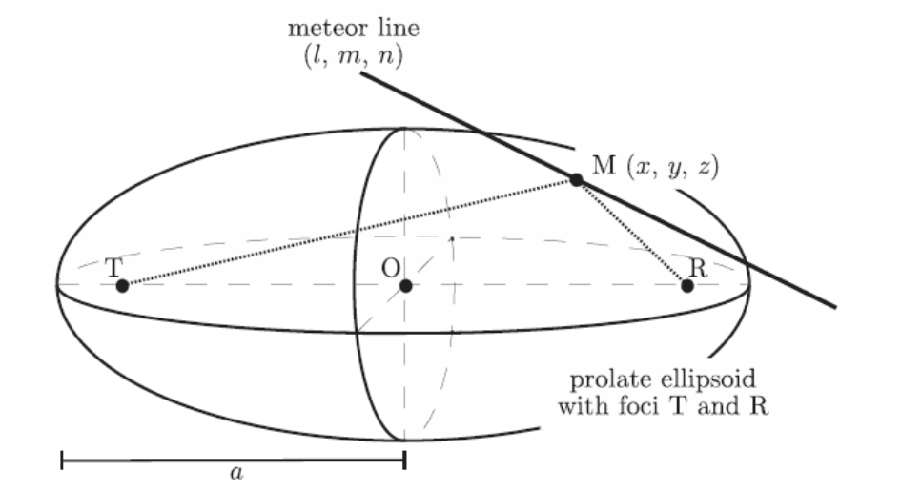
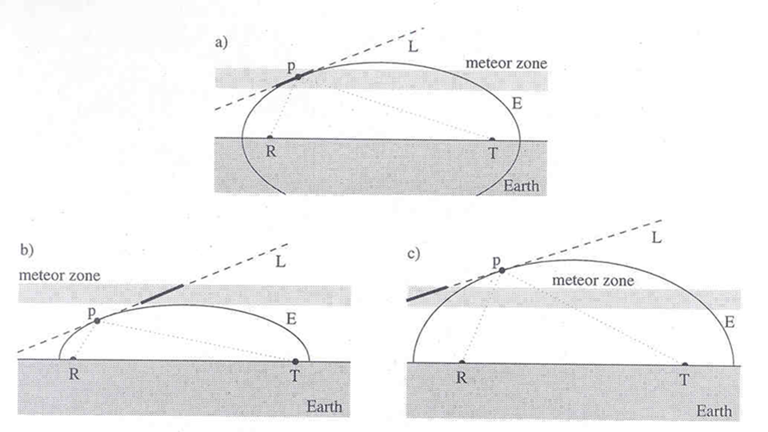
The specularity condition and its consequences
Suleymanova et al. (2008)
Wislez et al. (2005)

Slide 6
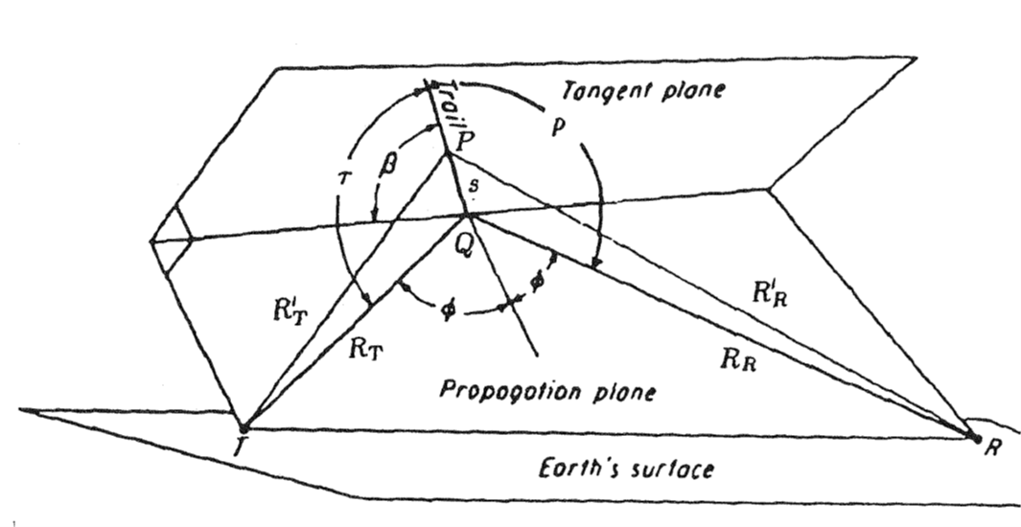
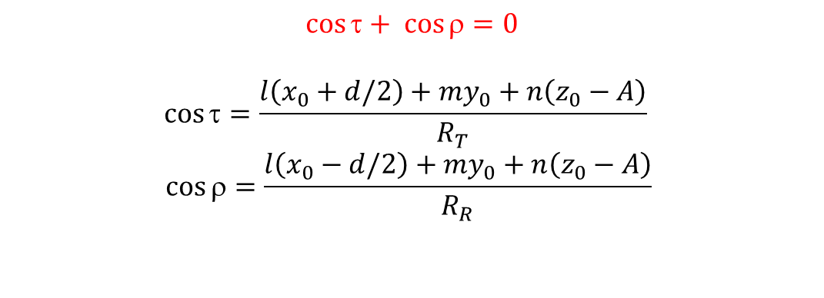
Observability Function (OF) : geometrical part
x₀, y₀, z₀ = coordinates of reflection point
l, m, n = director cosines of the radiant
$$\cos{τ+ \cos{ρ=0}}$$
$$\cos{τ=\frac{l\left(x_{0}+d/2\right)+my_{0}+n\left(z_{0}−A\right)}{R_{T}} }$$
$$\cos{ρ=\frac{l\left(x_{0}−d/2\right)+my_{0}+n\left(z_{0}−A\right)}{R_{R}} }$$
For a given altitude / z₀, we obtain a 6th order polynomial equation between x₀ and y₀

Slide 7
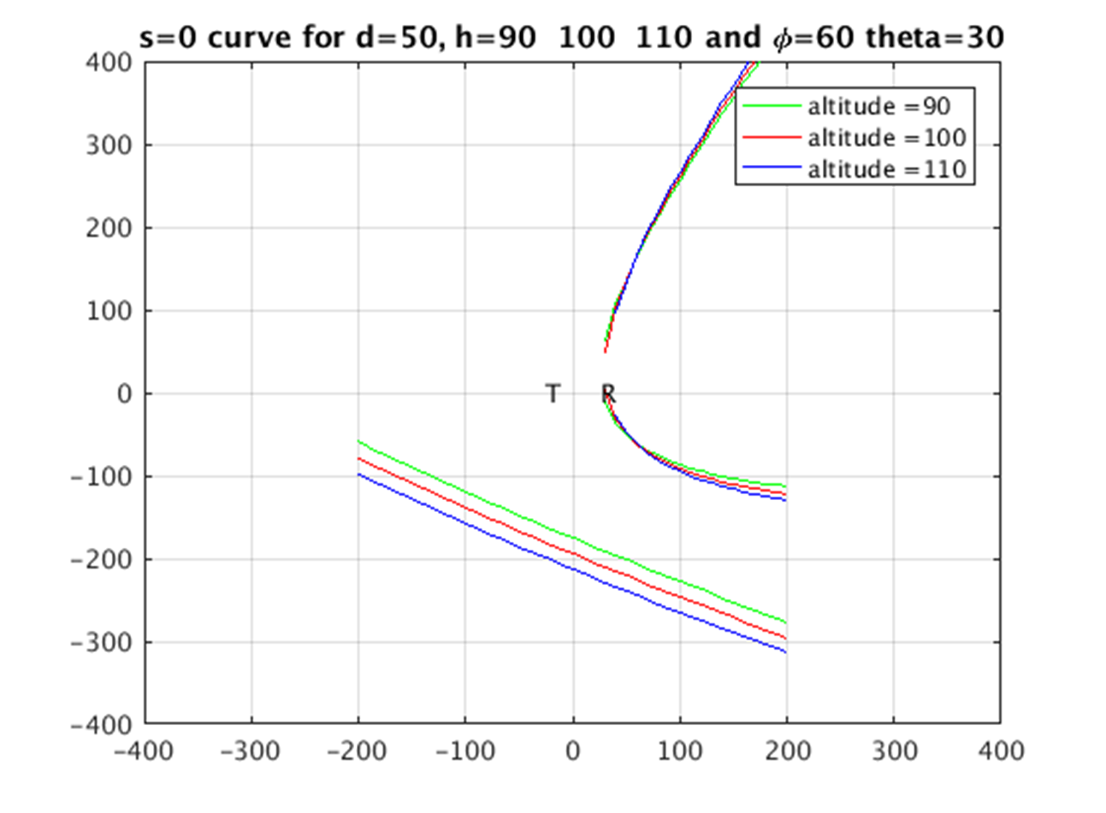
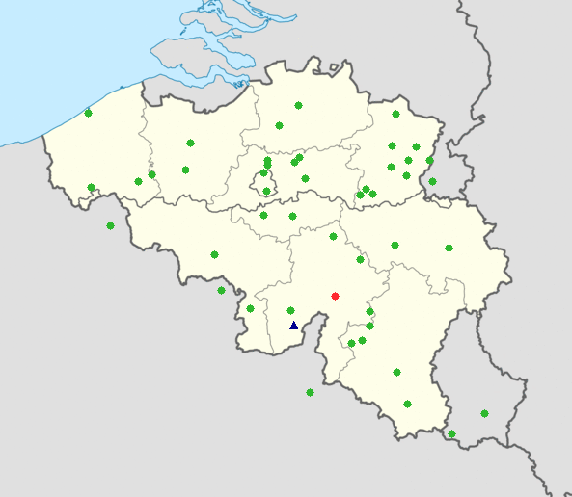
Example of geometrical OF calculated for the BRAMS network
l = sin θ cos φ, m = sin θ sin φ, and n = cos θ.
Integration over altitude with steps of 5 km

Slide 8
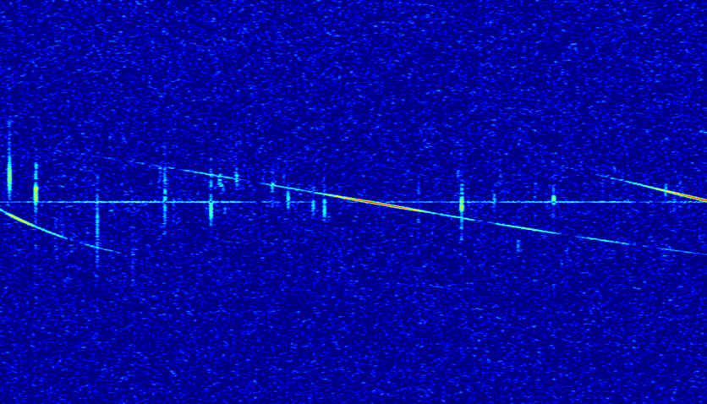
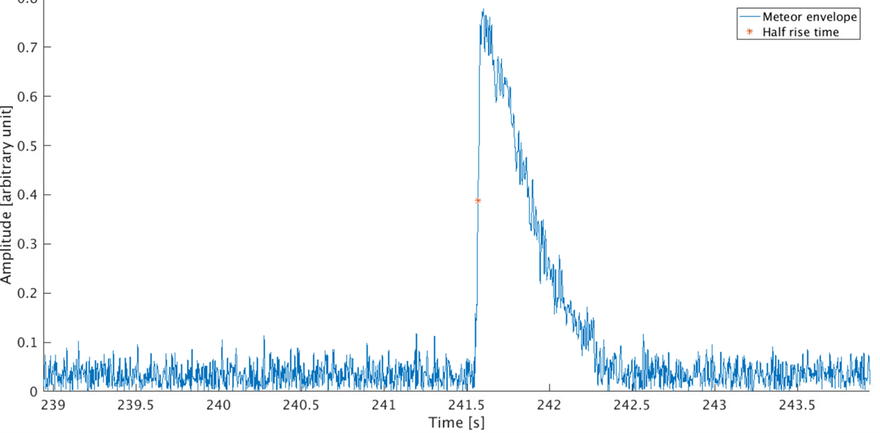
Observability Function : sensitivity part
A_{max}
A₀
Underdense meteor echoes

Slide 9

Observability Function : sensitivity part

Slide 10
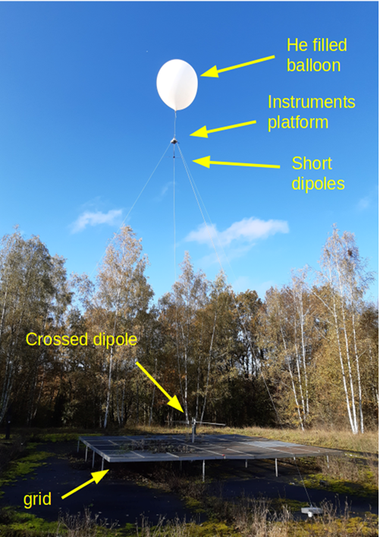
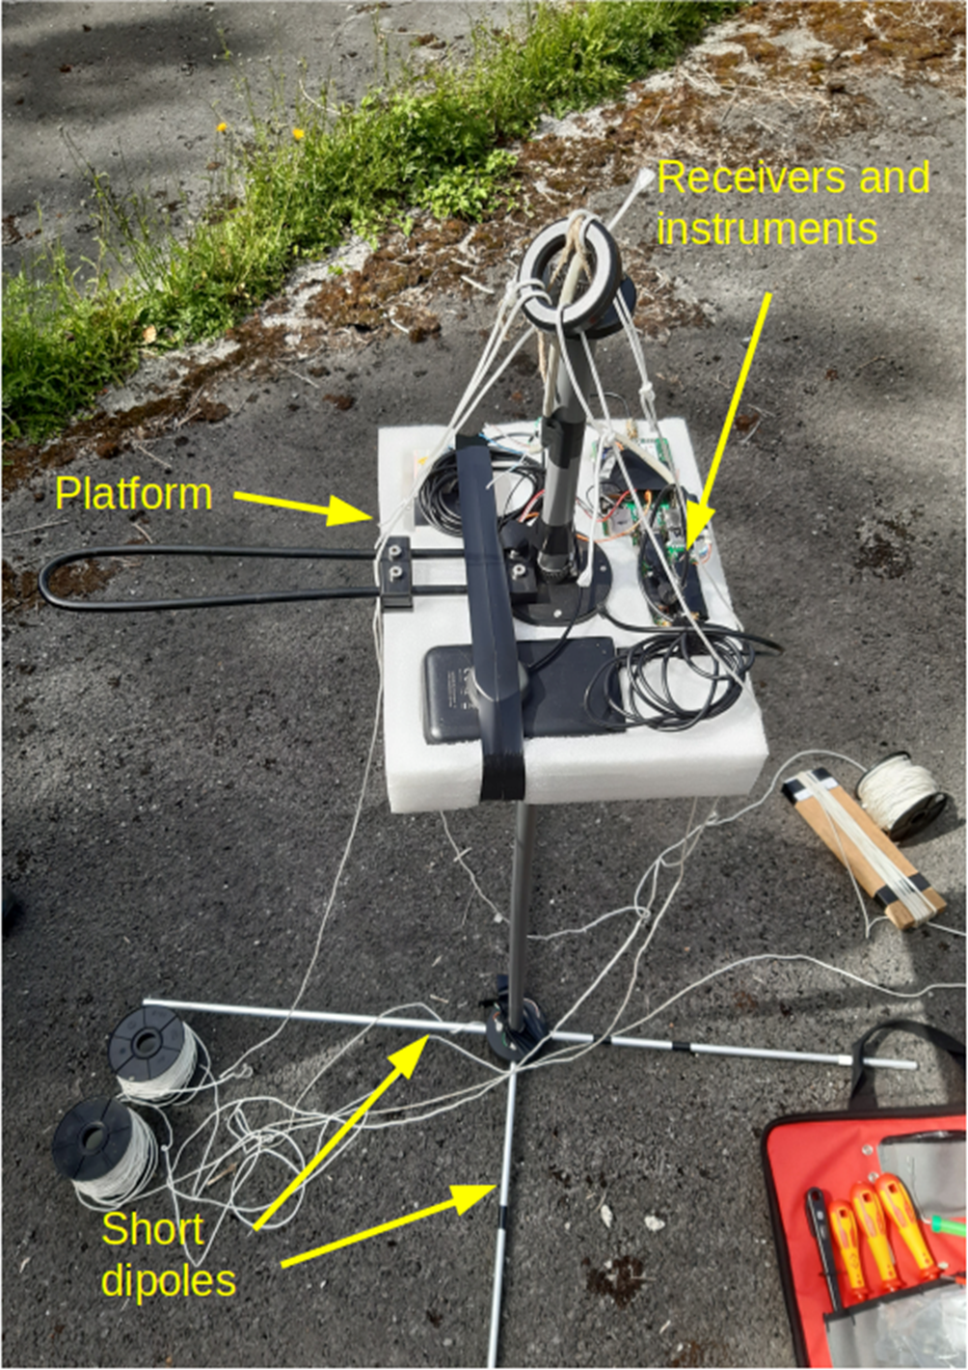
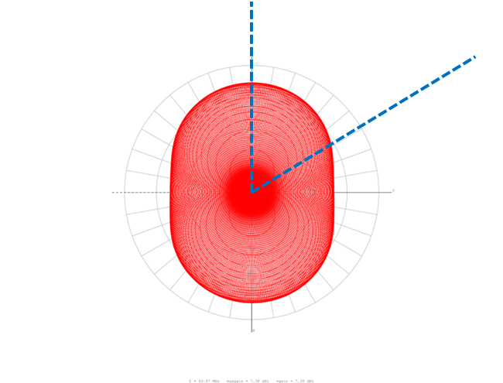
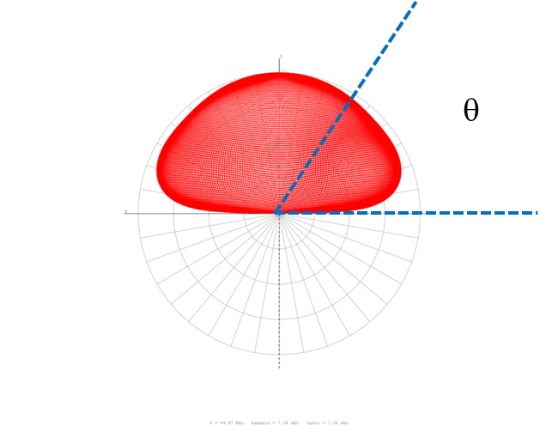
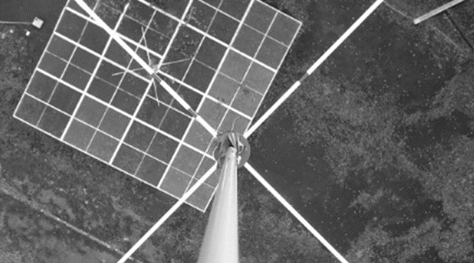
Observability Function : sensitivity part
φ
Receiving antennas
Transmitting antenna

Slide 11
Observability Function : sensitivity part
A_{max} ∼ K . α
K = K(G_{T}, G_{R}, γ, λ, geometrical parameters, r₀)
Min value for the ionization α
Min value for the mass m
Distribution of mass particles inside a meteor shower
N(m > m₀) ∼ m^{1-s}
s can come from previous measurements or be calculated from the CDF of meteor echoes amplitude

Slide 12
Example of Cumulative number of meteors vs amplitude
Blauuw et al. (2011)

Slide 13
Summary and perspectives
We can calculate the OF for a given Tx-Rx pair of the BRAMS network and for a given position of the radiant of a meteor shower.
We would like to produce a polar plot of the OF as was done e.g. by Pavel Zigo for the Lecce-Modra system
Zigo (2008)

Slide 14

Perspectives and limitations
2 stations : BEOUDS and BEHUMA
Several meteor showers analyzed by RMZ users
Different distances, different sensitivities, slightly different geometries
Calculating their OF at a given time and correct their raw data should provide two values which are consistent with each other
The sensitivity part assumes underdense meteor echoes while a non-negligible part of meteor echoes during meteor showers are intermediate or overdense …
Other formulas?

