Slide 1
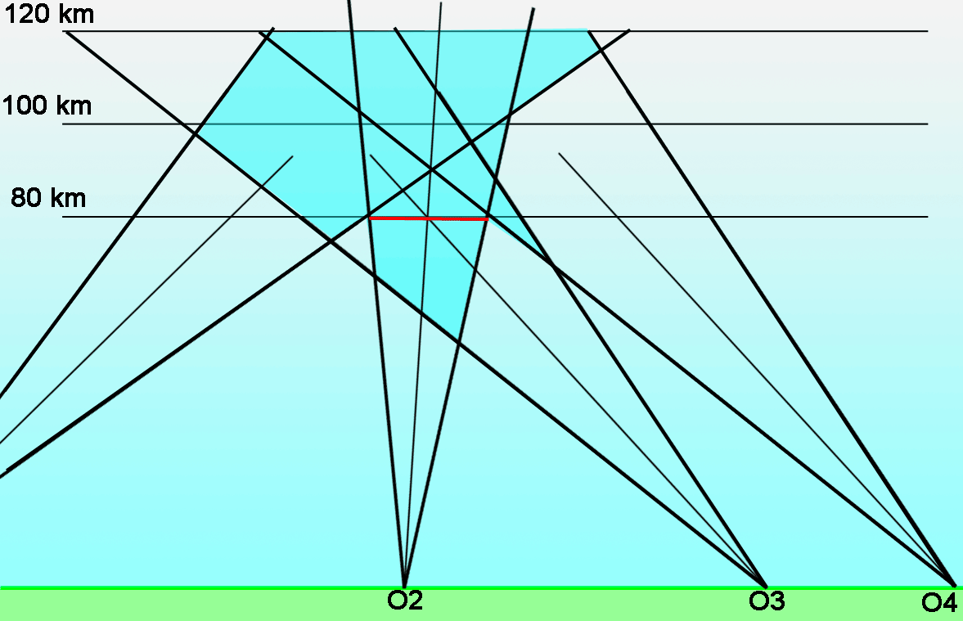
Status April 2023 CAMS & GMN
The purpose is to register meteors in the brightness range -5 to +5 at 80 - 120 km height from different sites for triangulations to obtain trajectories, velocities, and orbits

Slide 2
Status April 2023 CAMS & GMN
The aim is to obtain accurate trajectories, radiants, velocities and orbits to study meteor shower structures, outbursts and detect new showers
To determine the meteor flux rates for impact risk assessment
Determination of radiant and velocity is crucial for shower identification. Without these data identification is pure a guess therefore multi station meteor registration is required
Single station meteor recording is of little or no use
The CAMS and GMN data offer a unique opportunity to compare BRAMS data as the timing and positions are known

Slide 3
Status April 2023 CAMS & GMN
Main video camera networks in the world:
CMN Croatian Meteor Network from 2006
EDMOND (amateur) 2001-2016 ~300 cameras all over Europe
GMN Global Meteor Network (amateur) from 2018 ~700 cameras, 334668 orbits in 2022
SonotaCo (amateur) from 2007 ~150 cameras covering Japan 48788 orbits in 2022
CAMS (professional ~500 cameras) from 2010:
Arizona (106596), Arkansas (18972), California (52130), Florida (26454), Maryland (2384), Texas (19063)
Australia (38114), BeNeLux (61619), Brazil (105), Chile (49051), Namibia (81197), New Zealand (16856), South Africa (7867), Turkey (1605) and U.A.E (32597)
All-sky camera networks specific for fireballs and meteorite droppers (EN, FRIPON, etc.)

Slide 4
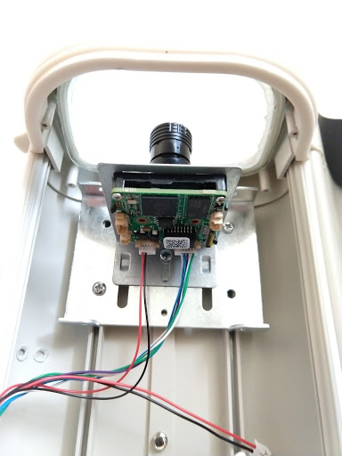
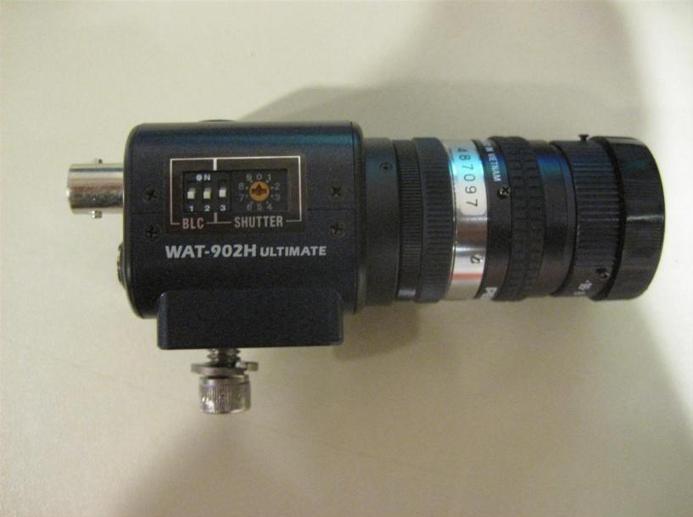
Status April 2023 CAMS & GMN
2019: Game changing RMS camera of the Global Meteor Network
CAMS system ~650 € + PC required
Hardware is now difficult to find, Sony
stopped producing the Watec sensors
RMS system ~200 € all-in, home built

Slide 5
Status April 2023 CAMS & GMN
Comparing old and new system
CAMS Watec H2 Ultimate ~650€ + PC desktop required 20 year old technology Last Watecs were bought in 2019 Technical support: on our own Software = black box Many false detections Poor calibration and astrometry Trajectory solver validation problem Many hyperbolic orbits NASA data embargo | RMS (Raspberry Pi Meteor Station) ~200€ (components) or 520€ plug&play IP cameras IMX291, IMX307 + RPi4B First RMS bought end 2018 Large community, lot of mutual support Software open source Few false detections (Machine Learning) Calibration and astronomy solved Trajectory solver rejects all error sources Few hyperbolic orbits Data free available within 24/48 hours

Slide 6
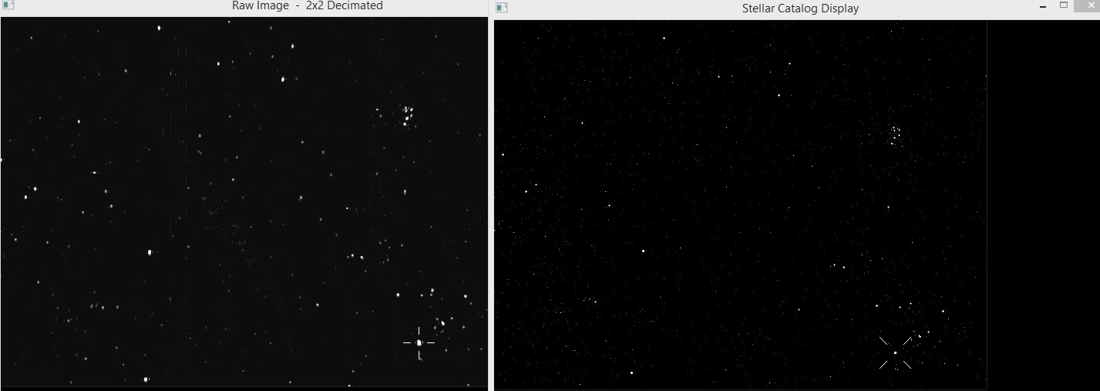
Status April 2023 CAMS & GMN
CAMS Astrometry and calibration
CAMS uses single calibration per night assuming the plate center moves ~1’ or 2’
CAMS matches unsuitable stars and grey pixels, no way to check
Watecs produce often poor images with too few stars, difficult to calibrate

Slide 7
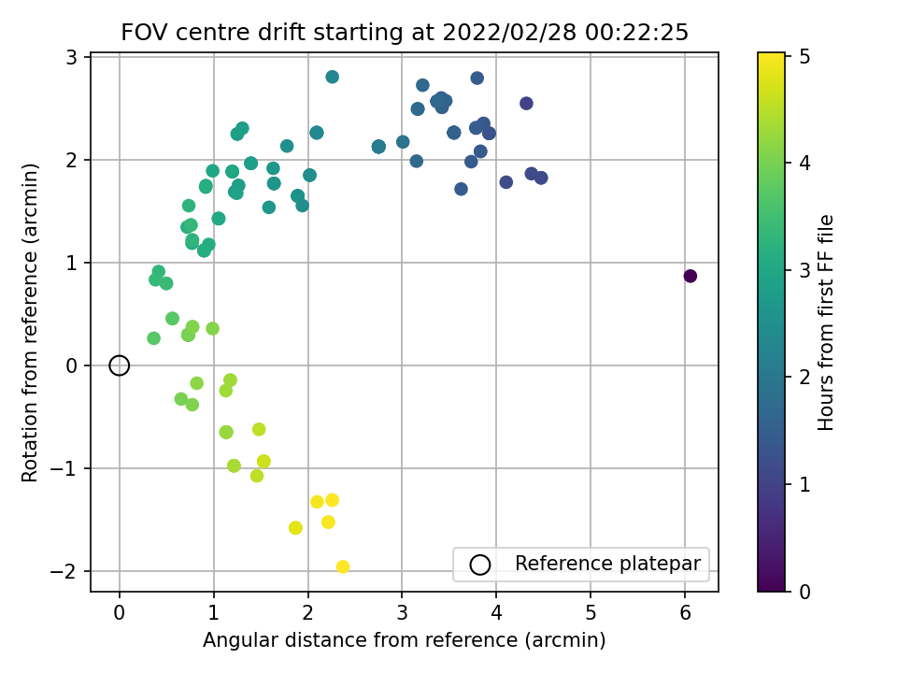
Status April 2023 CAMS & GMN
The plate centers ‘dance’ up to 15’ around the reference point

Slide 8
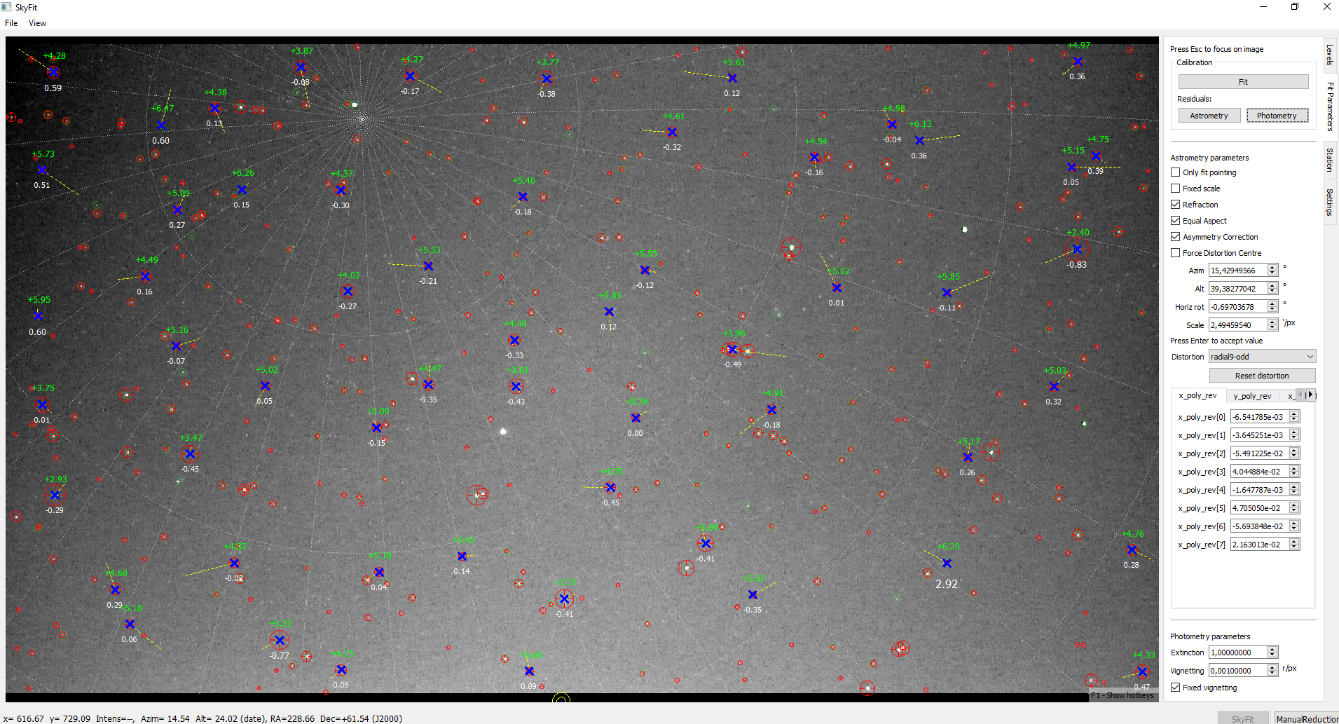
Status April 2023 CAMS & GMN
RMS calibrates each detection and uses higher order fits to better correct distortion
SkyFit2 allows to zoom in, check suitability of stars and visualize the residuals

Slide 9
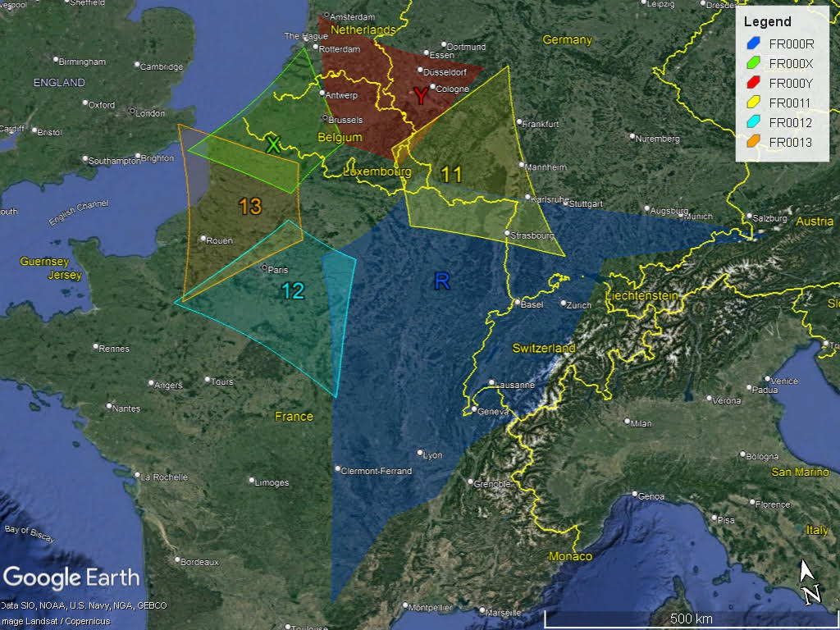
Status April 2023 CAMS & GMN
New RMS observatory at Hagnicourt, France (Pierre-Yves Péchart)

Slide 10
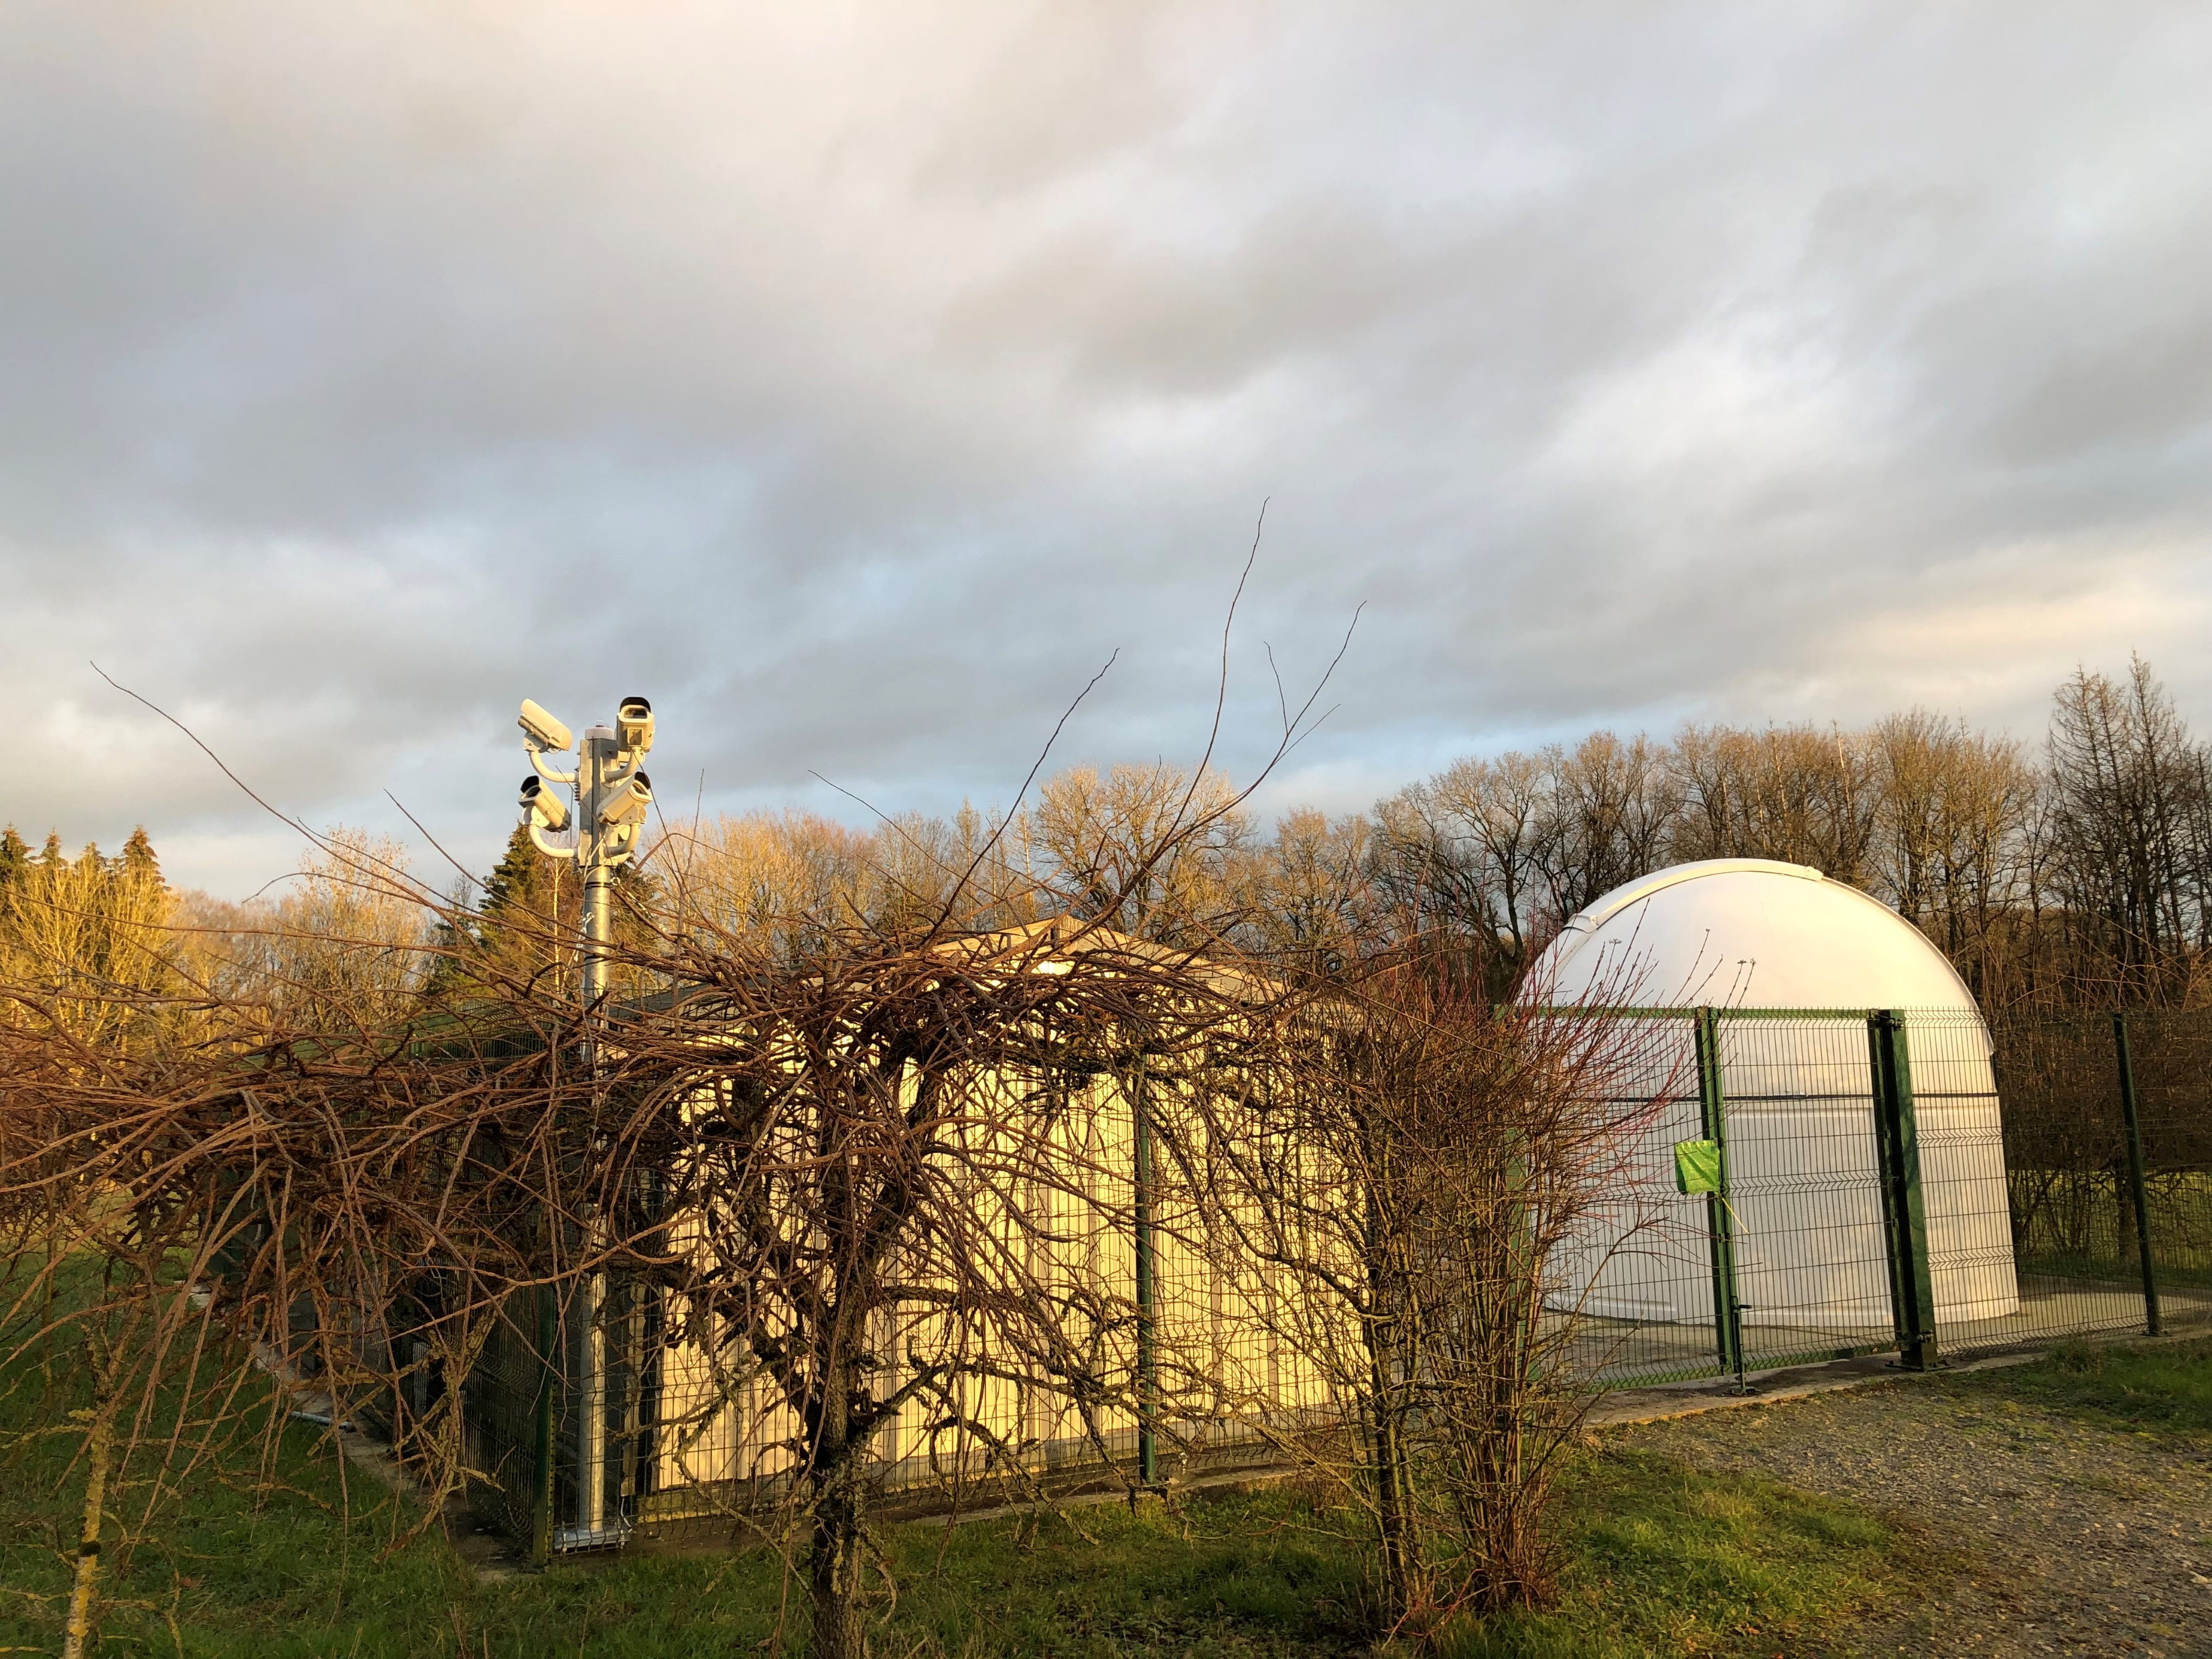
Status April 2023 CAMS & GMN
Observatoire Omega, Hagnicourt – France (Pierre-Yves Péchart)

Slide 11
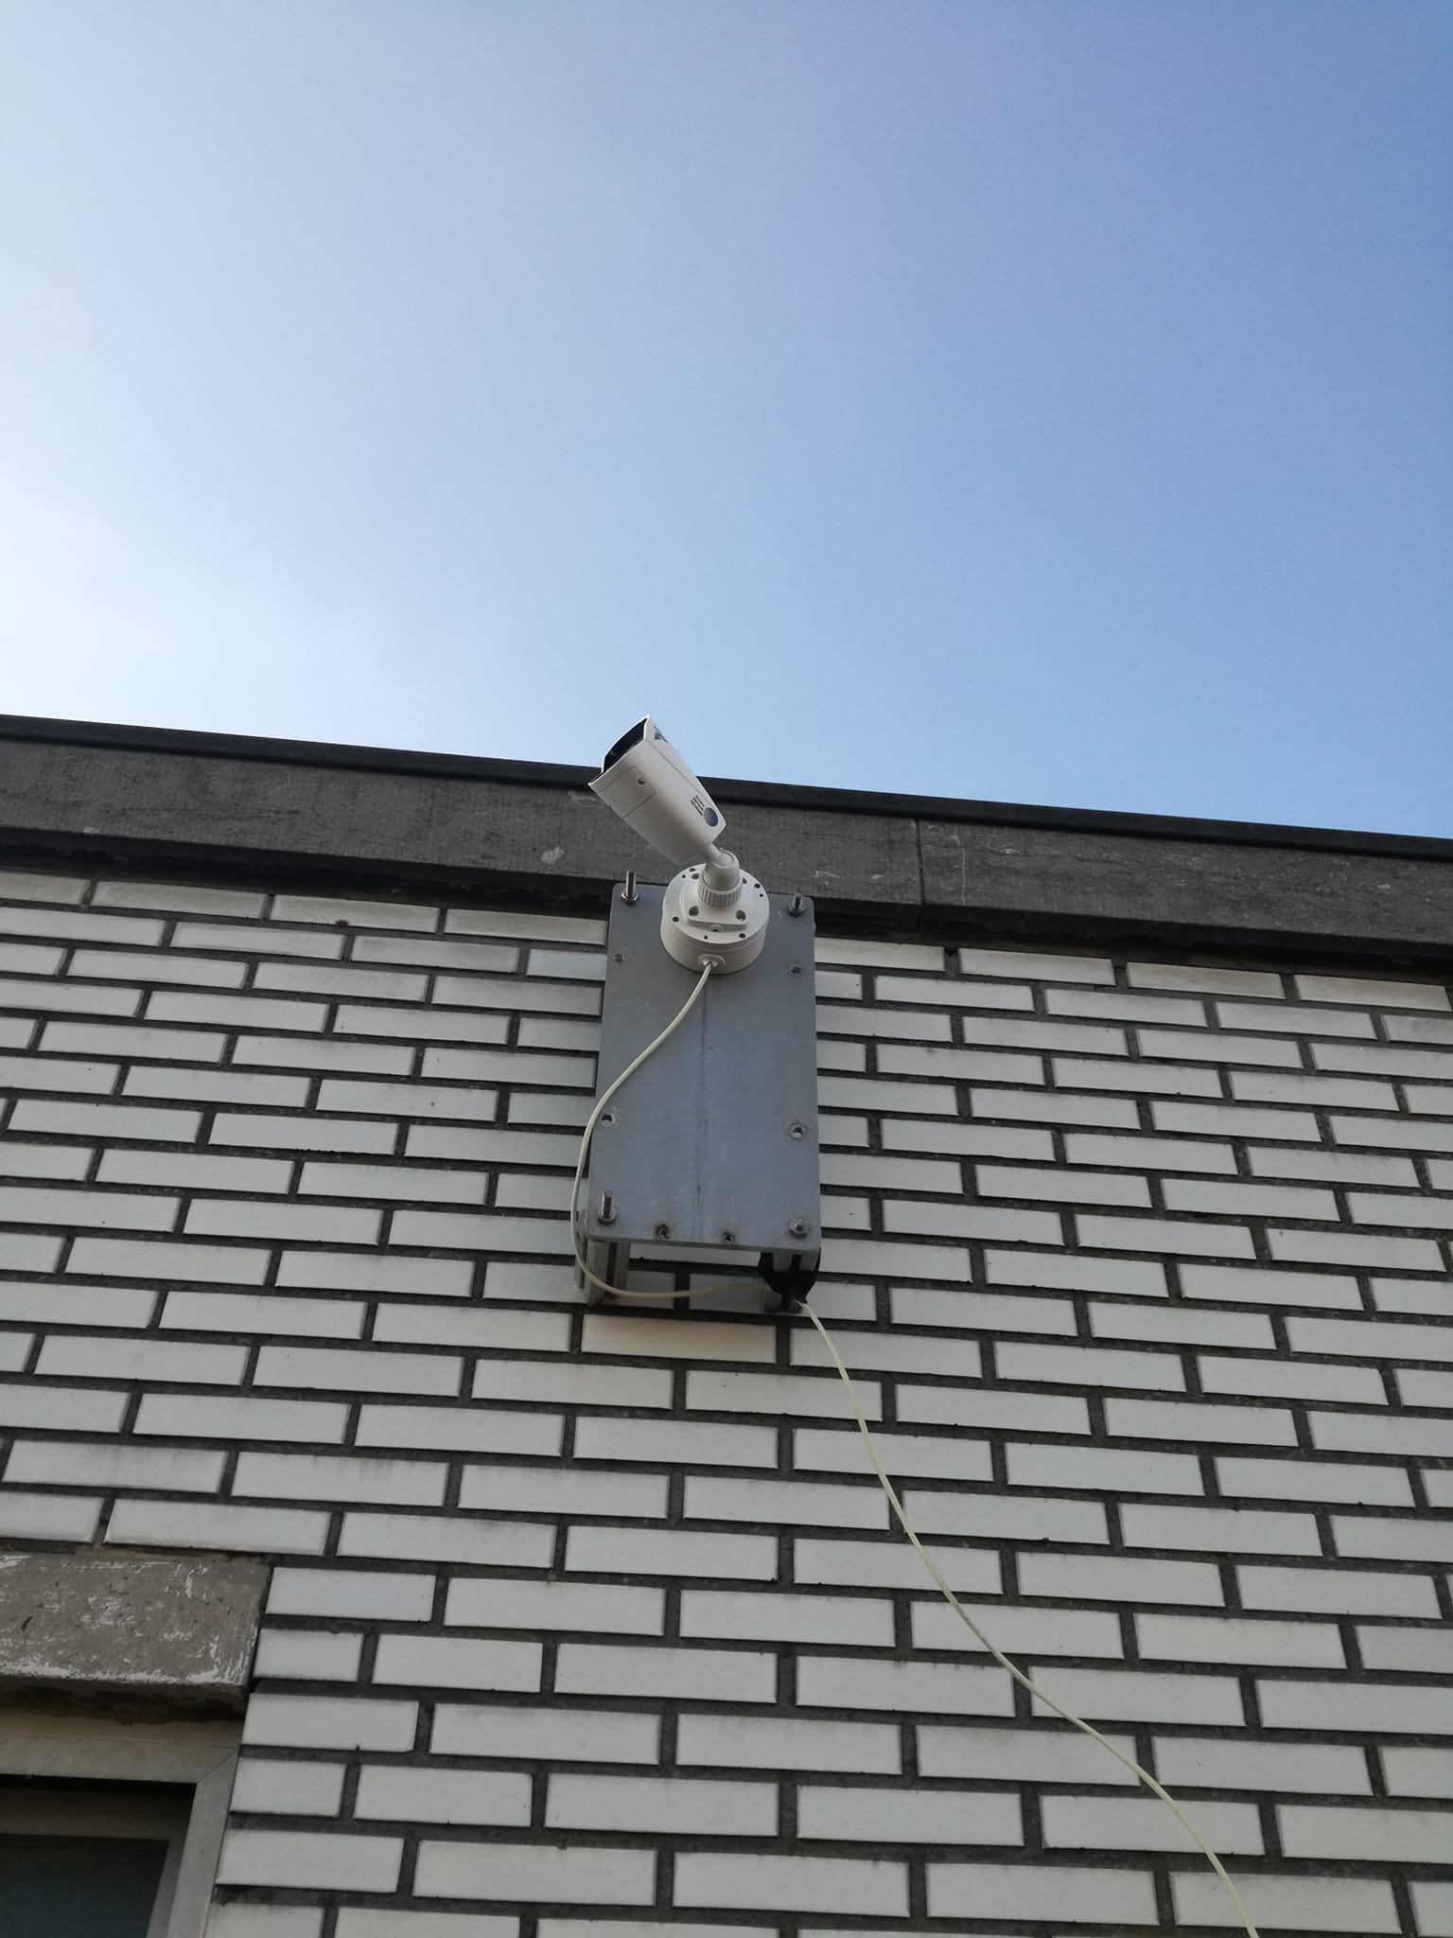
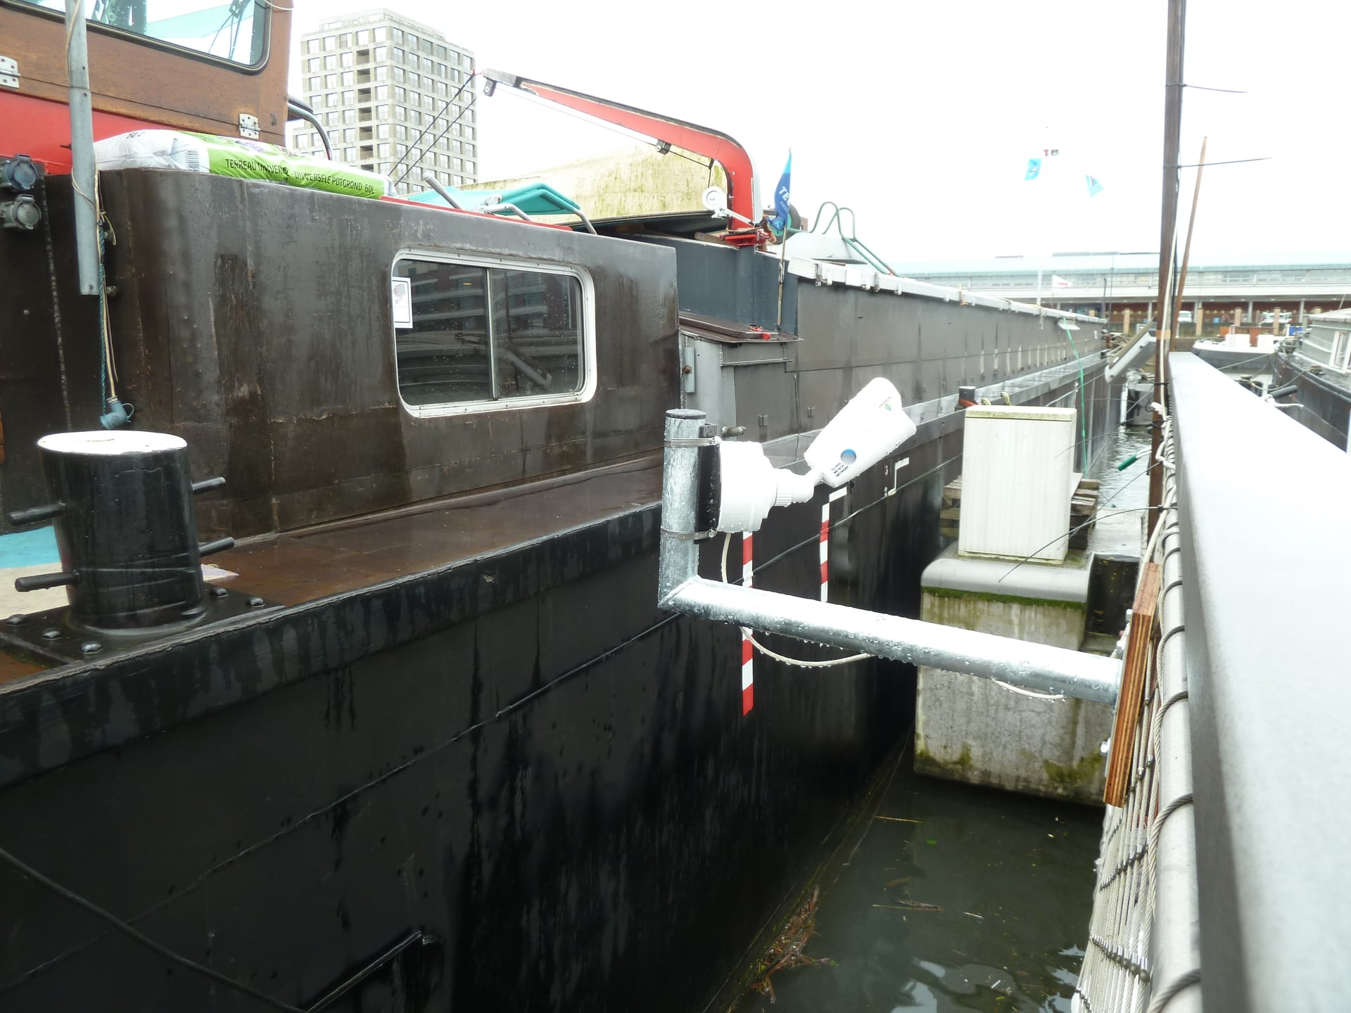
Status April 2023 CAMS & GMN
RMS BE000K on RU Gent (Tim Polfliet)
RMS BE000A, Gent (Tim Polfliet)

Slide 12
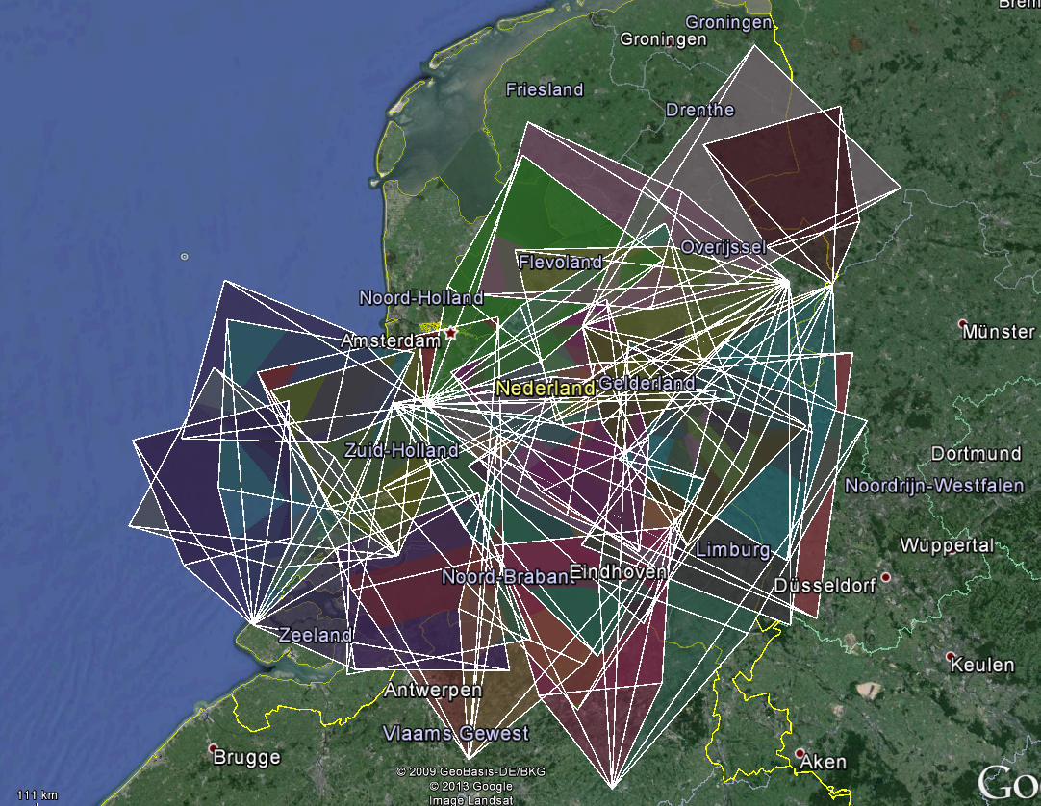
Status April 2023 CAMS & GMN
CAMS BeNeLux camera fields begin 2014 at first presentation for BRAMS
~30 cameras at 12 sites

Slide 13
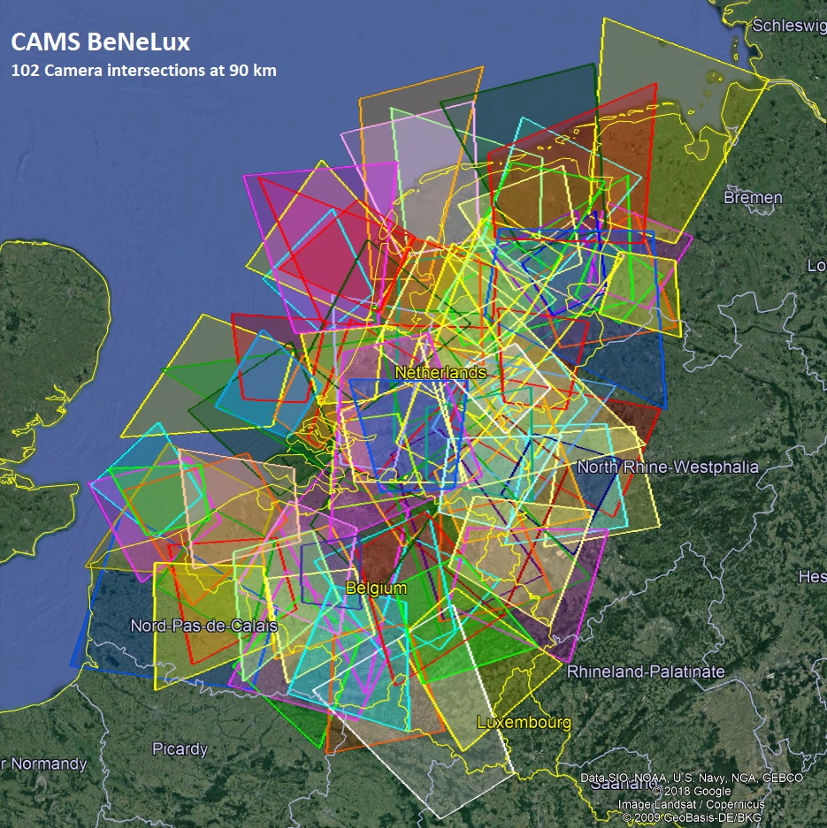
Status April 2023 CAMS & GMN
End 2018, 102 Watec cameras at 21 sites (70 Watecs left beginning 2023)

Slide 14
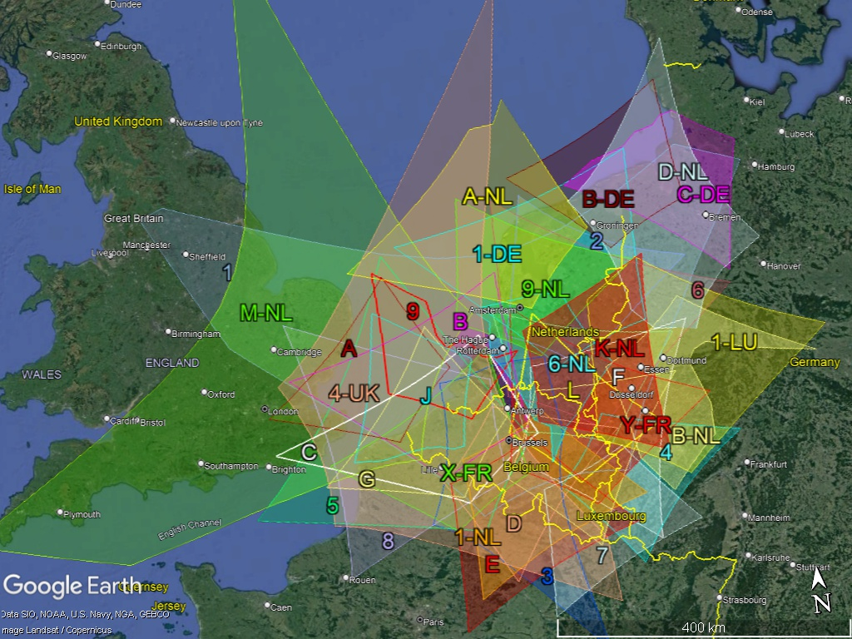
Status April 2023 CAMS & GMN
The RMS camera fields (41) participating in CAMS BeNeLux (2023)

Slide 15
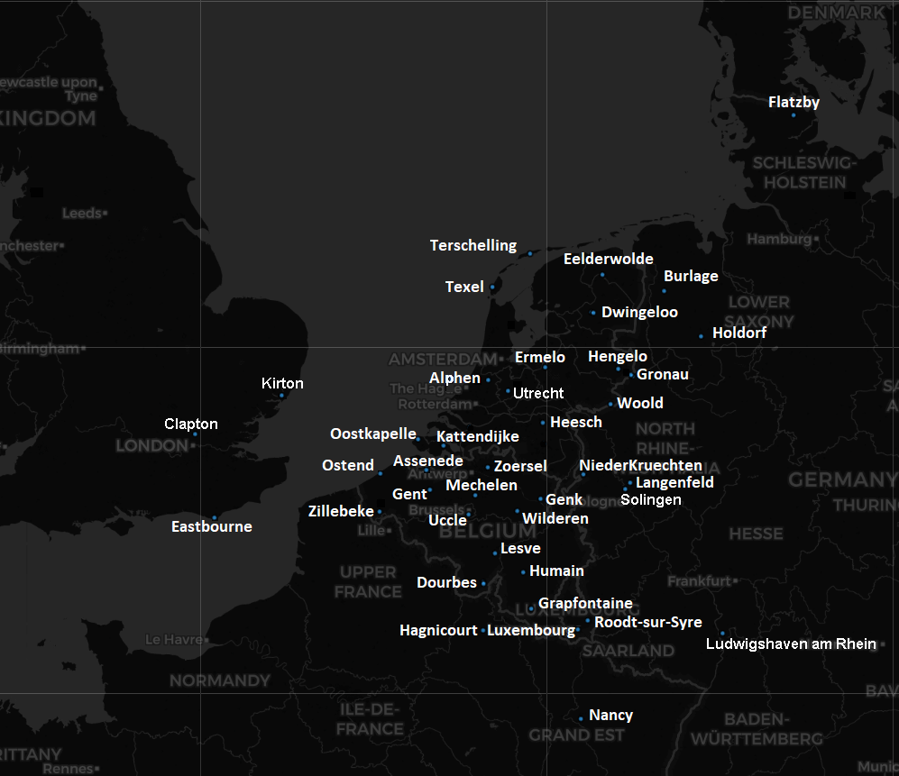
Status April 2023 CAMS & GMN
CAMS-BeNeLux April 2023
40 camera stations:
13 in Belgium
12 in the Netherlands
8 in Germany
3 in the UK
2 in France
2 in Luxembourg

Slide 16
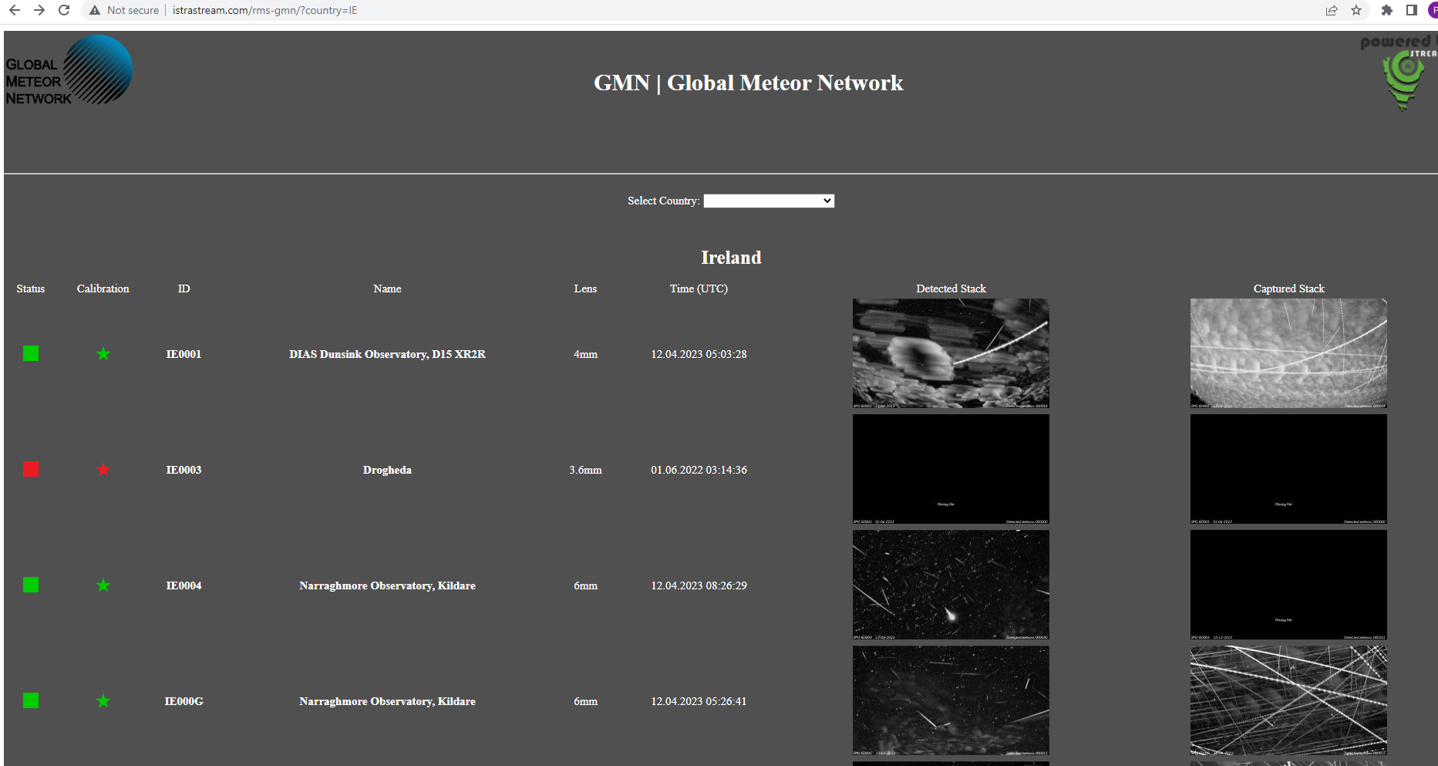
Status April 2023 CAMS & GMN
After each night a detailed report is available for each RMS camera at
http://istrastream.com/rms-gmn/

Slide 17
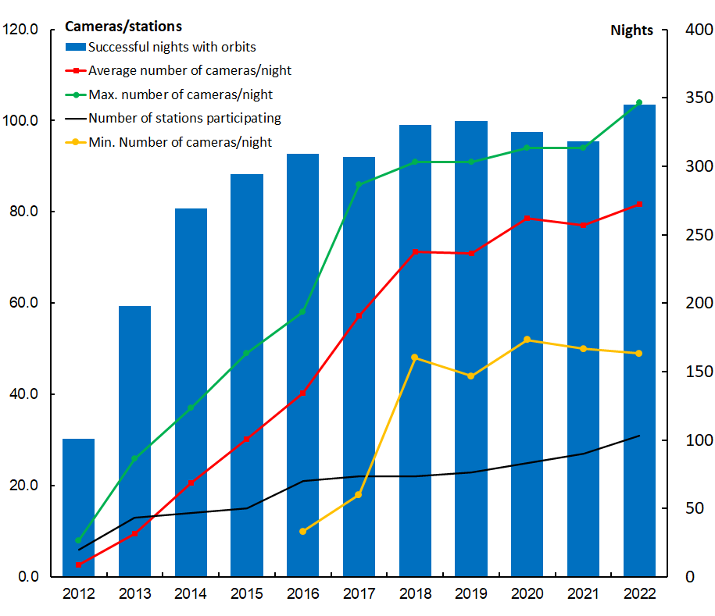
Status April 2023 CAMS & GMN
CAMS-BeNeLux

Slide 18
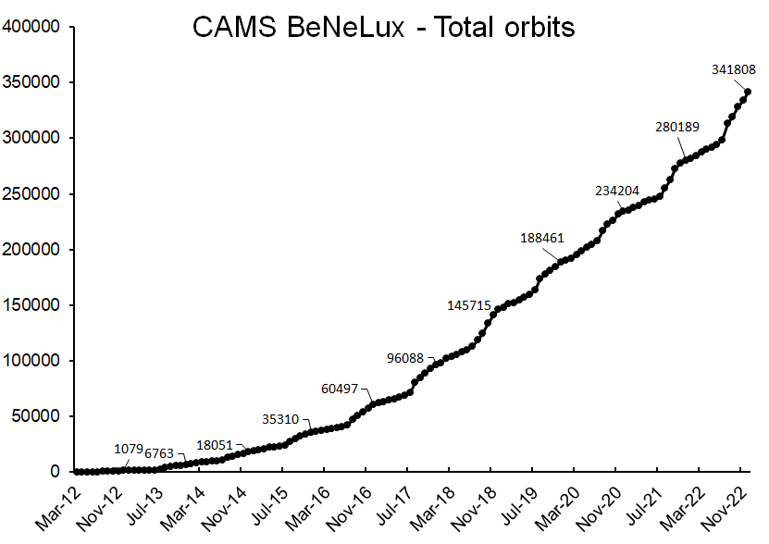
Status April 2023 CAMS & GMN

Slide 19
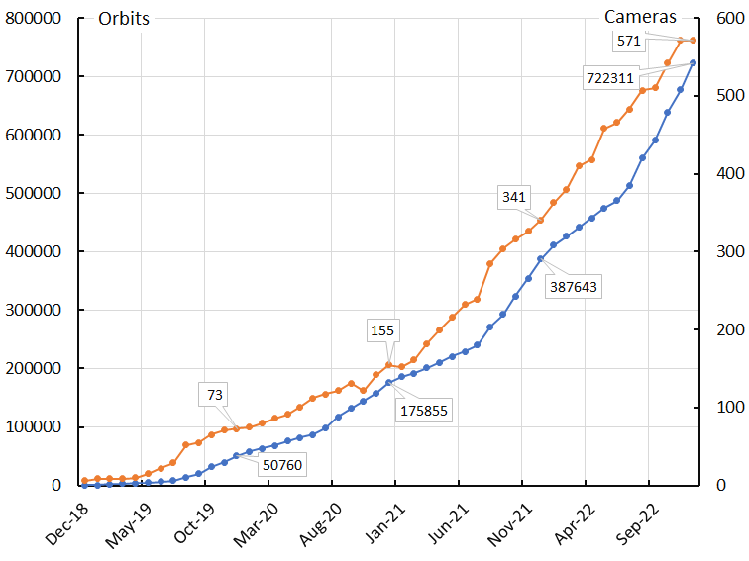
Status April 2023 CAMS & GMN
Global Meteor Network

Slide 20
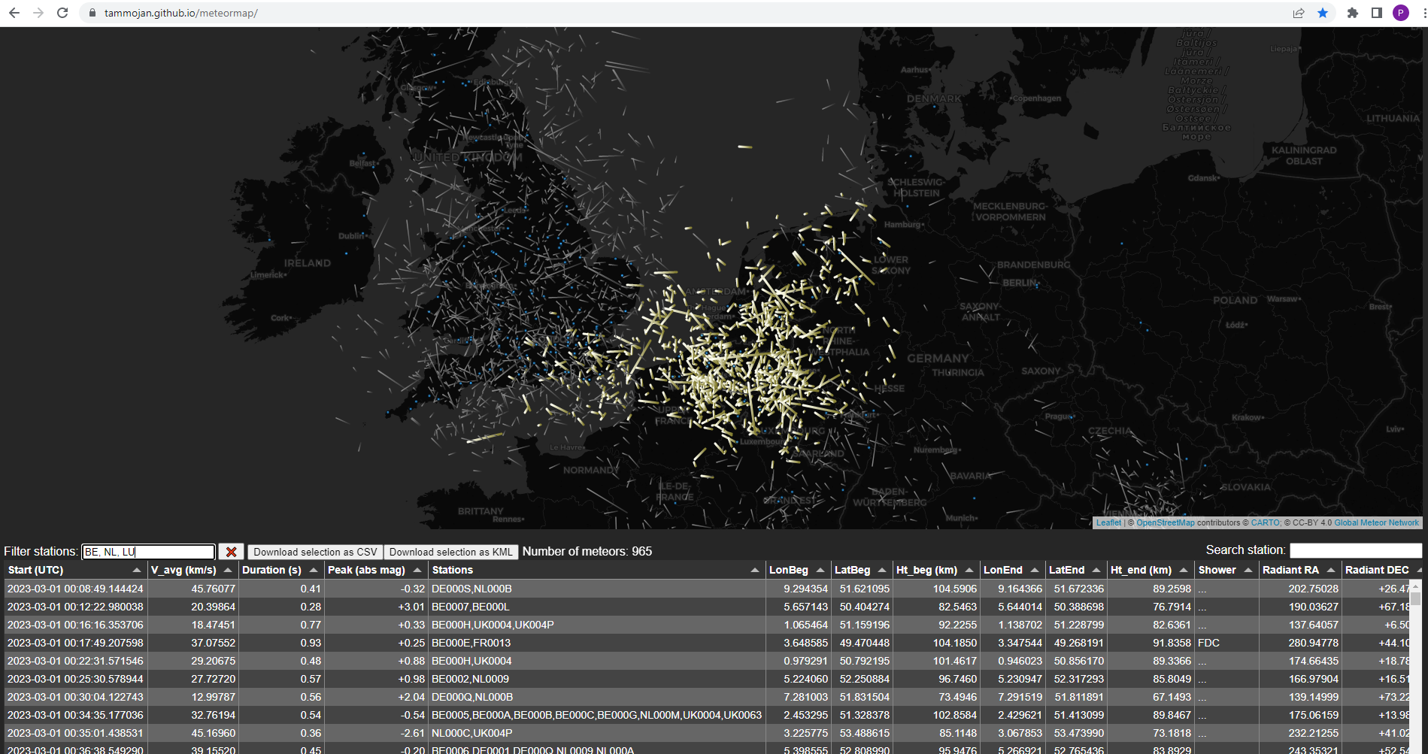
Status April 2023 CAMS & GMN
Meteor Map displays all trajectories : https://tammojan.github.io/meteormap/

Slide 21
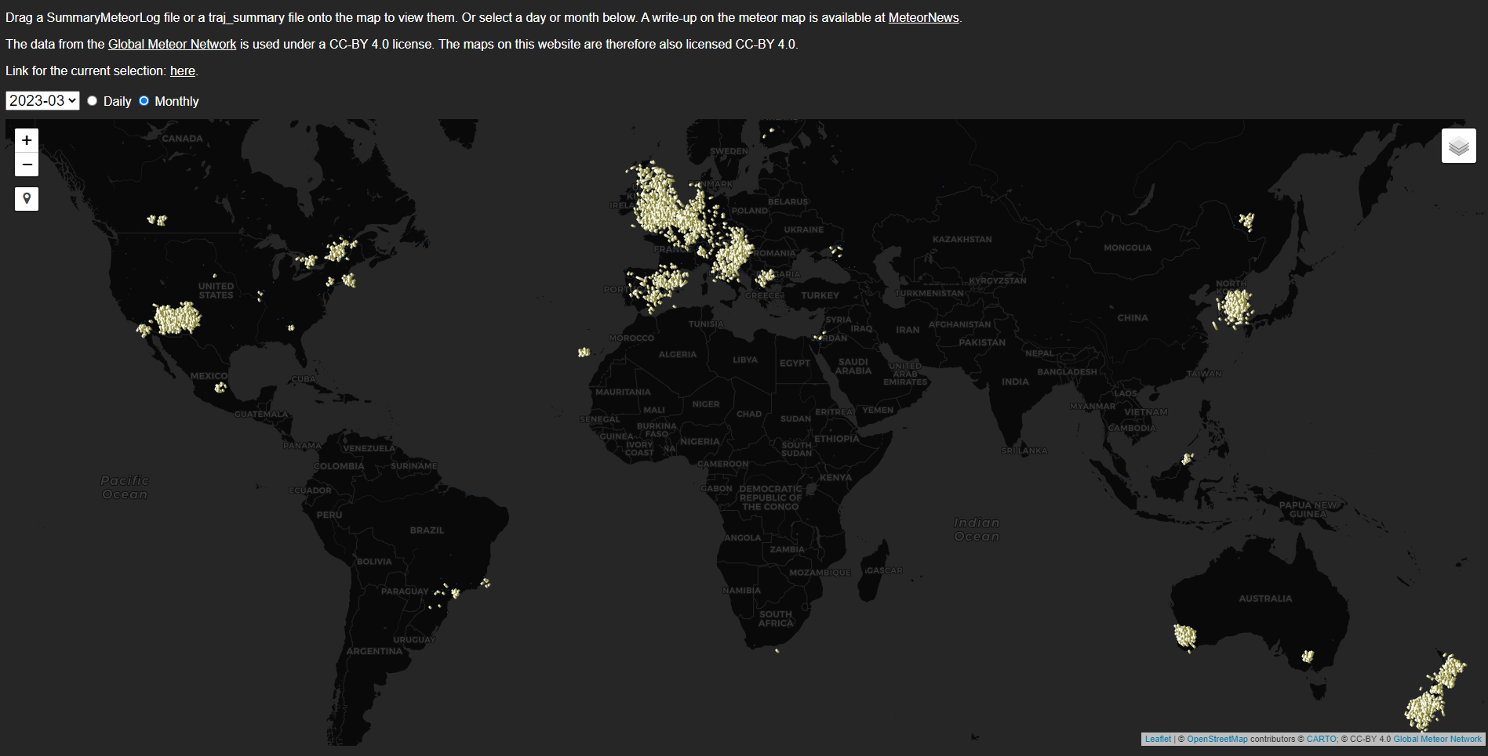
Status April 2023 CAMS & GMN
Meteor Map for the Global Meteor Network (March 2023)

Slide 22
Status April 2023 CAMS & GMN
Total harvest in orbits:
CAMS (since 2010) : ~2,500,000 orbits
of which 341,808 contributed by CAMS-BeNeLux
Global Meteor Network: (since 2018): 722,311 orbits
SonotaCo Japan (2007-2022): 443,196 orbits
EDMOND (2001-2016): 317,380 orbits
So far, ~4 million orbits are available by these networks

Slide 23
Status April 2023 CAMS & GMN
Conclusions
Major progress is the introduction of RMS systems
RMS provides data in 3 formats: GMN, CAMS and UFOCapture
Gradually phasing out Watecs and installing more RMS
Data feed to two projects CAMS and Global Meteor Network
If CAMS quit, Global Meteor Network will continue

Slide 24
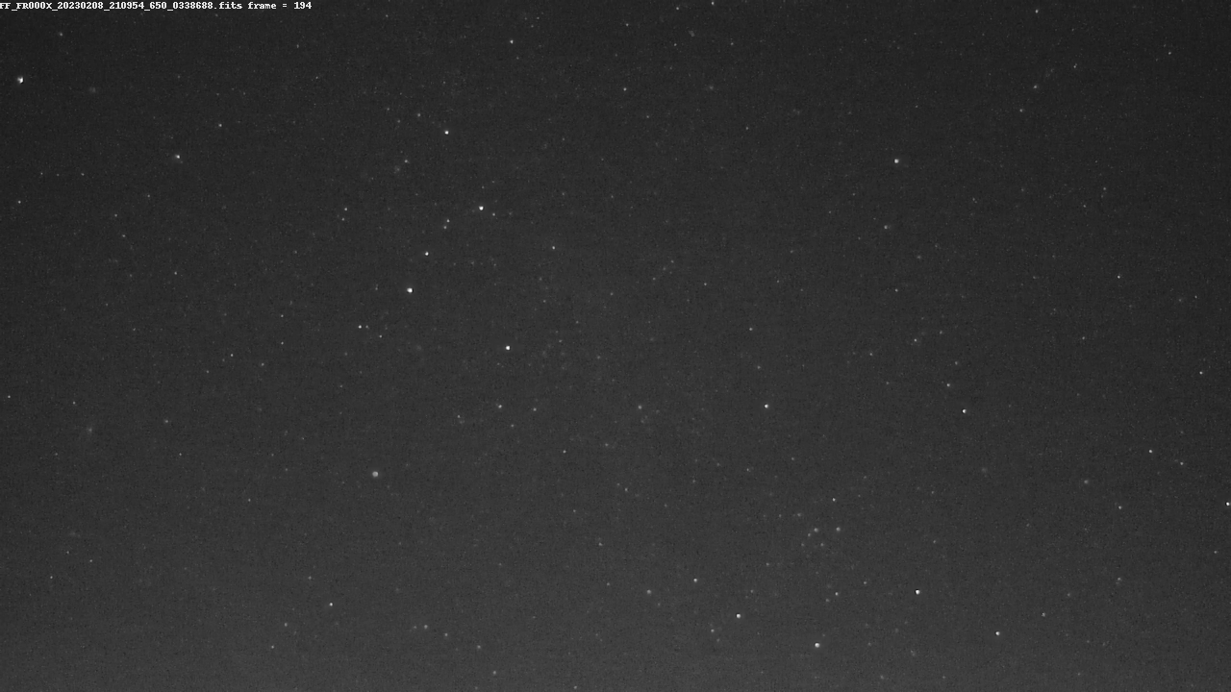
Status April 2023 CAMS & GMN
Thank you for your attention
Any questions?

