Slide 1
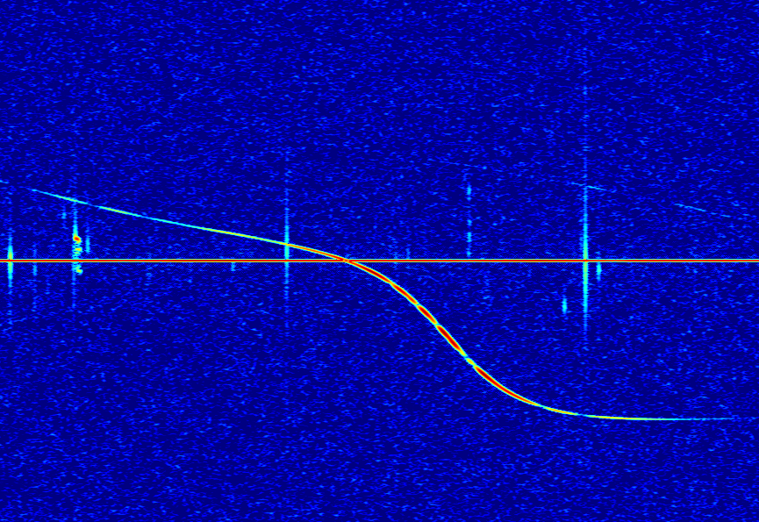
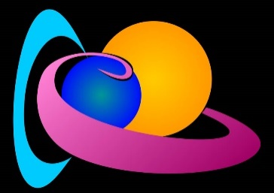
Reconstructing meteoroid trajectories using simulated data
Joachim Balis
Supervisors:
Hervé Lamy (Royal Belgian Institute for Space Aeronomy)
Emmanuel Jehin (Origins in Cosmology and Astrophysics, ULiège)

Slide 2
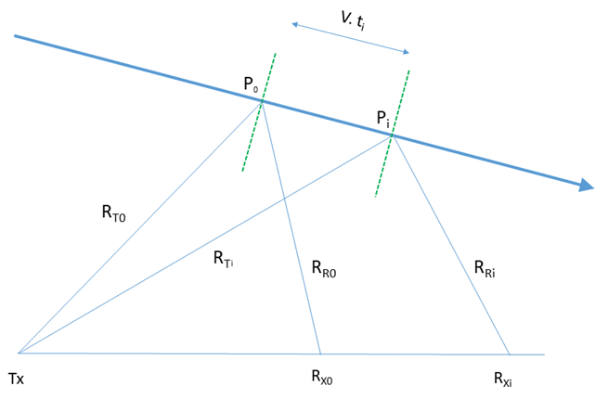
Adapted from Hervé Lamy’s IMC 2021 presentation
Distance minimization
Specular reflection : S_{i} = R_{Ti} + R_{Ri} must be minimum for each station i
6 unknowns: 3 coordinates of one specular point P₀ + 3 components of speed v (assumed to be constant)
At least 6 equations : dS_{i} / dt = 0 i=1, …, n
Set of ≥ 6 non-linear equations which contains the time delays Δt_{i} between appearances of meteor echoes at station i and a reference station.
Non-linear solver + additional constraints on height of the specular reflection point (e.g. between 85 and 110 km) and speed values (≥ 11 km/s and ≤ 72 km/s)
! Here the time delays are not obtained by measurements. They are computed theoretically and are then injected into the system of n equations !

Slide 3
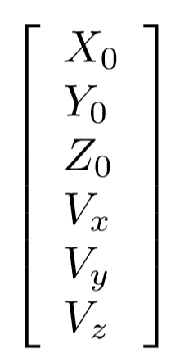
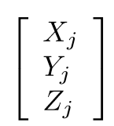
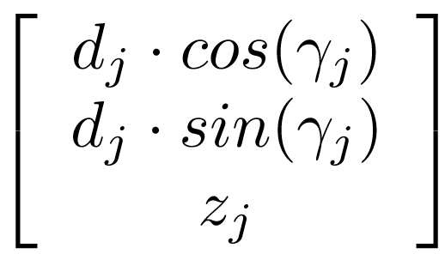
Equations nondimensionalization
Specular point for station j
Location of station j
Solution vector
Dimensions: Distance/Time
Dimensionless

Slide 4
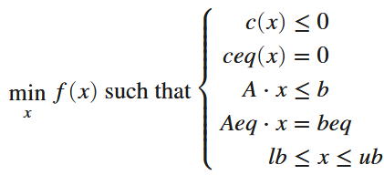
Solver
fmincon
lsqnonlin
Solve nonlinear least-squares (nonlinear data-fitting) problems
Does not allow the introduction of constraints
Find minimum of constrained nonlinear multivariable function
Allows the introduction of (in)equality linear and nonlinear constraints
The target objective (to be minimized) has to be scalar: chosen initially as the L2-norm of the n equations dS_{i} / dt = 0

Slide 5
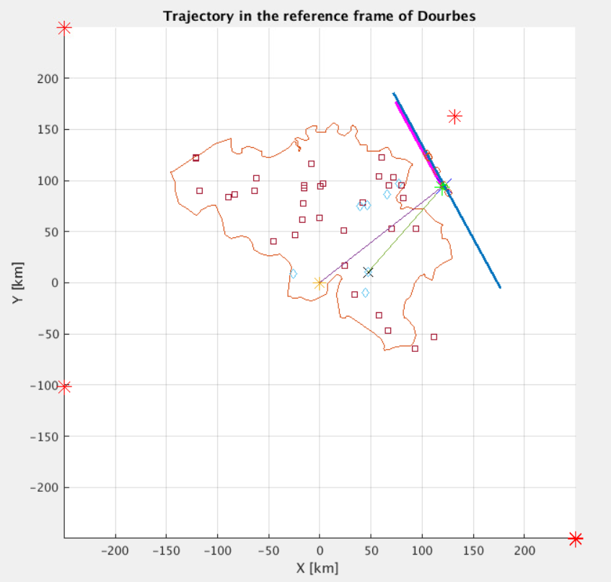
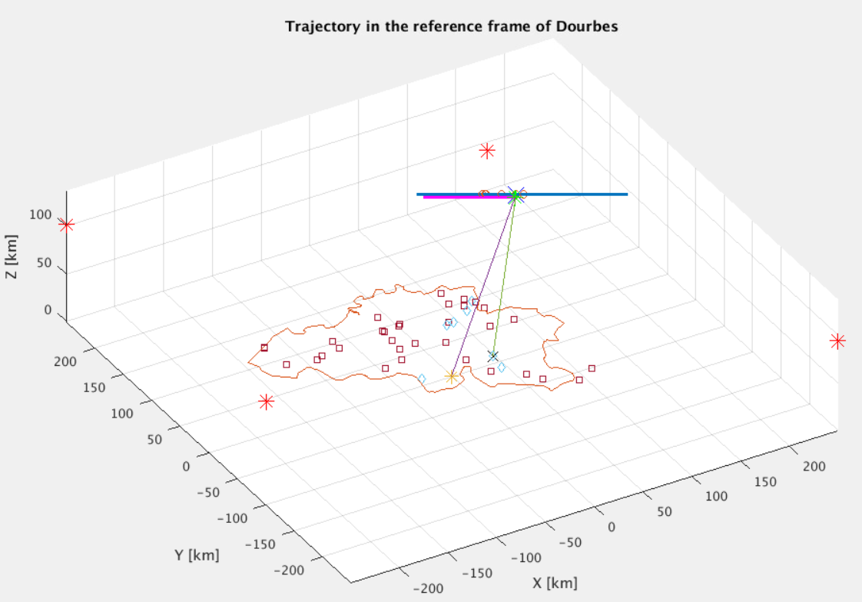
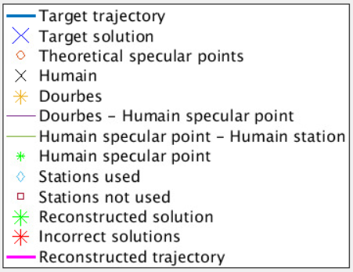
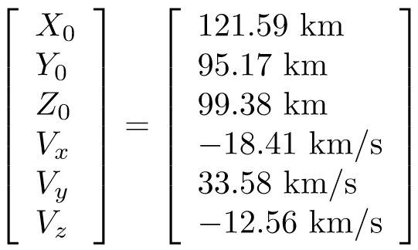
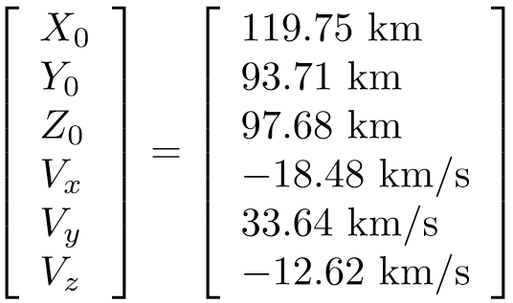
Trajectory 105
Echo theoretically detected by 16 stations but only 7 are exploited from the BRAMS data
Theoretical solution (from CAMS)
Reconstructed solution

Slide 6
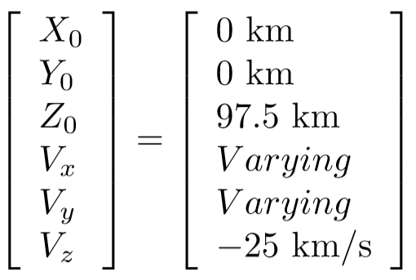
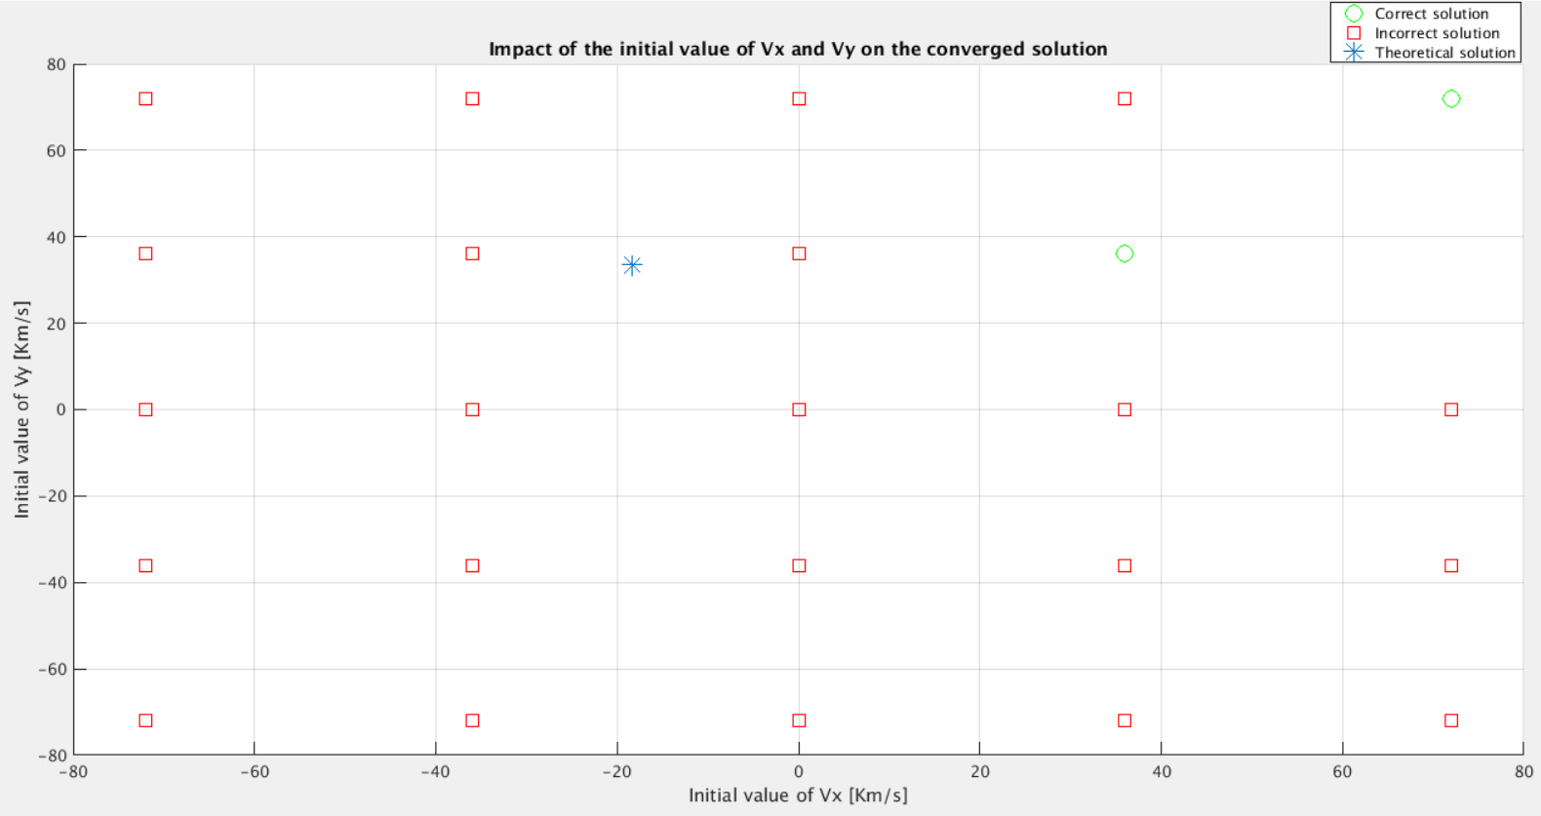
Convergence map Vx-Vy – Default Guess
Default Guess
Actual solution

Slide 7
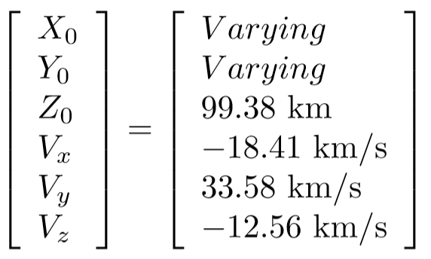
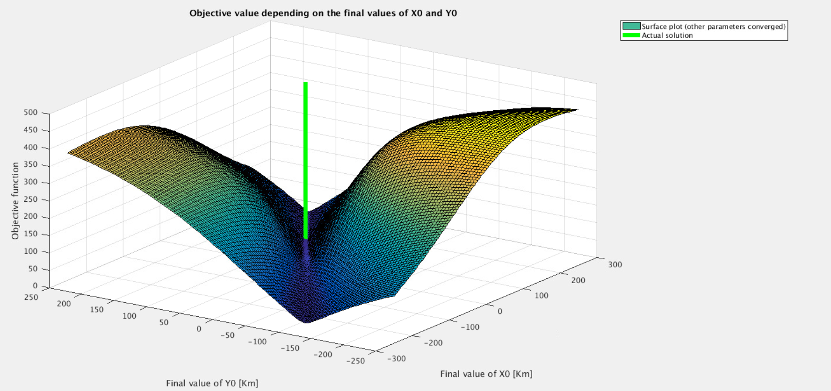
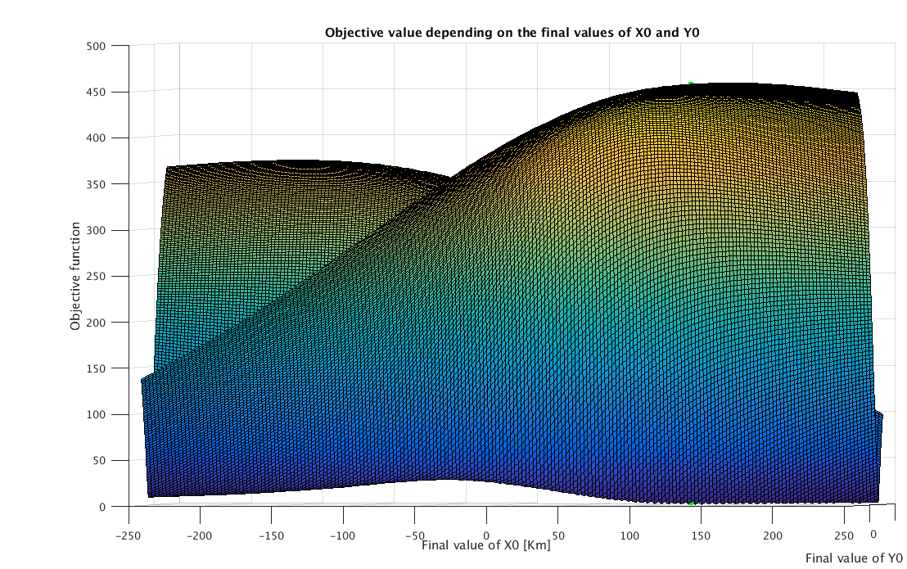
Smoothness maps
Variation of the objective function with X0 and Y0 (other parameters are converged)
Valley with multiple critical points
Solver can fall there and never recover..
Correct solution

Slide 8
Towards a better target objective...
Here we have two weighted terms:
The first one penalizes the solver if it finds a trajectory which does not minimize the total distance travelled by the signal (from the transmitter to the receptor after reflection at the specular point).
The second one penalizes the solver if the time delays reconstructed from the solution are different from the observed time delays.
The only disadvantage is that it takes about 5-7x more computational time.
From now on, we will set w1 = 0:

Slide 9
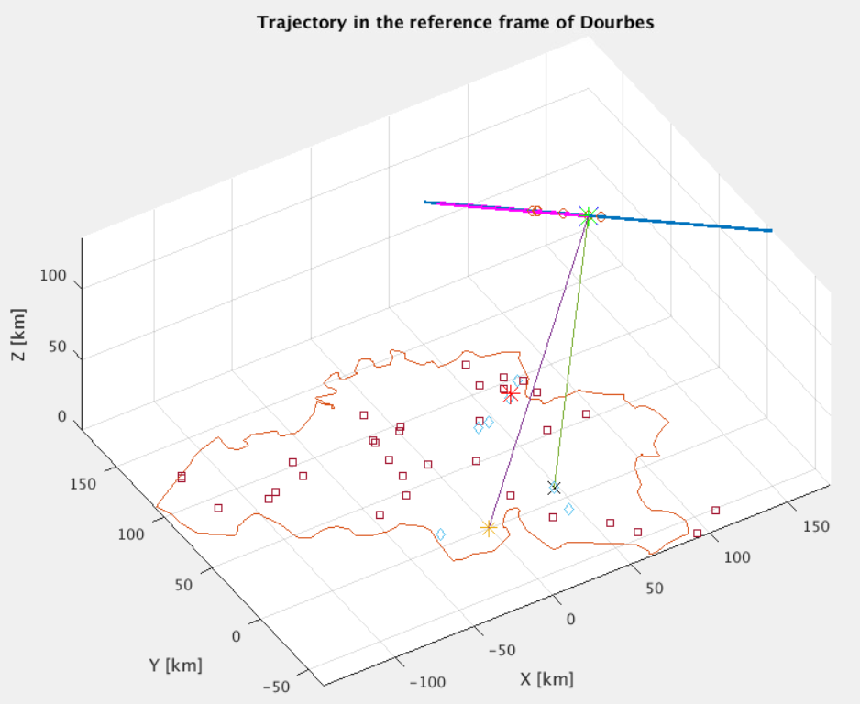
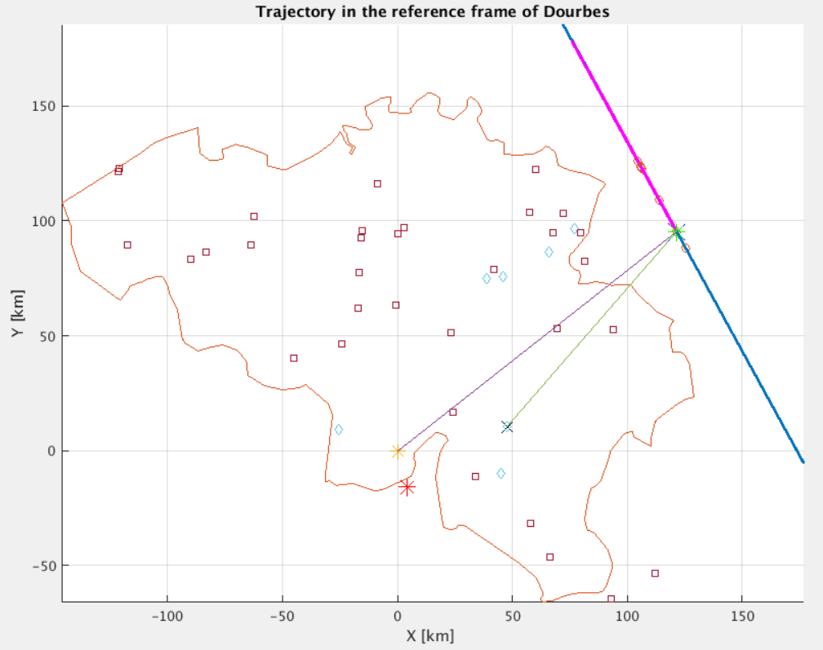
Trajectory 105
Theoretical solution (from CAMS)
Reconstructed solution

Slide 10
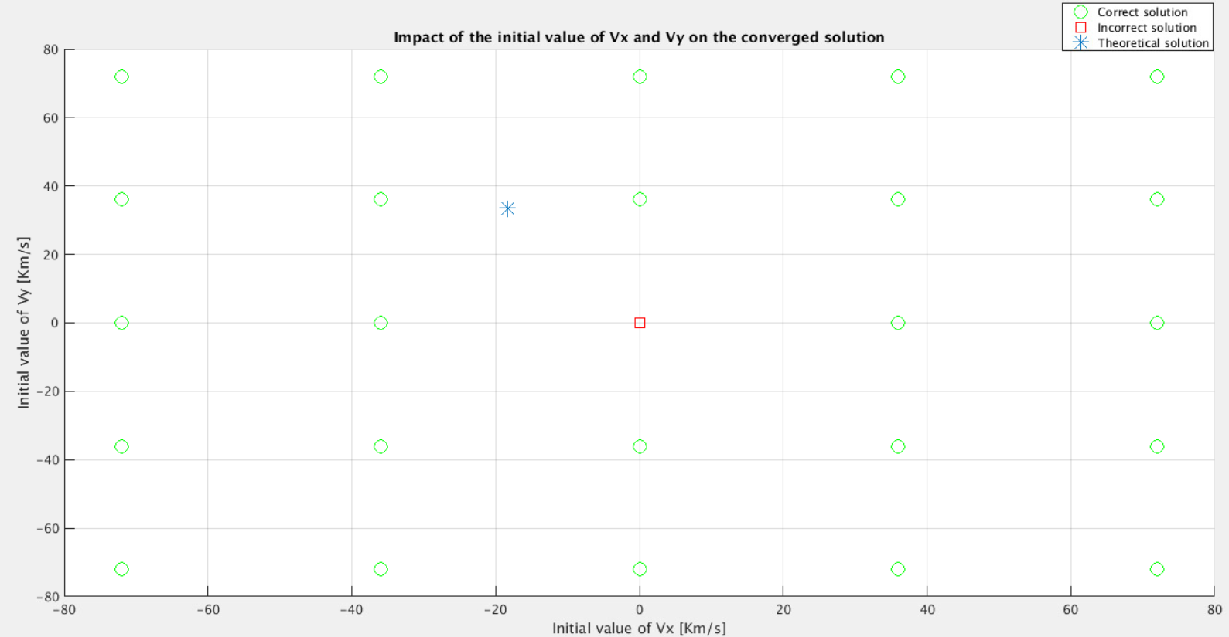
Convergence map Vx-Vy – Default Guess
Default Guess
Actual solution

Slide 11
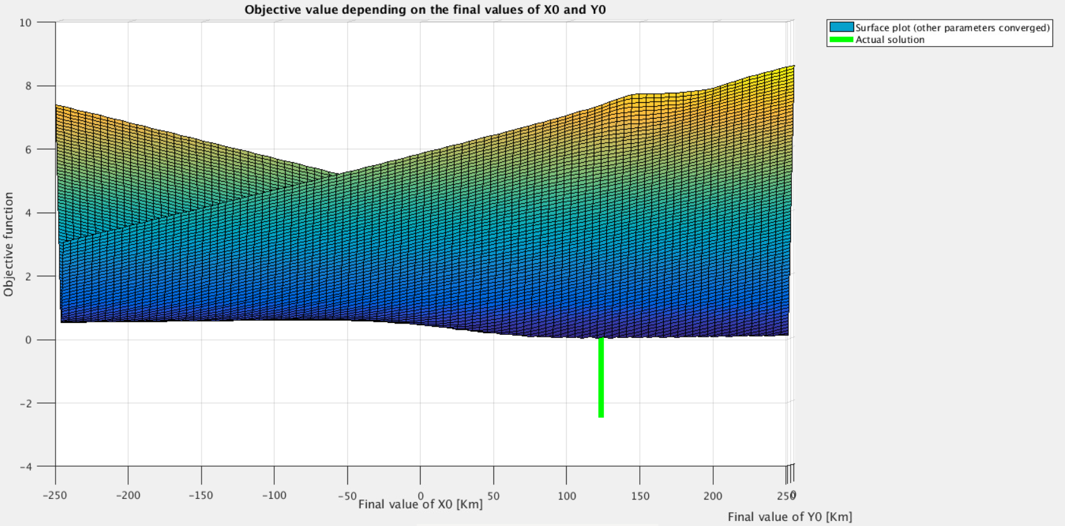
Smoothness maps
Variation of the objective function with X0 and Y0 (other parameters are converged)
Solver could still be stuck here
Correct solution

Slide 12
Uncertainty on the trajectory 105
We analyze the effect of errors on the input time delays on the output trajectory
To do so, we add some random noise on the measurements of the time delays around the correct theoretical value
Number of stations - weights | Noise [ms] | Error on the trajectory angle [°] | Error on the trajectory position [km] | Error on the velocity norm [km/s]
7 – w1 = 1, w2 = 0 | 0 (theoretical) | 0,064 | 2,901 | 0,104
7 – w1 = 0, w2 = 1 | 0 (theoretical) | 0,0009 | 0,002 | 0,0002
7 – w1 = 1, w2 = 0 | 2 | 9,43 | 56,49 | 4,23
7 – w1 = 0, w2 = 1 | 2 | 1,12 | 9,20 | 0,58
7 – w1 = 1, w2 = 0 | 5 | 18,43 | 99,49 | 7,23
7 – w1 = 0, w2 = 1 | 5 | 6,83 | 22,65 | 0,79
9 – w1 = 1, w2 = 0 | 5 | 7,81 | 25,01 | 4,12
9 – w1 = 0, w2 = 1 | 5 | 0,51 | 11,39 | 0,53
9 – w1 = 1, w2 = 0 | 10 | 15,12 | 75,13 | 6,42
9 – w1 = 0, w2 = 1 | 10 | 5,42 | 24,12 | 3,28

Slide 13
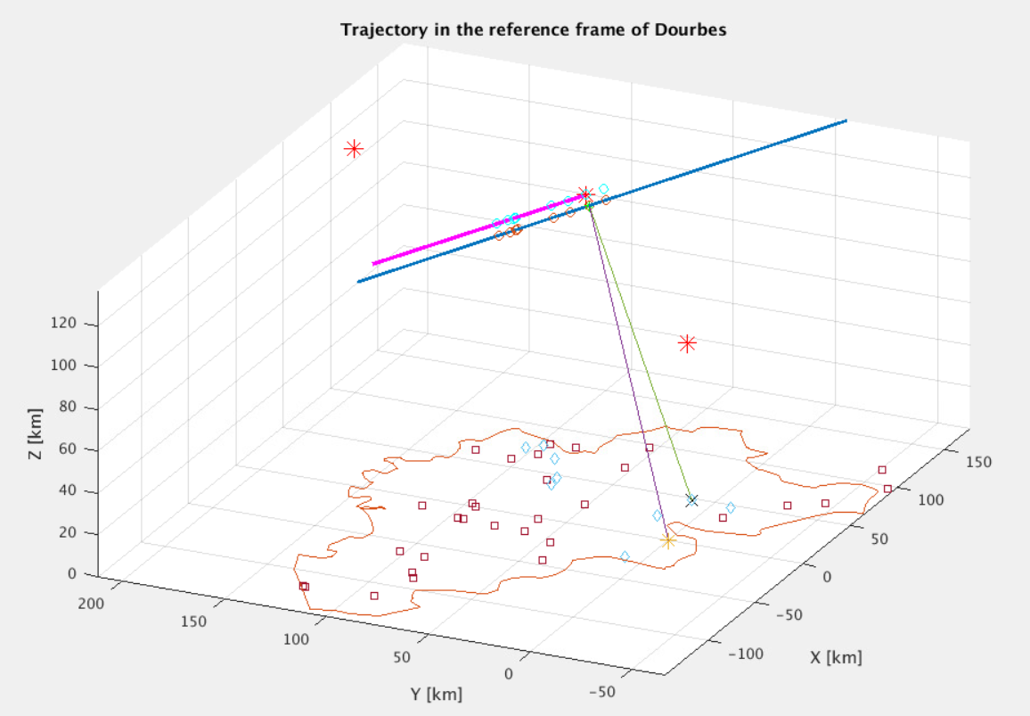
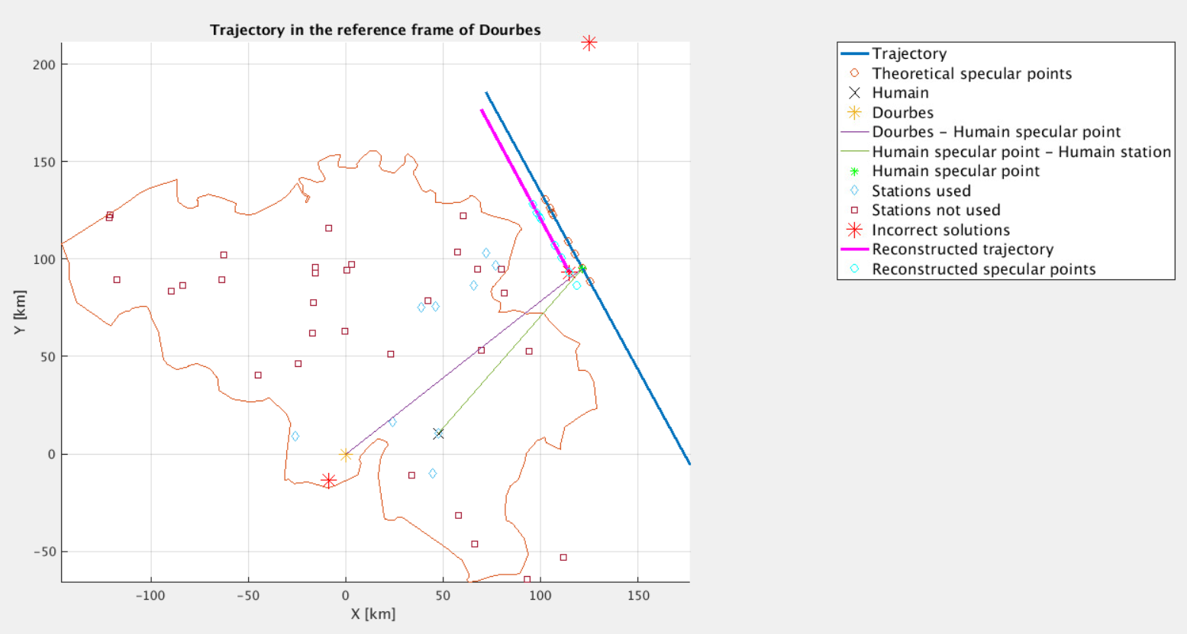
Trajectory 105 reconstructed with 5E-3 error

Slide 14
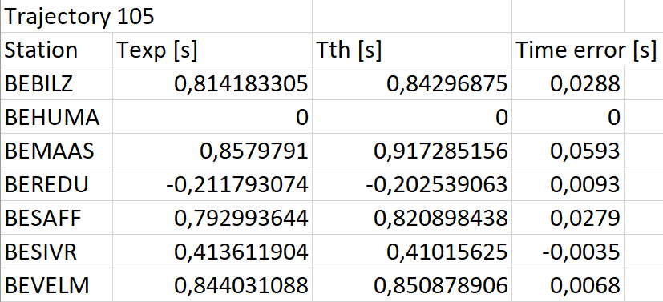
Uncertainty on the trajectory 105
With 7 stations, 5 ms is too much uncertainty even with the added terms
With 9 stations, 5 ms is handled well with the novel target while it diverges with the old target => important improvement
The maximum error is of the order of 60 ms, far too much for our algorithms to converge
Need for a better post-processing (substraction of the direct signal, filtering) at the receiving stations

Slide 15
Post-processing steps
The signal is acquired at the station with a sampling frequency of 5512 Hz and is then centered around 1000Hz.
The direct beacon signal is reconstructed and subtracted.
A window of 10 seconds around the theoretical appearance time of the signal is selected and a Blackman filter is applied.
The envelope of the filtered signal is obtained through an Hilbert transform.
The half-rise time is identified on the envelope signal.

Slide 16
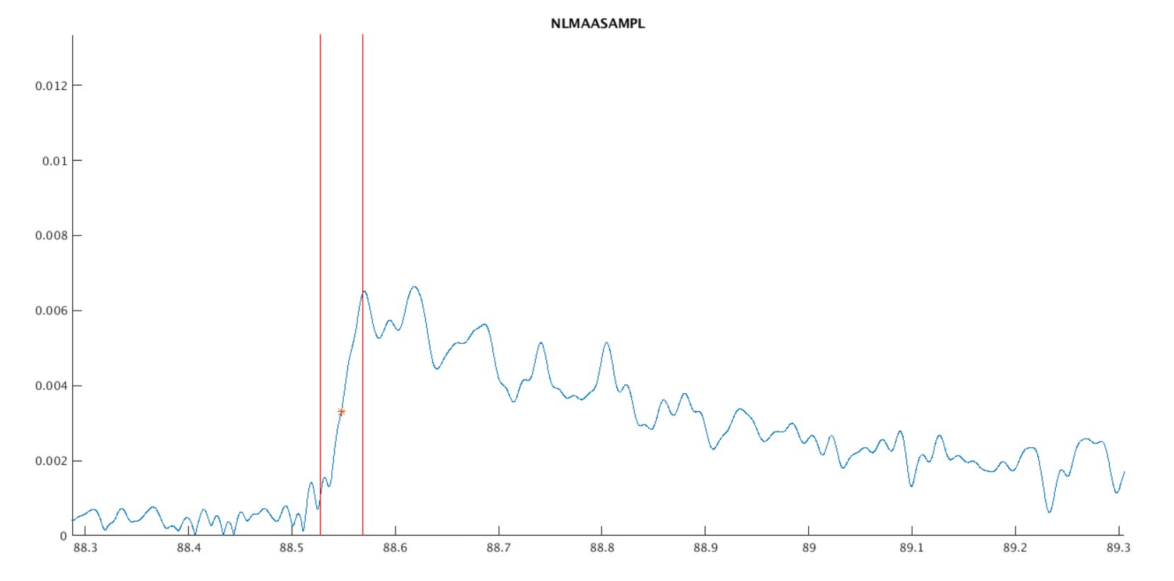
Sources of experimental errors
The clock which gives an error of about 1ms for Windows stations and 0.166 ms for Raspberry Pi stations.
The electronics circuitry at the stations: analogue filters introduce delays.
The wave propagation delay: the maximum difference of distance travelled by the wave between two stations is of the order of 100km, i.e. 0.33 ms of potential error.
The main error source comes from the selection of the half-rise time on the WAV files.
Power of the filtered envelope signal for NLMAAS
Arbitrary power unit
Time [s]

Slide 17
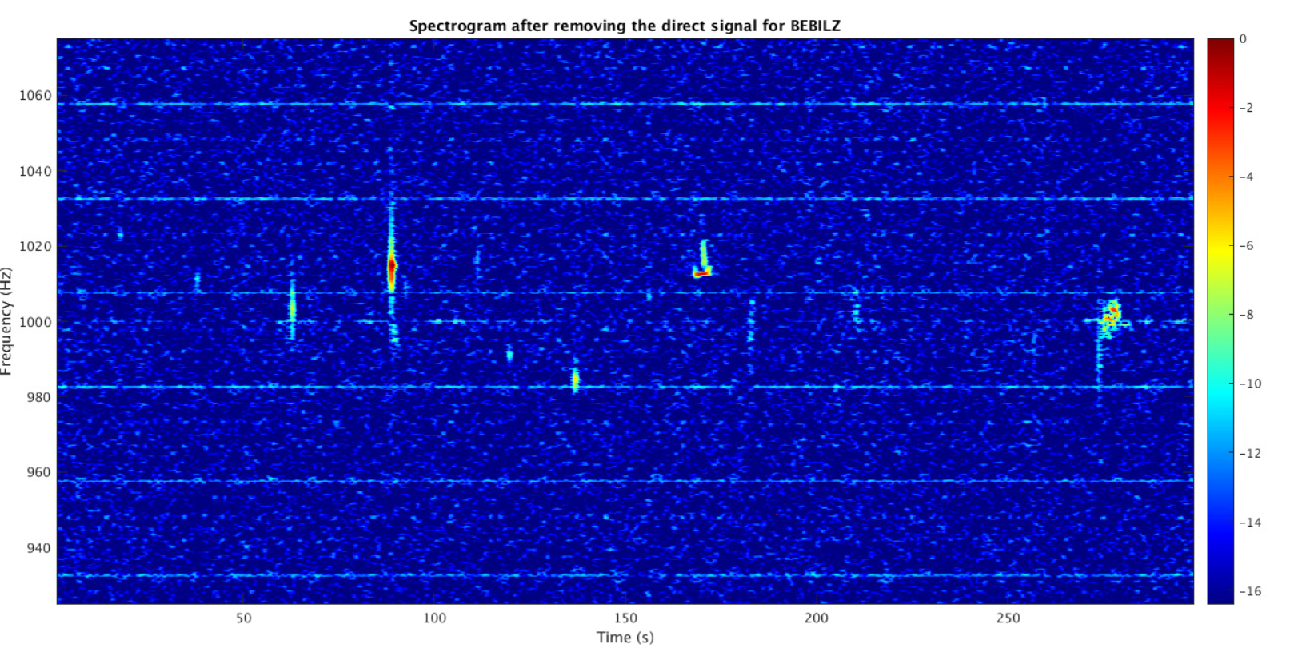
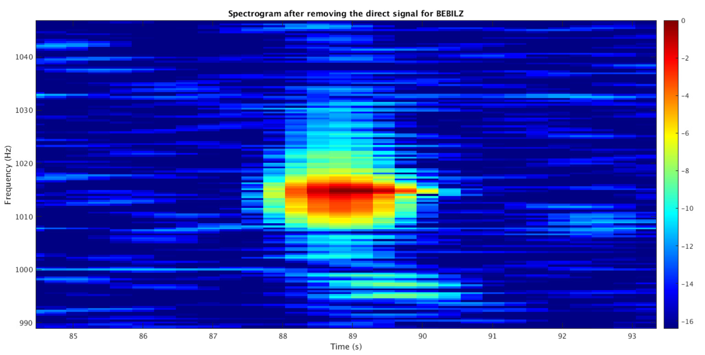
Bilzen spectrogram
Zoom on the meteor echo of Bilzen spectrogram

Slide 18
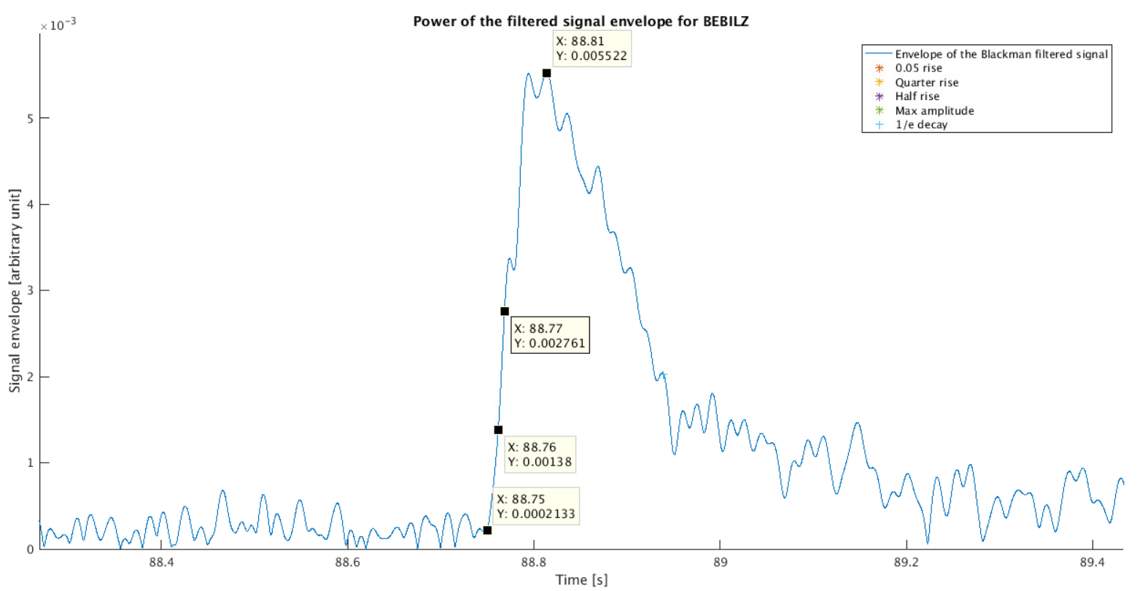
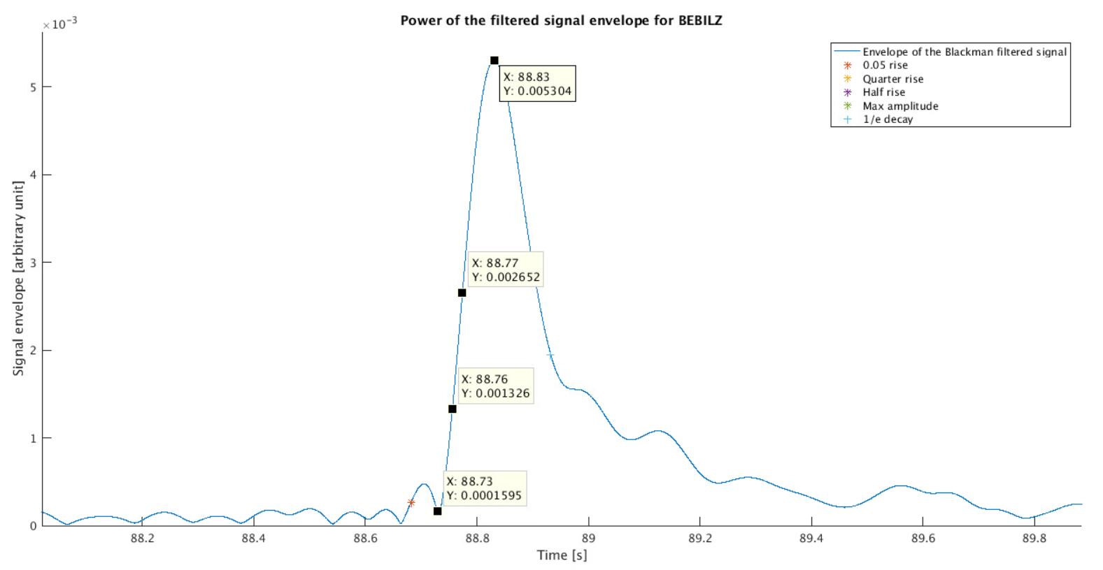
D
Low-pass Blackman: 1050 Hz
High-pass Blackman: 1000 Hz
Rise time of 0.06s
D
D
Low-pass Blackman: 1022 Hz
High-pass Blackman: 1007 Hz
Rise time of 0.10s

Slide 19
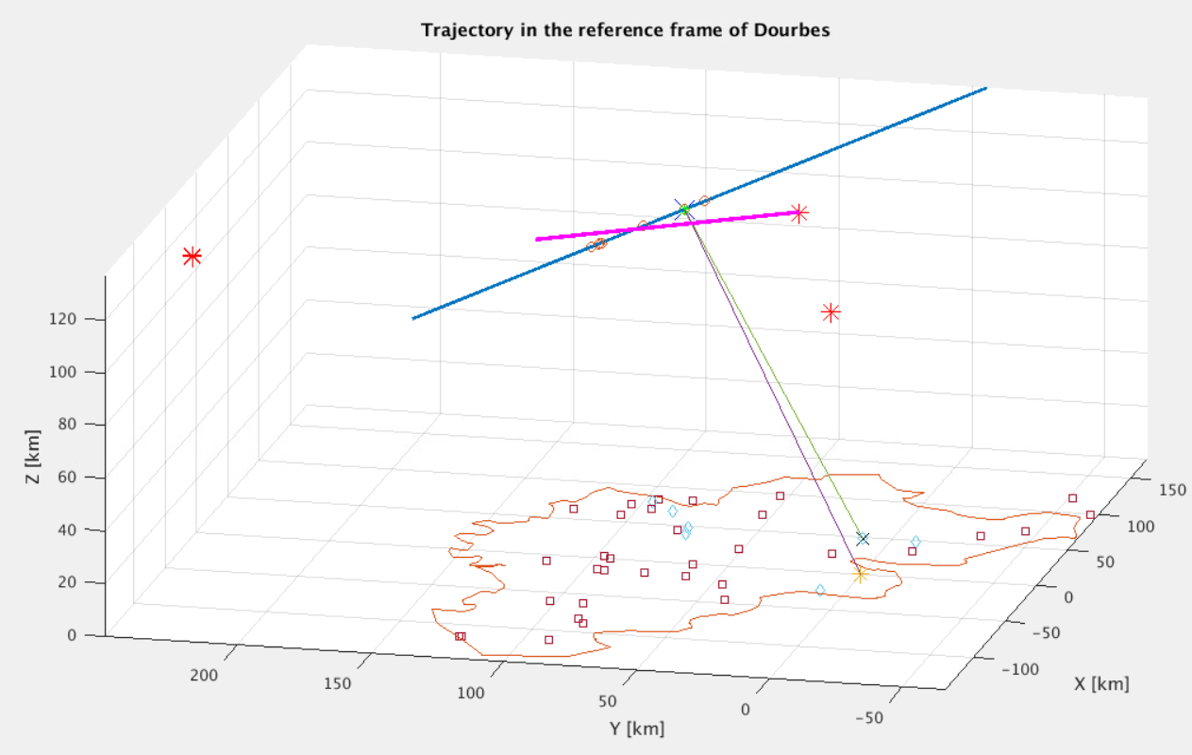
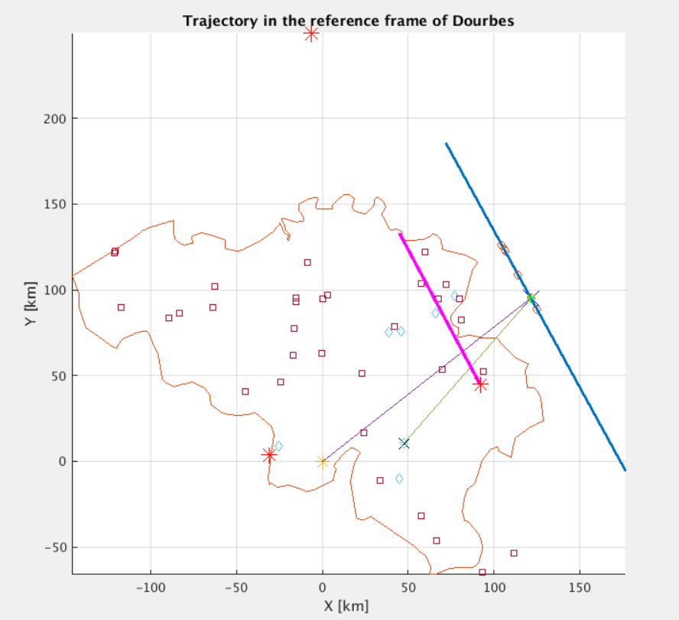
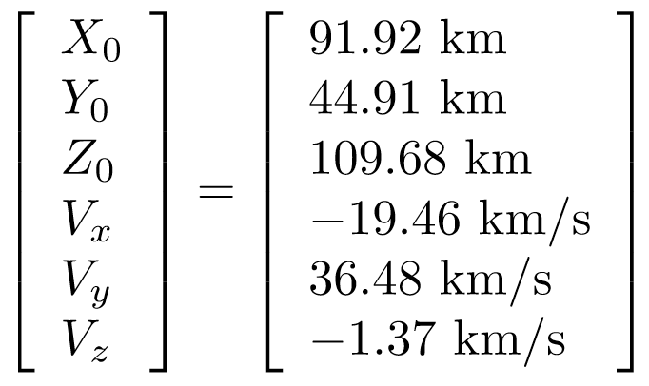
Trajectory 105 reconstructed with best experimental time delays
Error on the trajectory position = 59,52 km
Error on the trajectory angle = 16,27°
Error on the velocity norm = 1,07 km/s
Reconstructed solution

Slide 20
Conclusions & Perspectives
The solver has been corrected, adapted and improved.
The signal post-processing needs to be improved (subtraction of the direct signal and noise filtering).
There is a trade-off between a fast rise time and enough filtering.
Currently, it seems difficult to obtain the required accuracy of < 5 ms.
Simulated meteors will be used to quantify the filtering impact on the signal rise.

Slide 21
Thank you for your attention!

Slide 22
Appendices

Slide 23
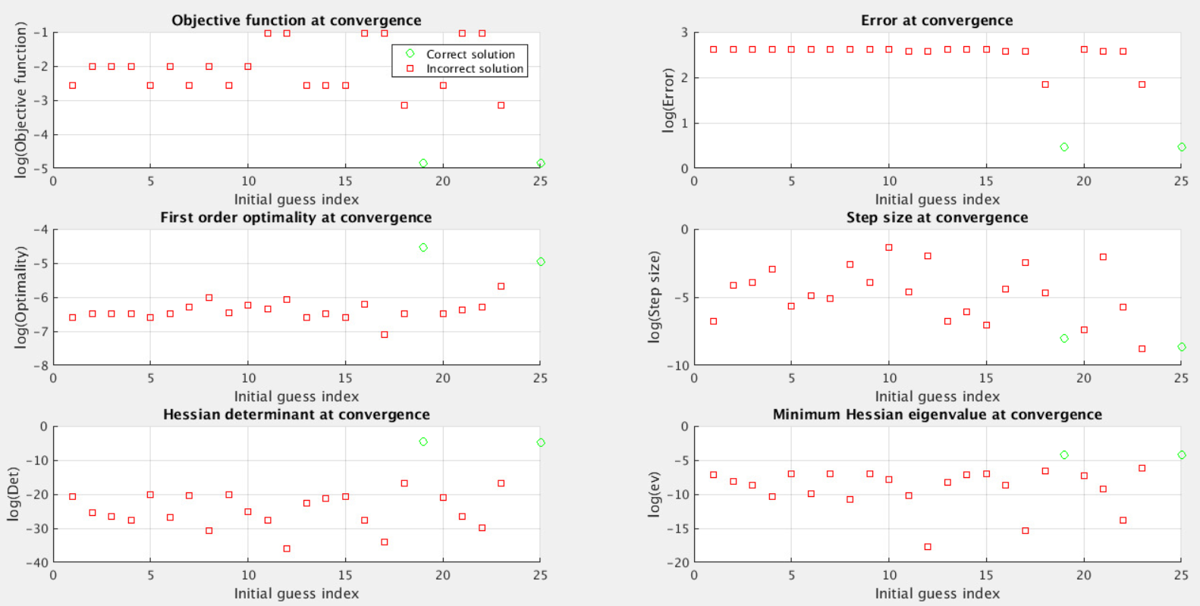
Convergence criteria

Slide 24
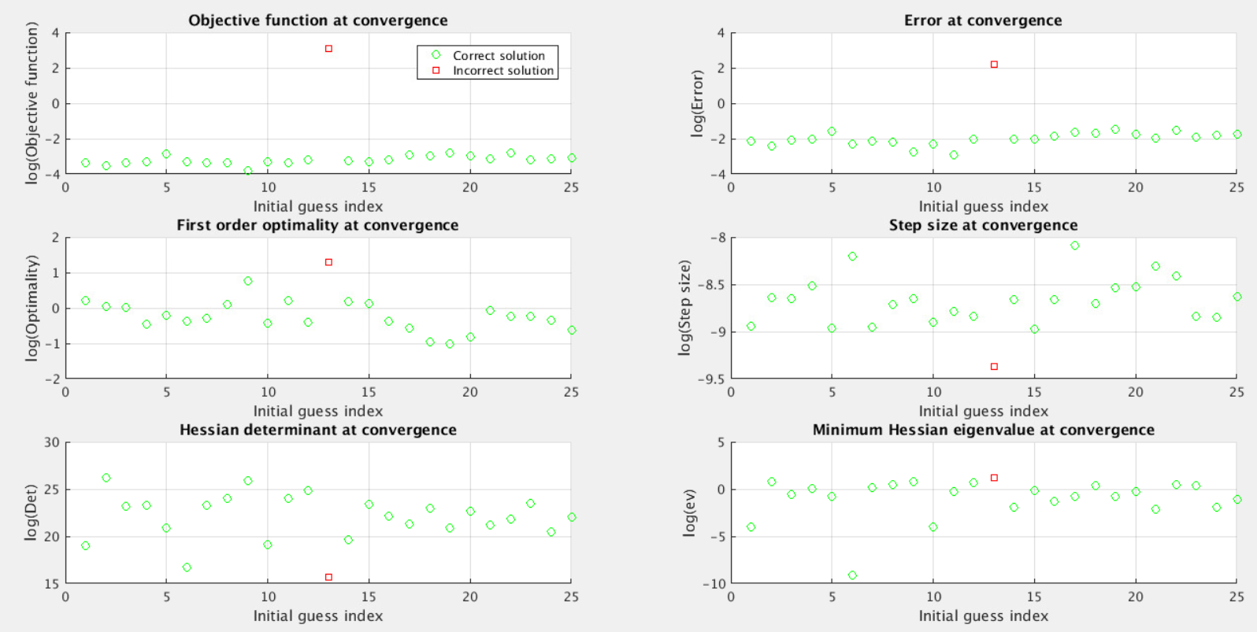
Convergence criteria

Slide 25
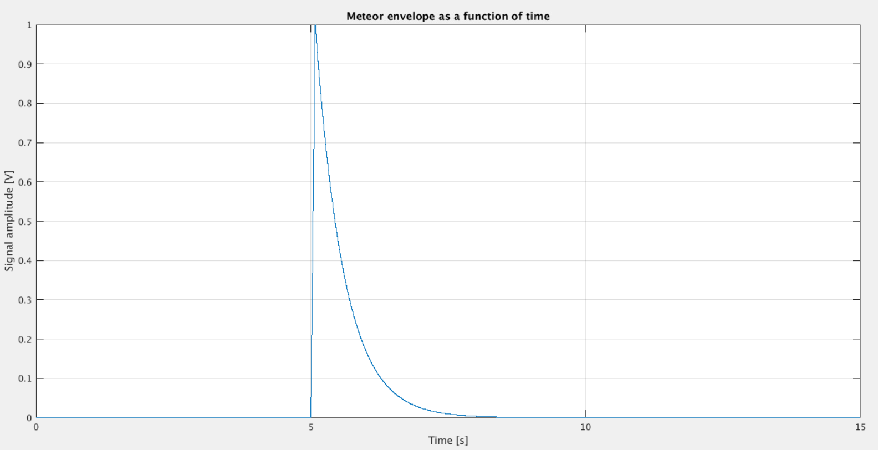
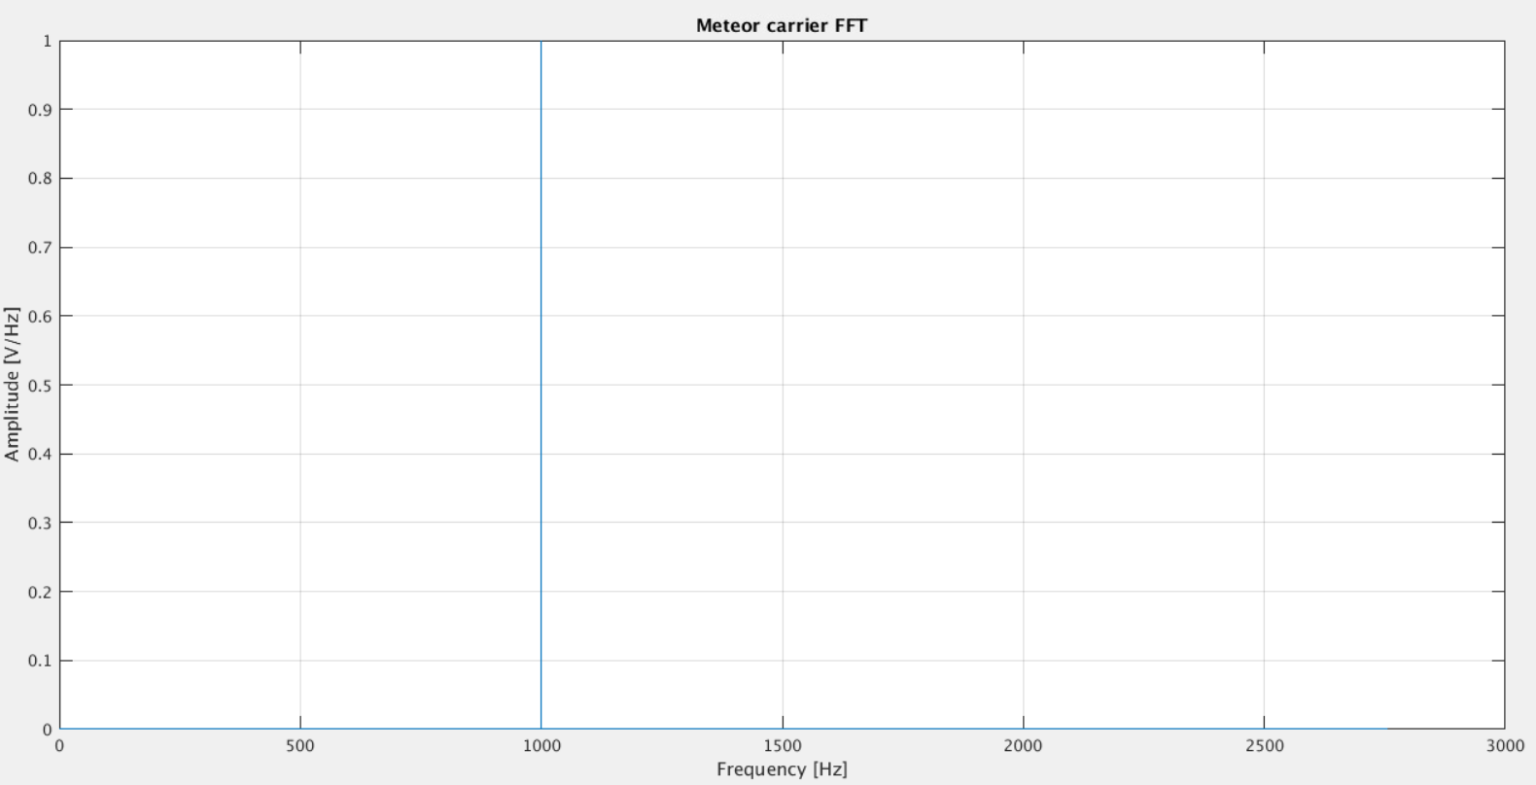
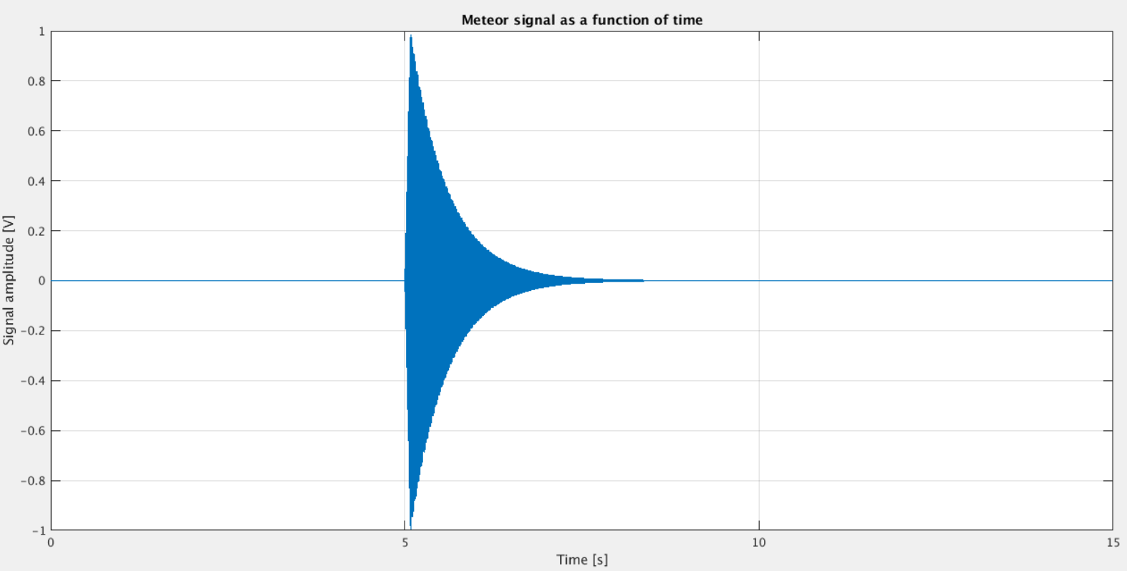
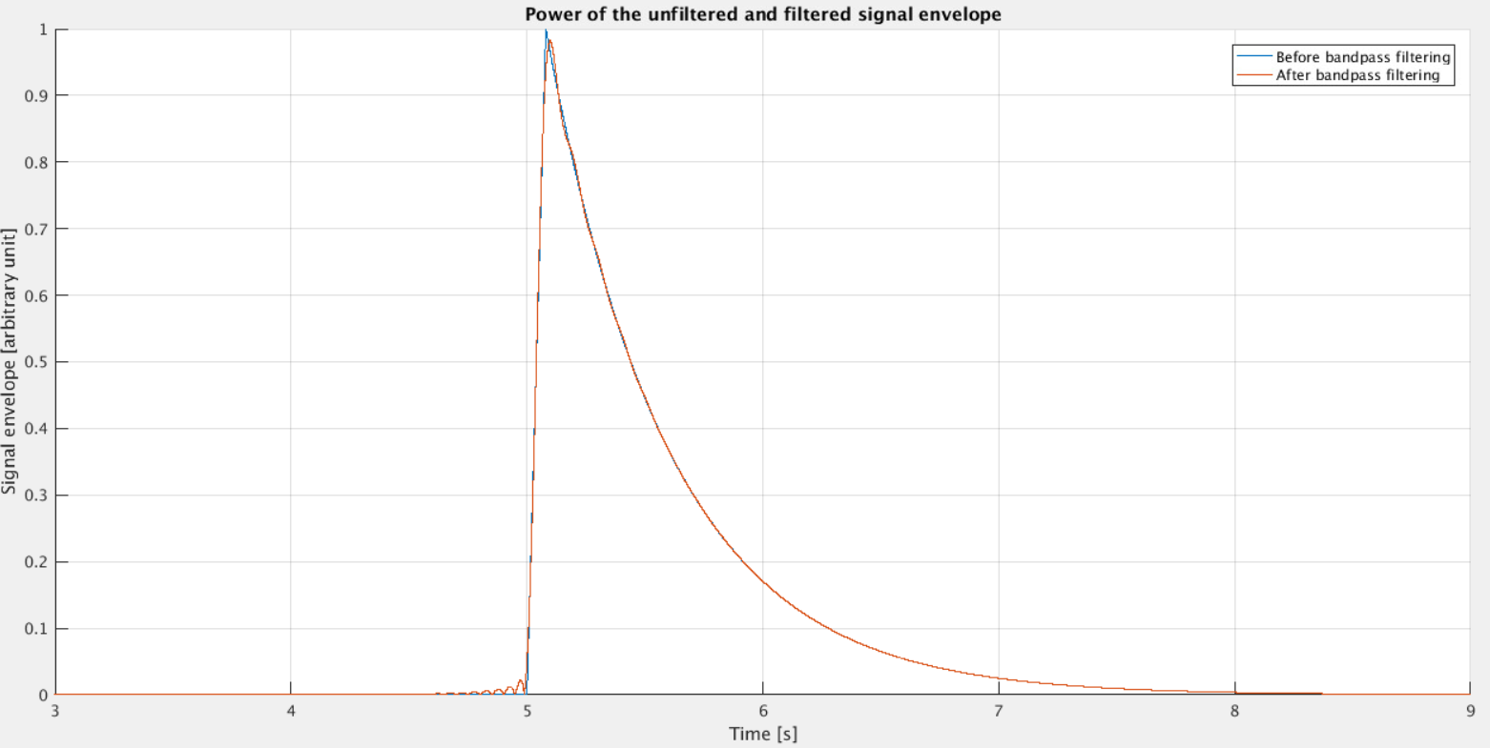
Simulation of a meteor signal modulated by a sine wave at 1000Hz and bandpass filtered
+-10 Hz filter

Slide 26
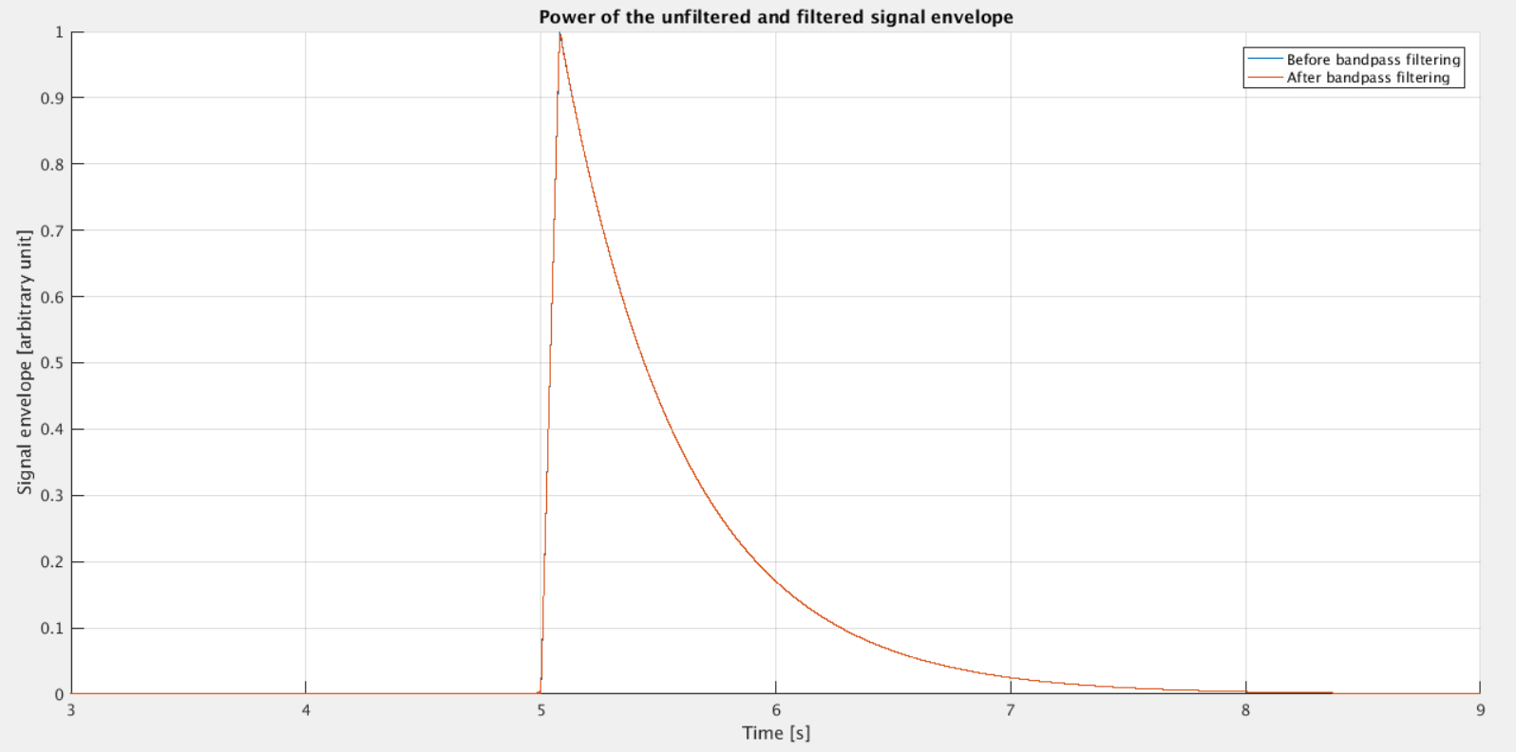
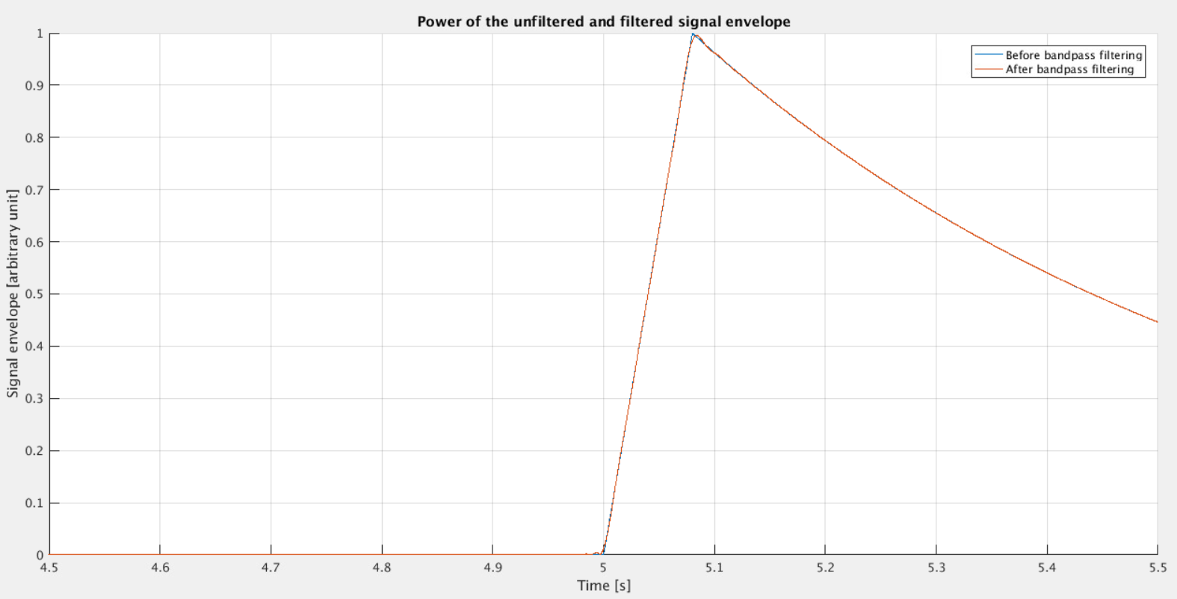
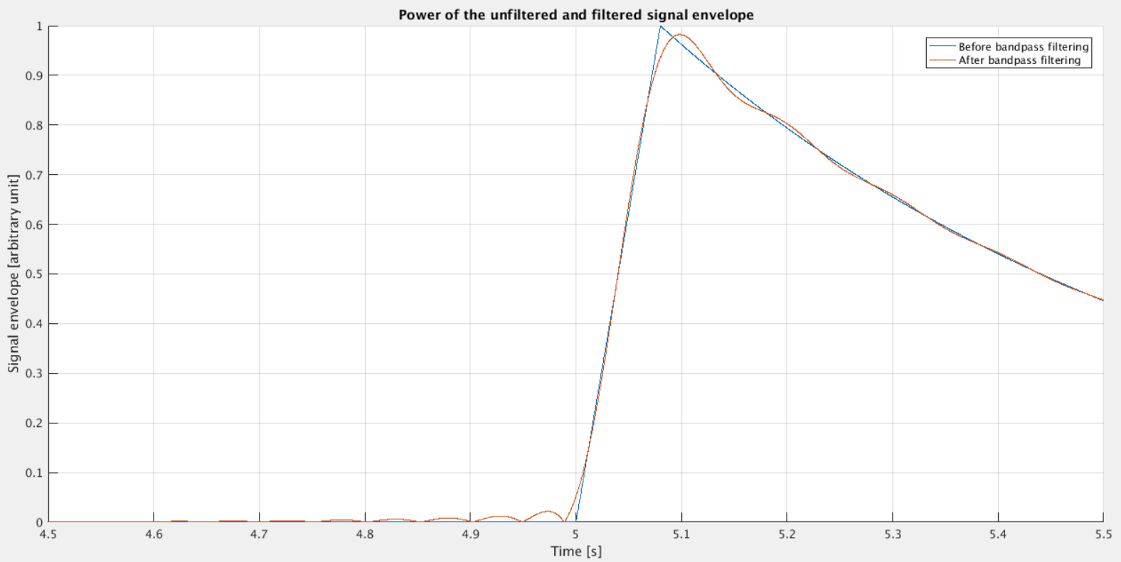
Analysis of the Blackman filter impact
+-50 Hz filter
+-10 Hz filter

Slide 27
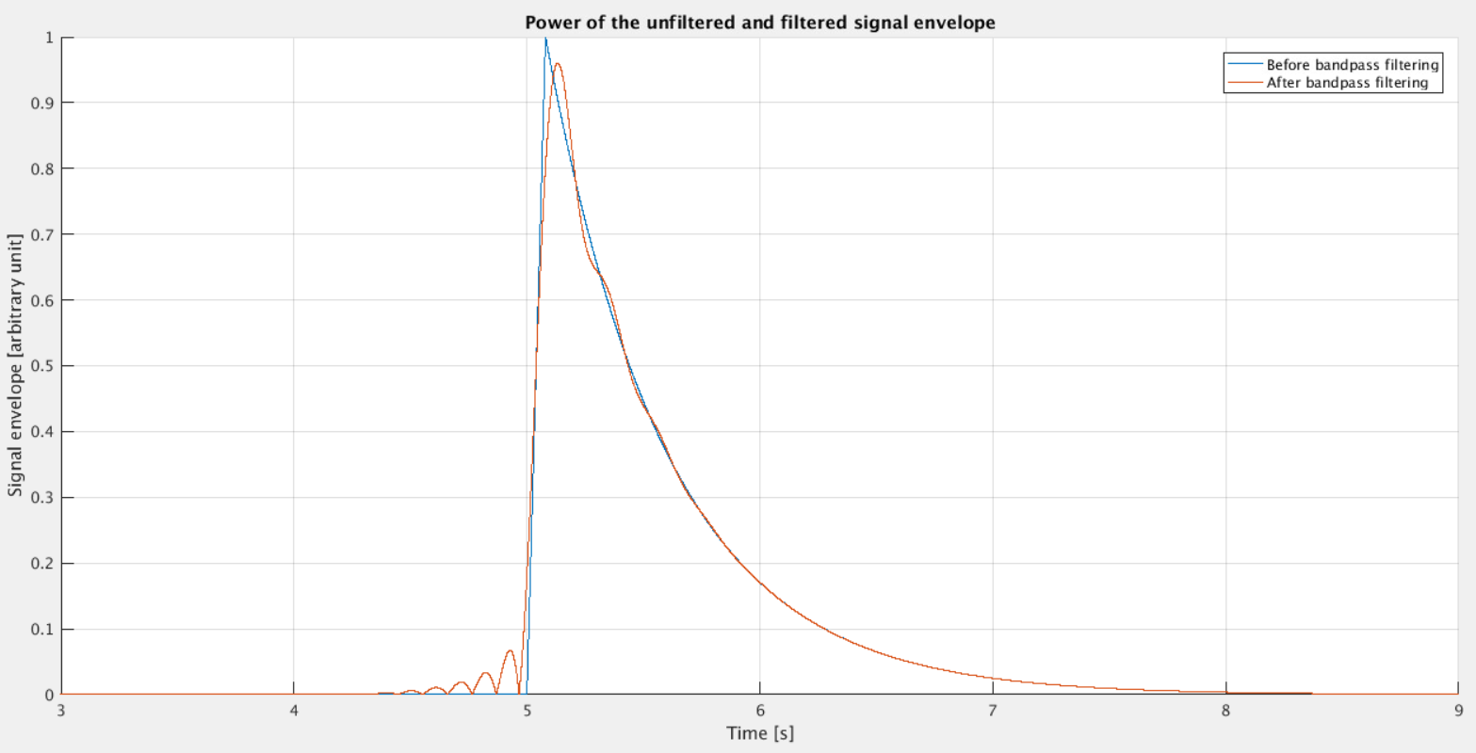
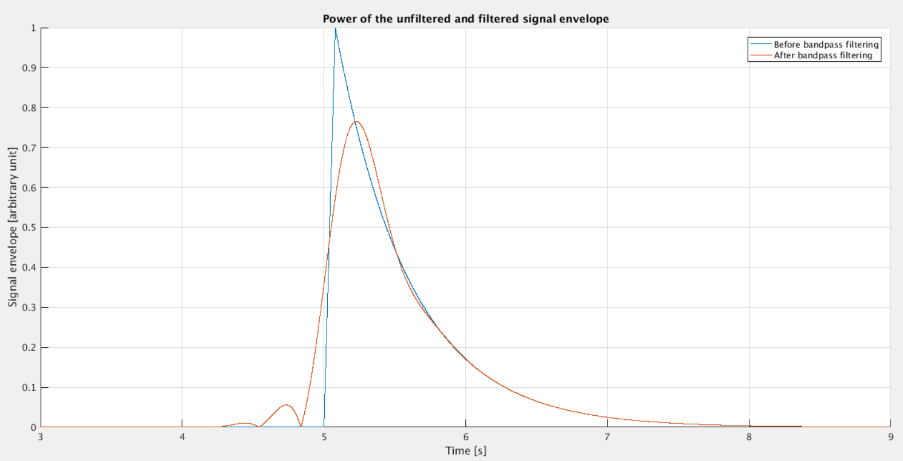
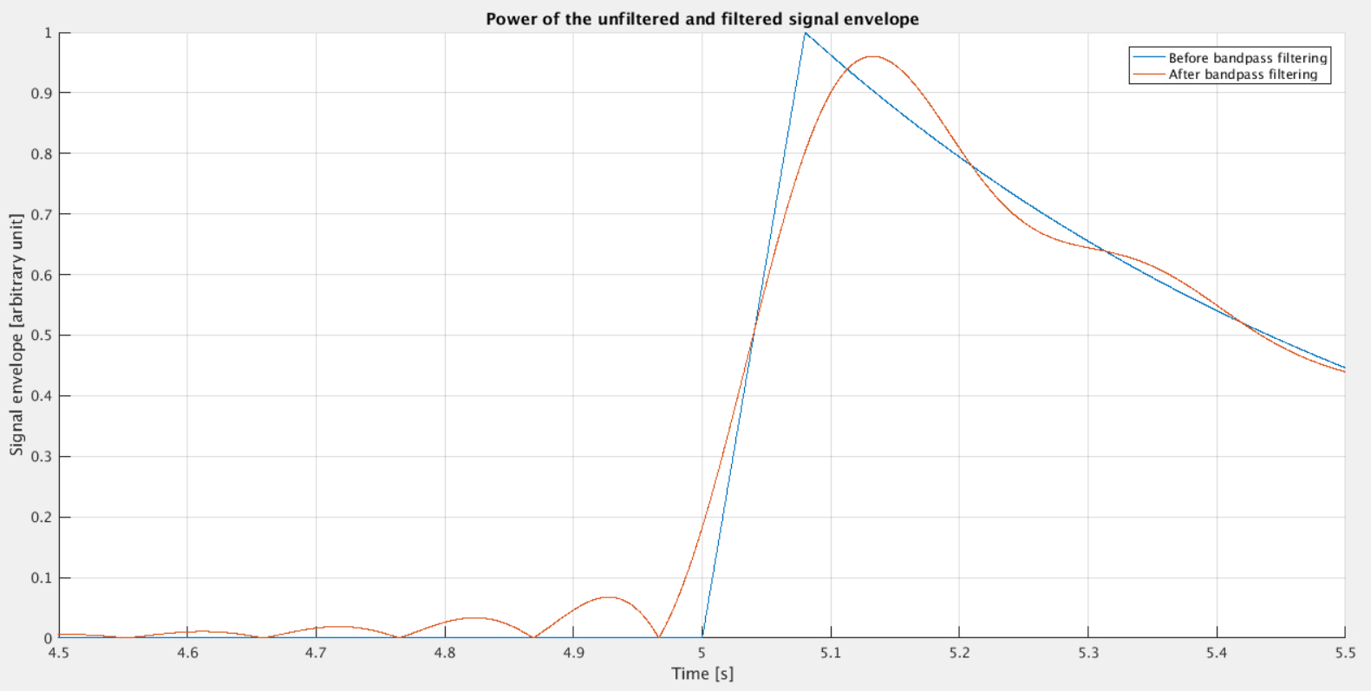
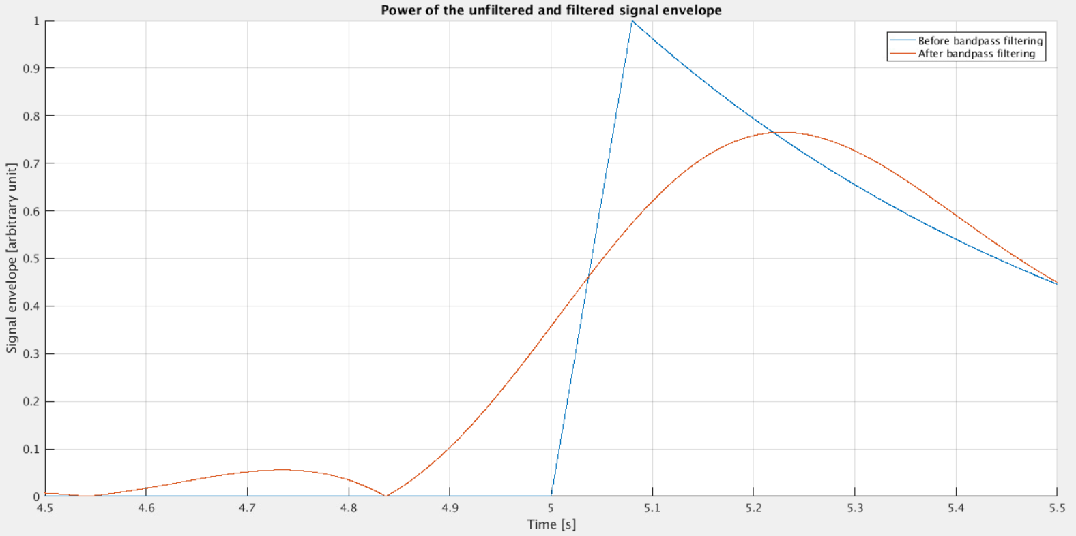
Analysis of the Blackman filter impact
+-5 Hz filter
+-2 Hz filter

Slide 28
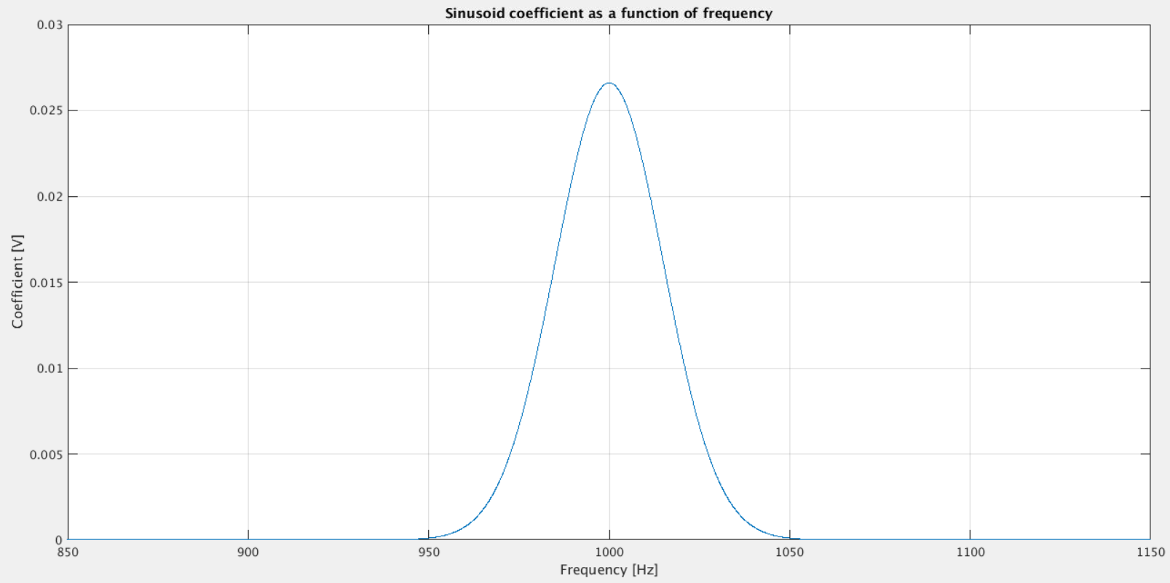
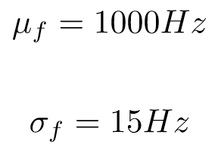
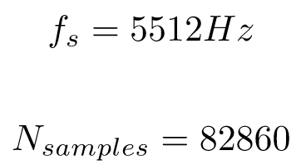
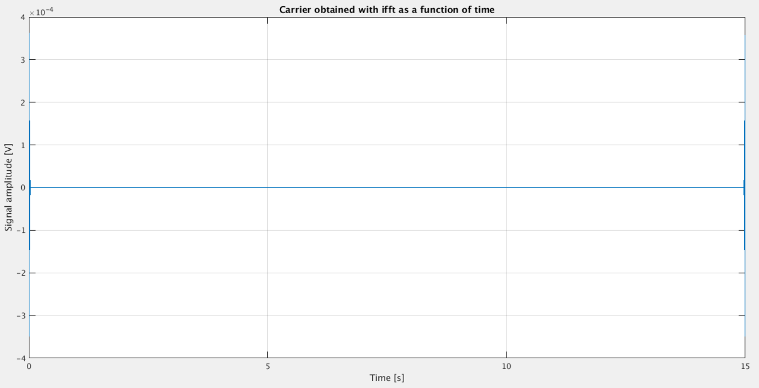
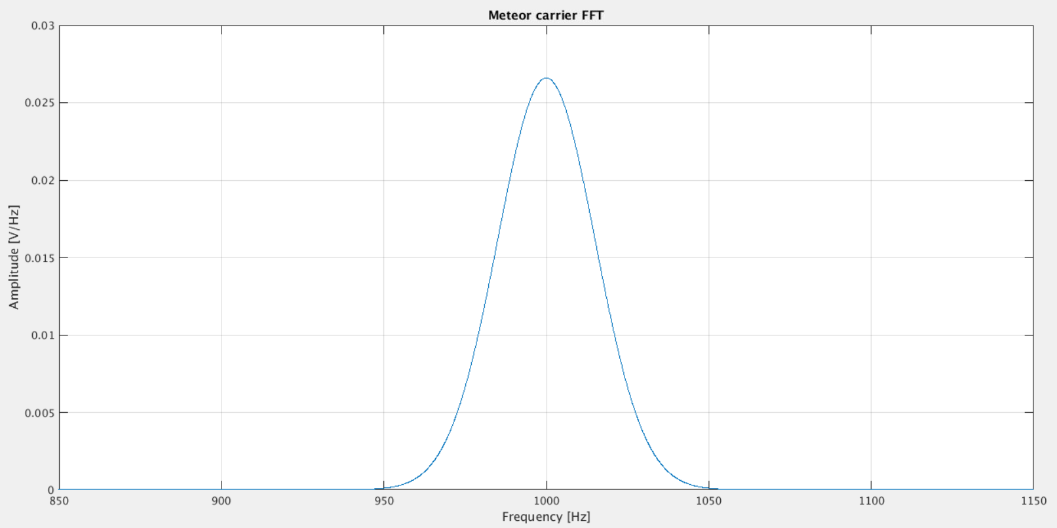
Simulation of a meteor signal modulated by a combili of sine waves at different frequencies & modulated in amplitude by a Gaussian
with

Slide 29
Simulation of a meteor signal modulated by a combili of sine waves at different frequencies & modulated in amplitude by a Gaussian
We only have non-zero coefficients between 998 and 1002 Hz
Here the carrier is a combili of sine waves between 998 and 1002 Hz (by step of 0.067Hz) and modulated by the same Gaussian as before

